Slide 1
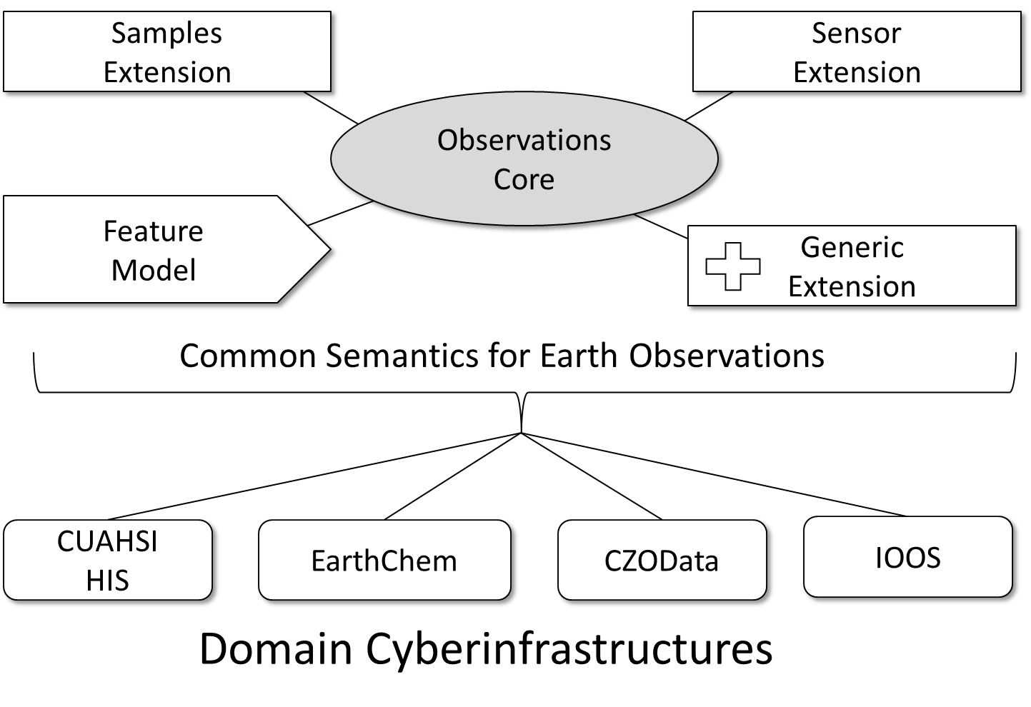
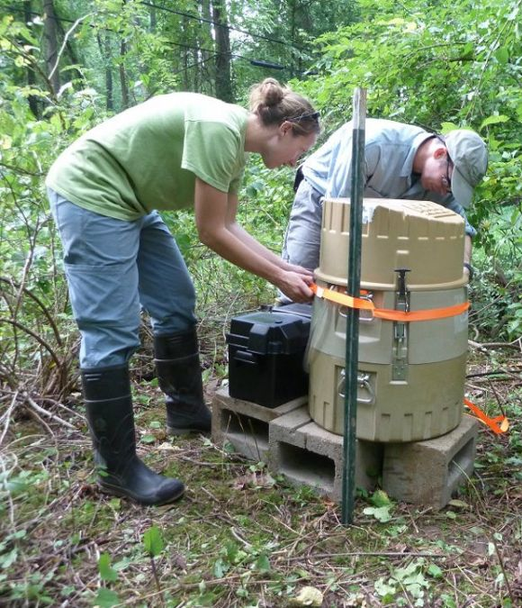
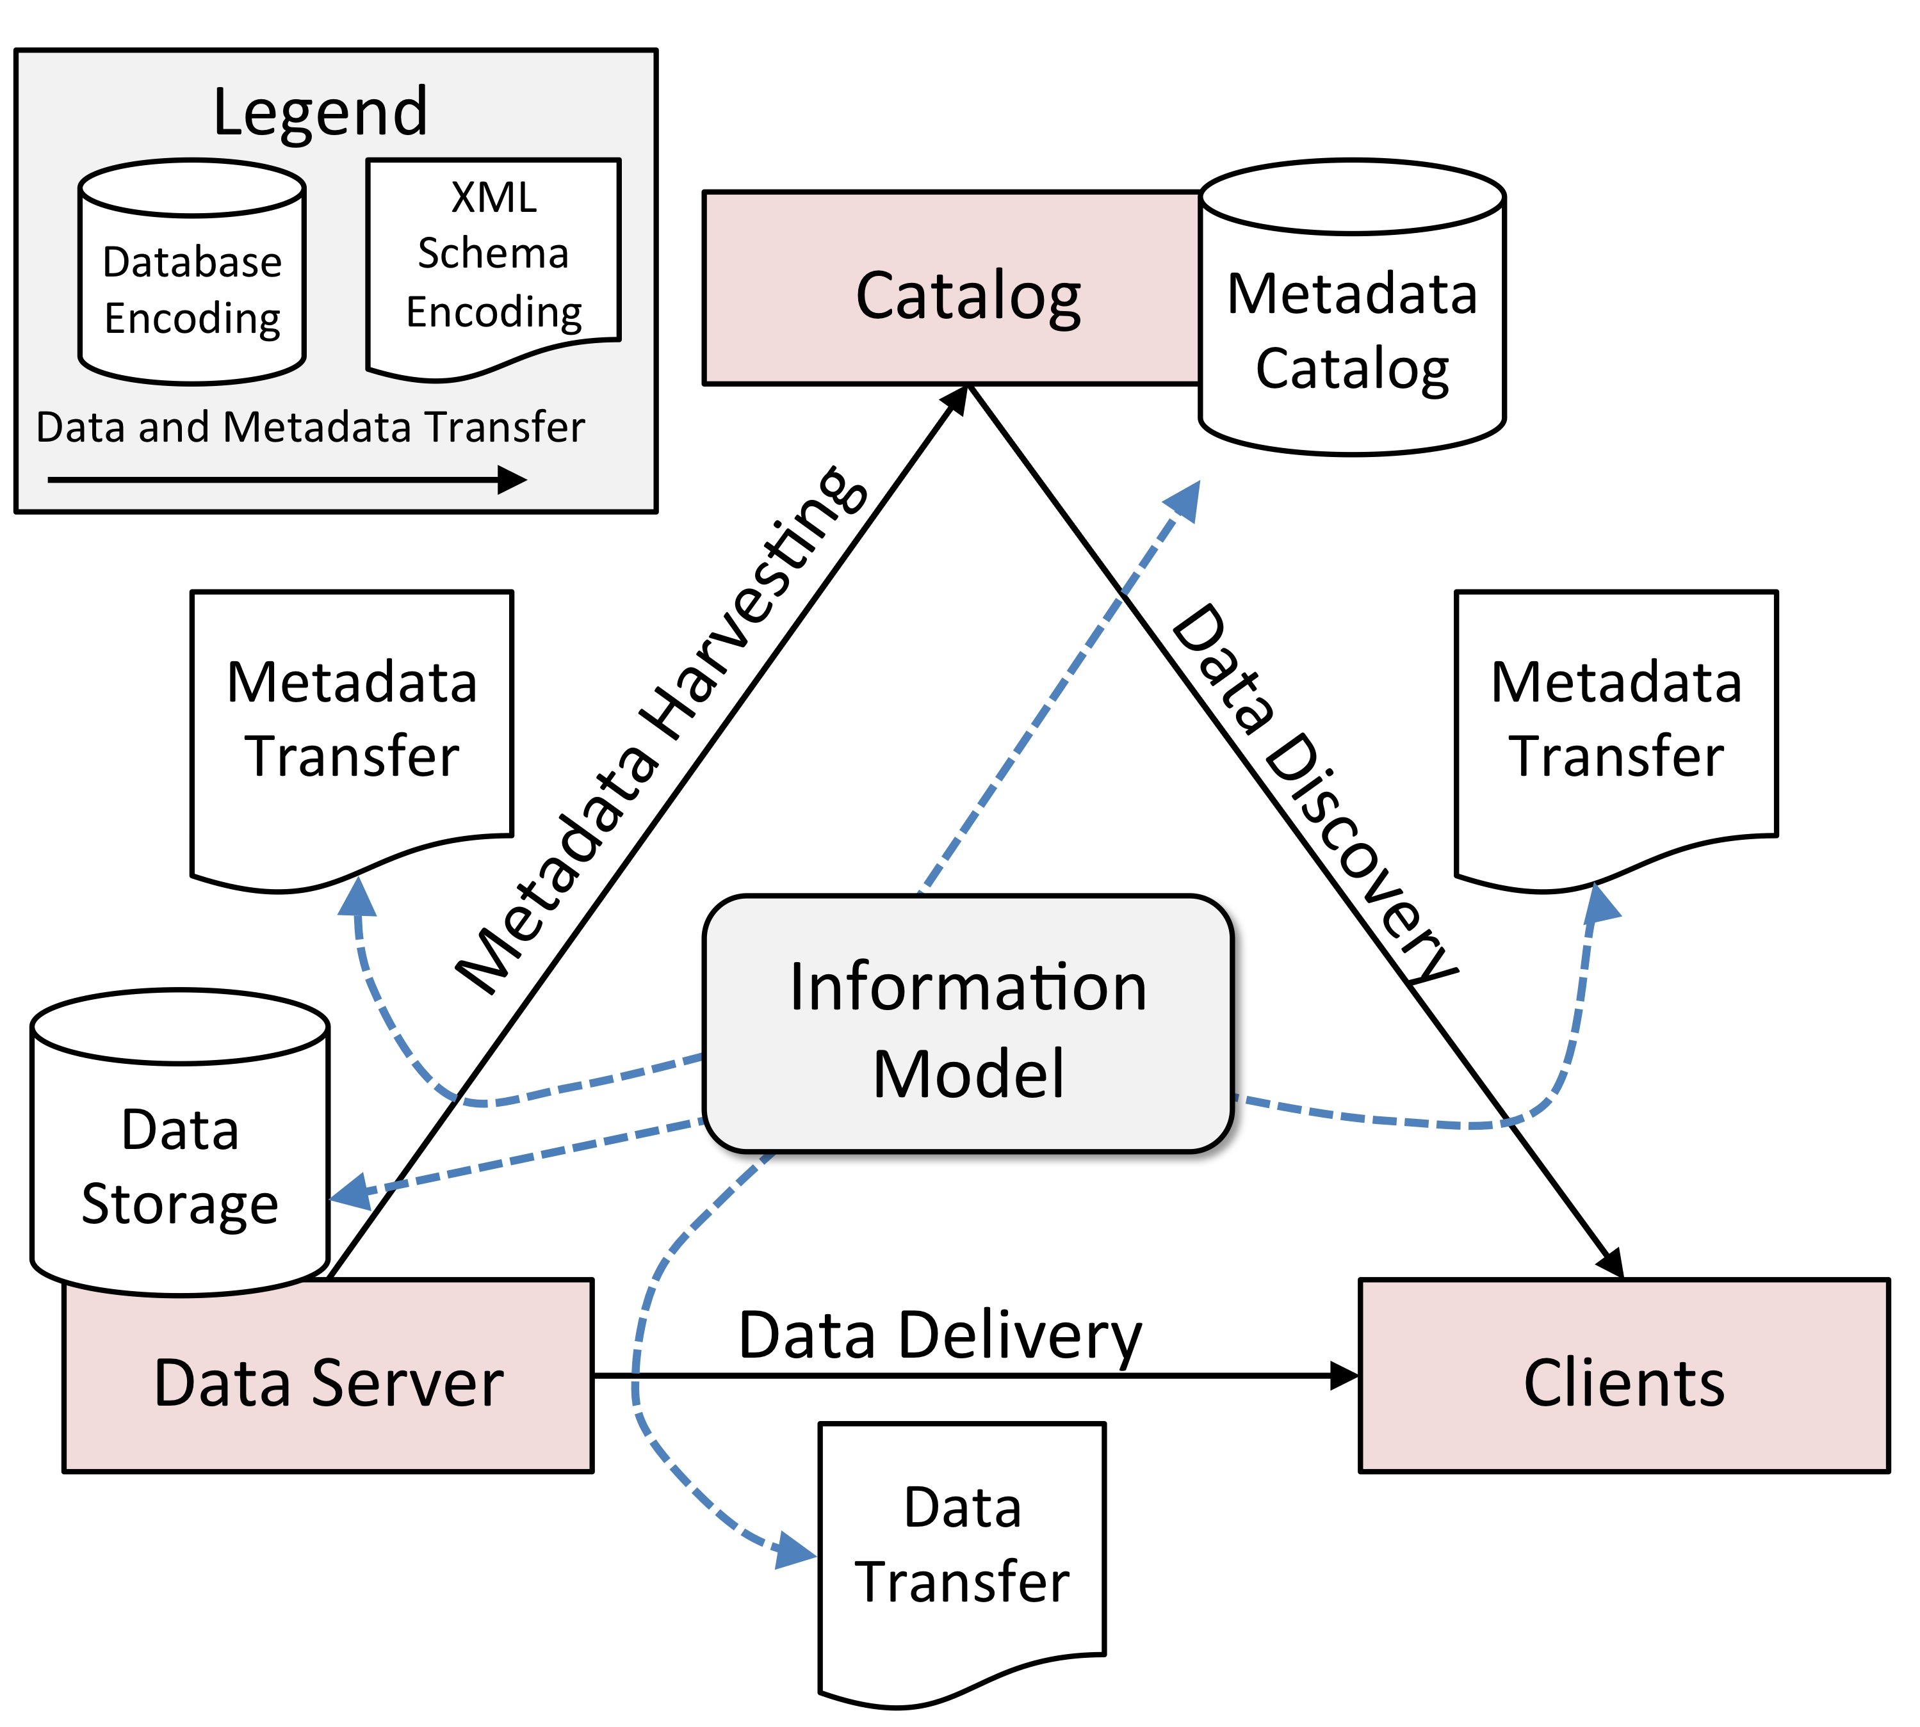
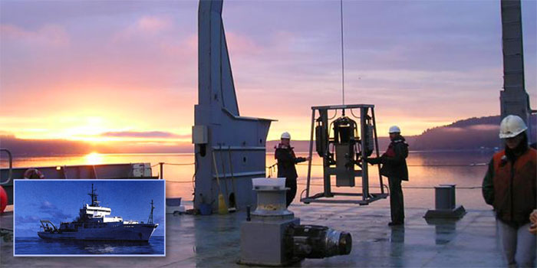
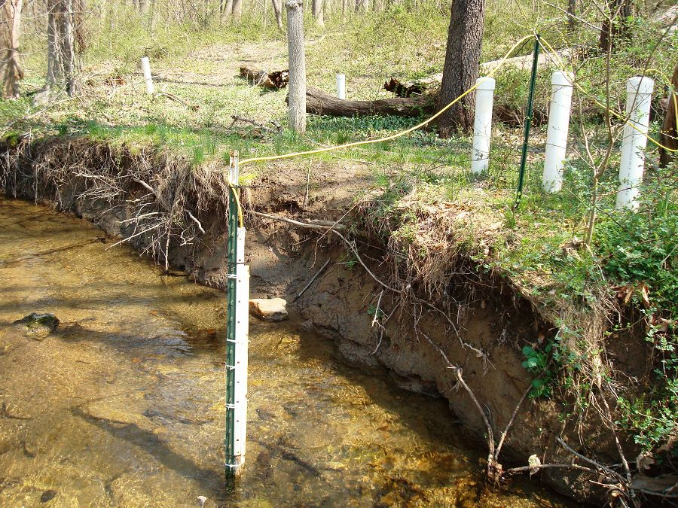
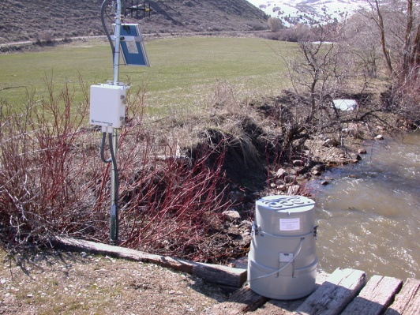
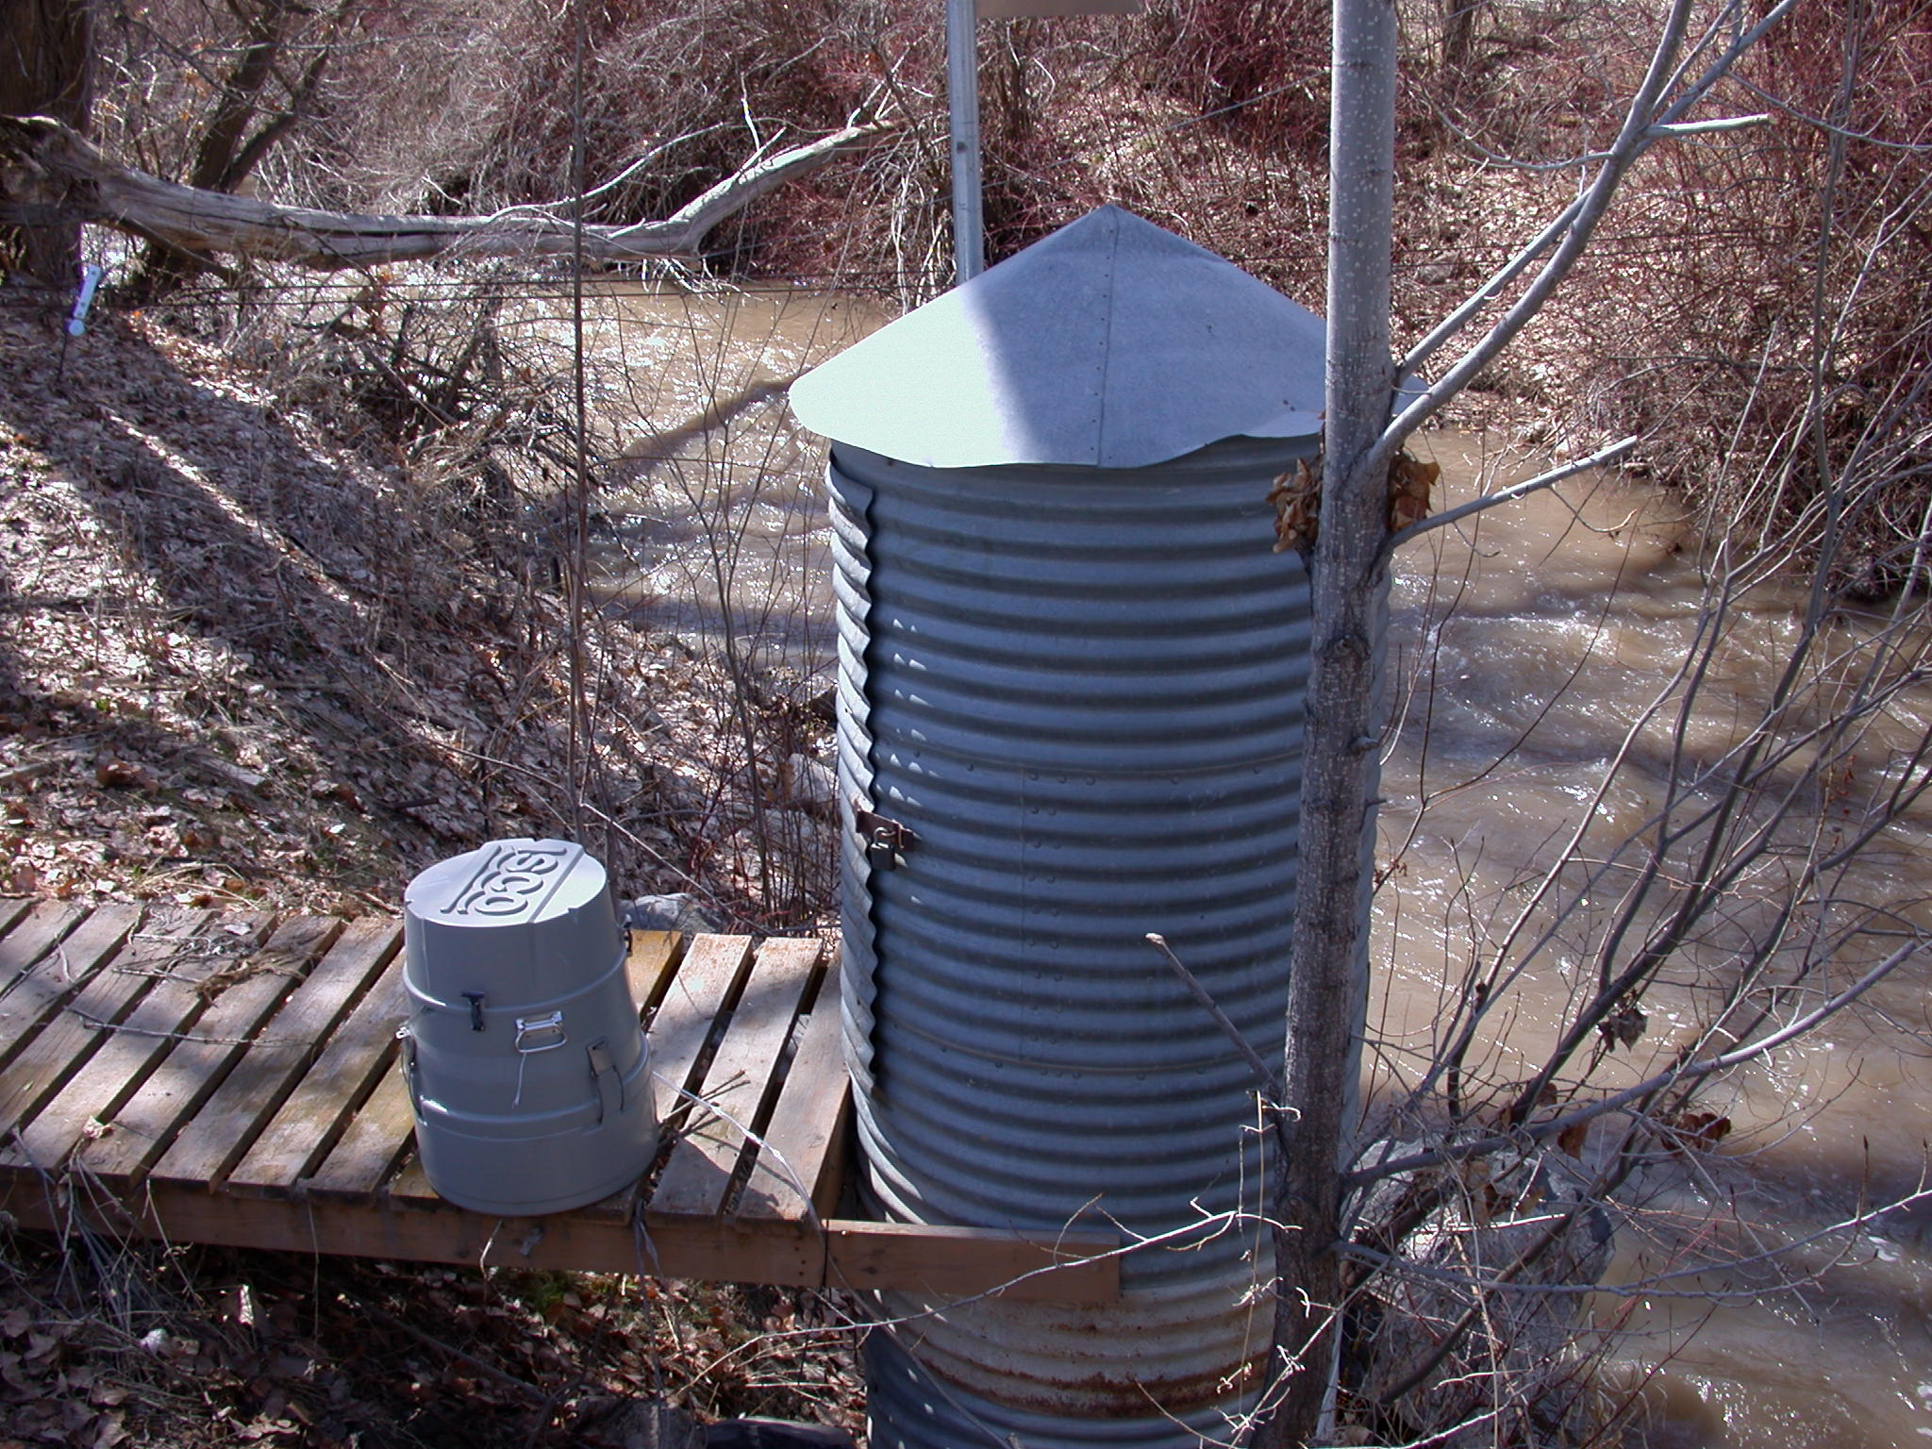
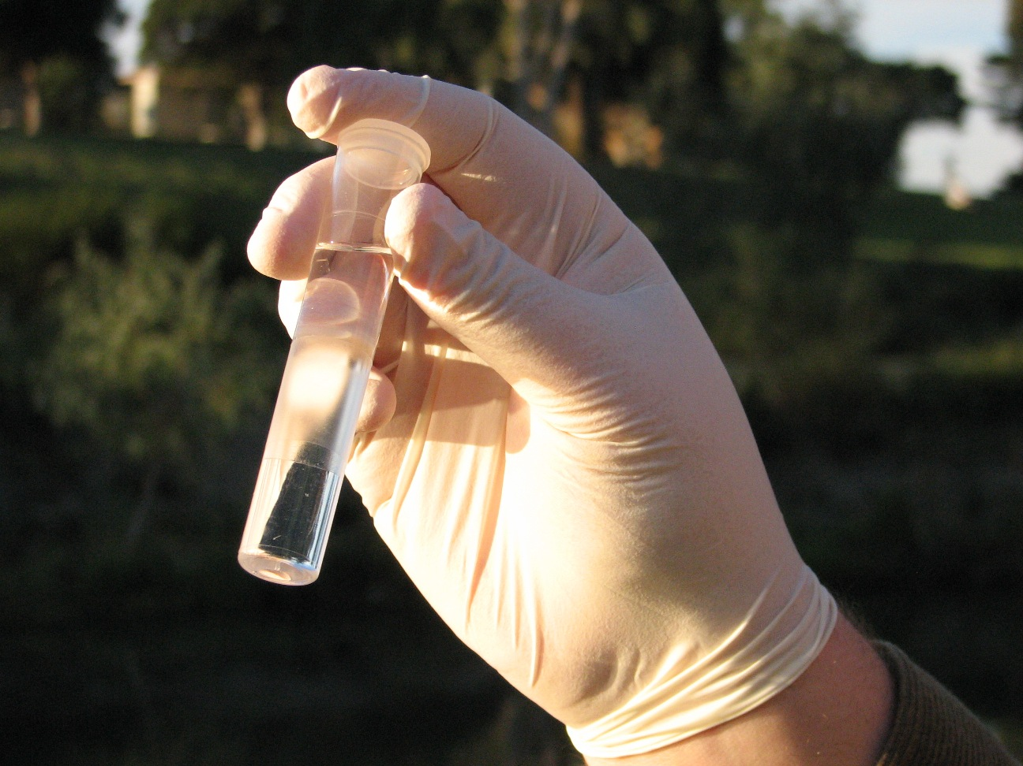
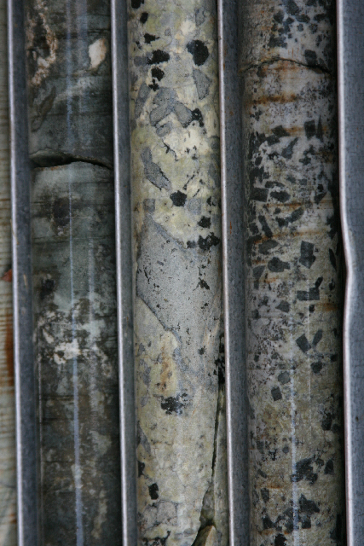
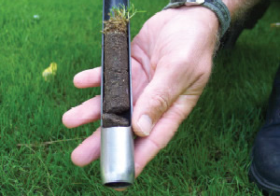
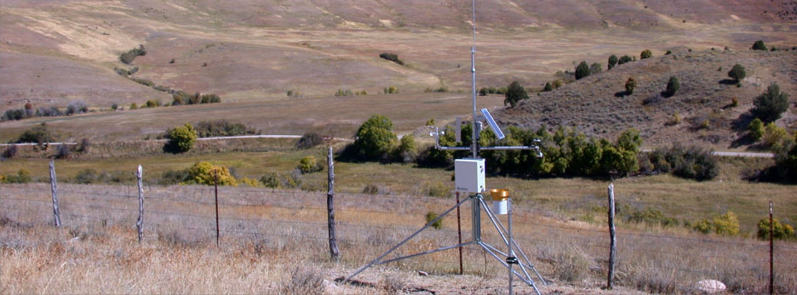
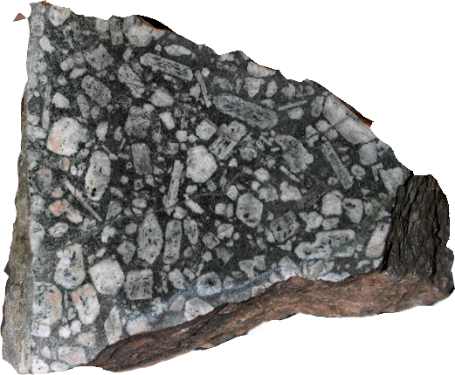
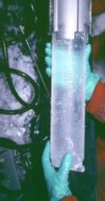
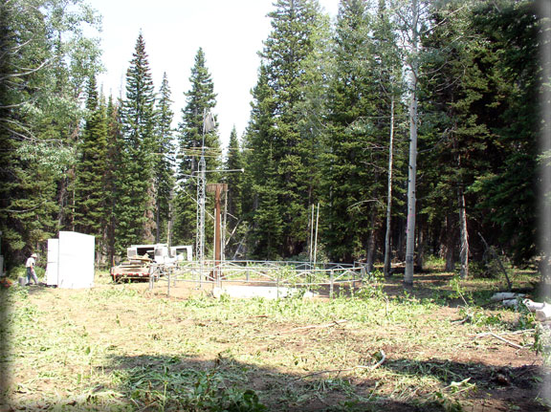
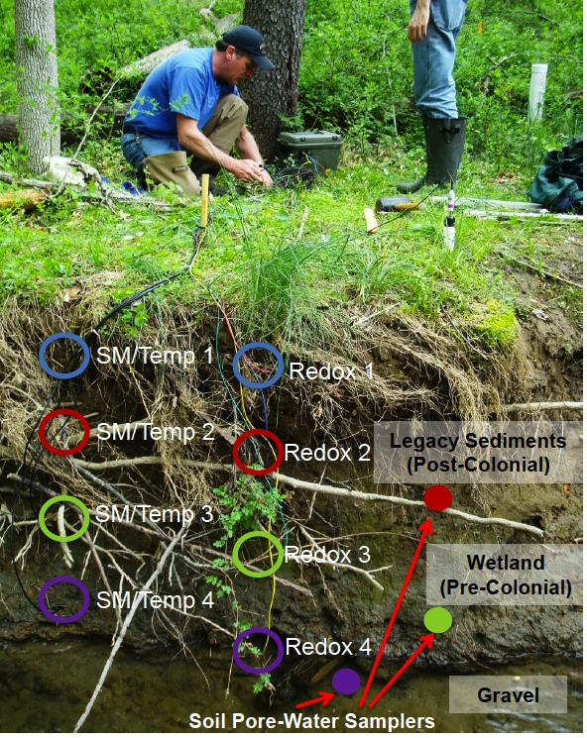
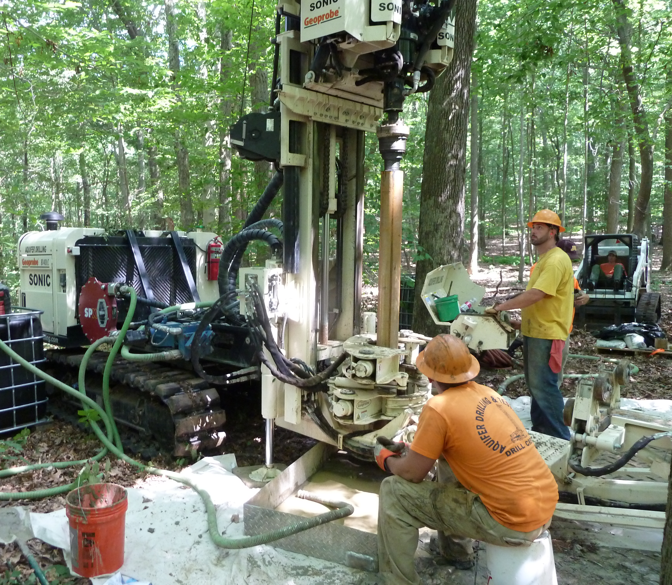
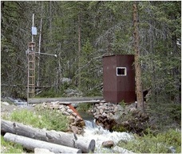
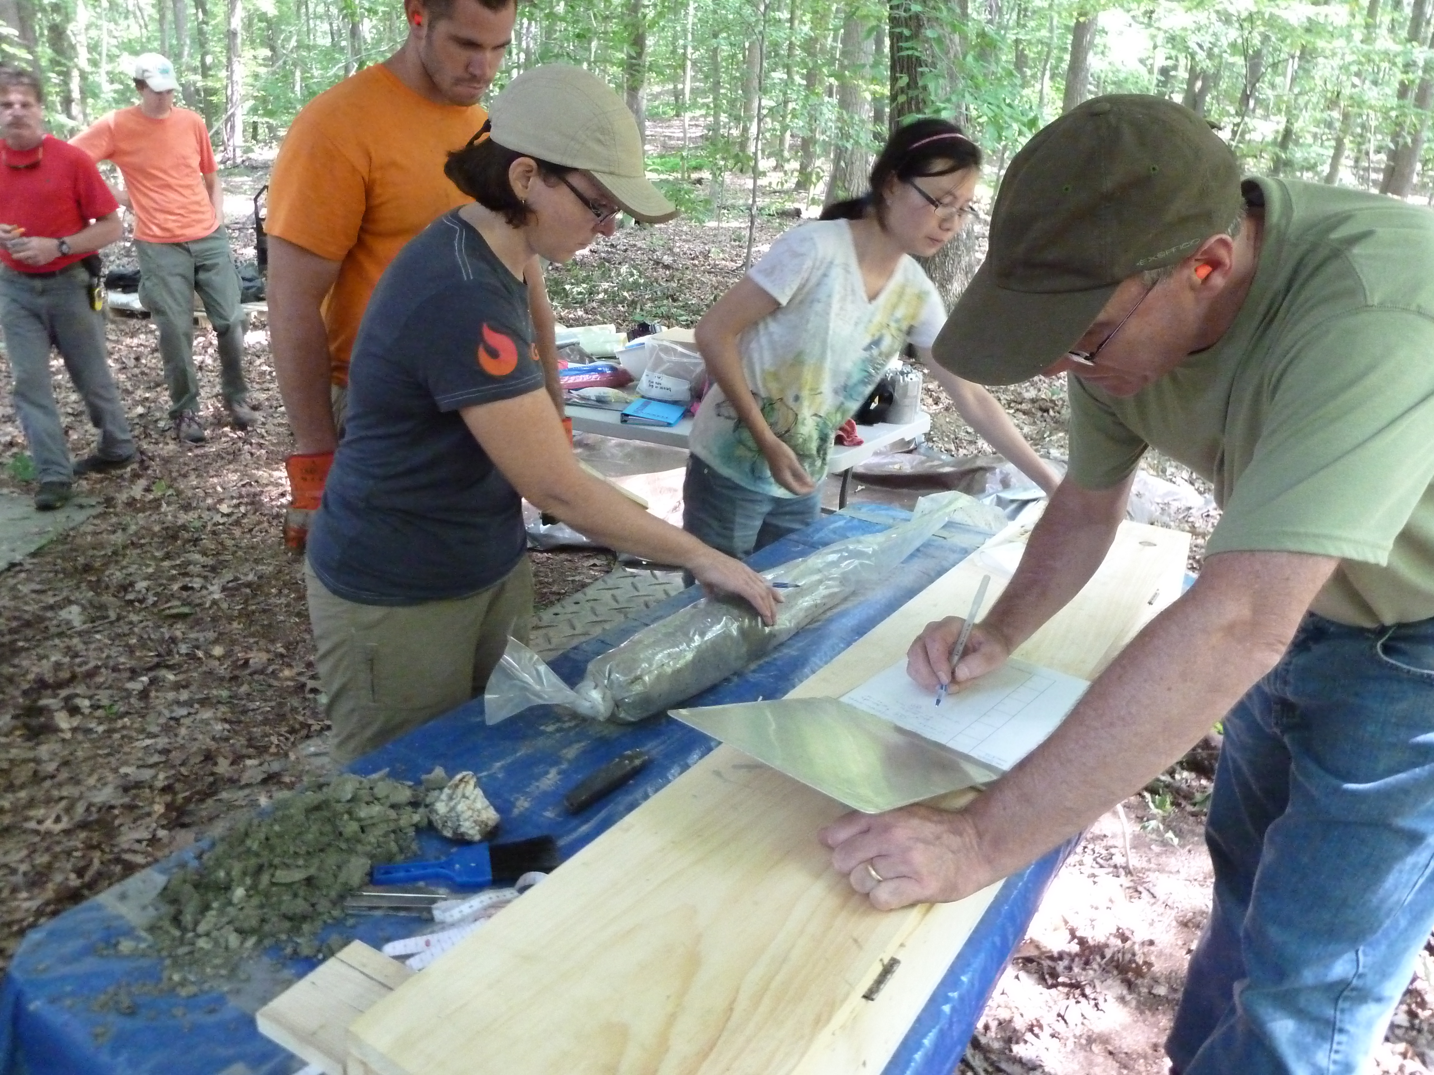
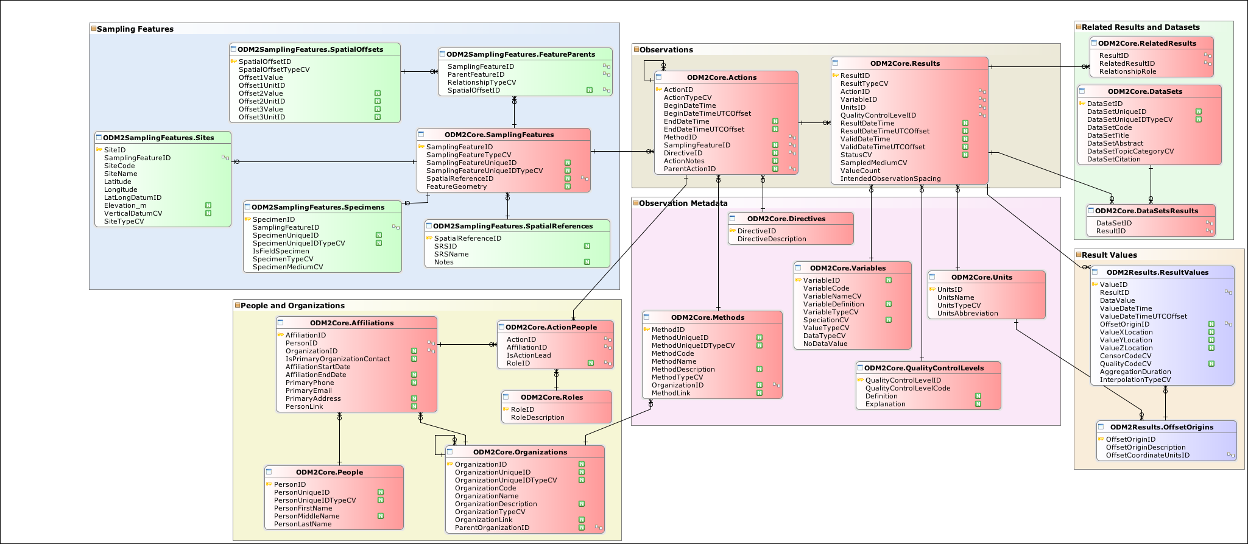
H11E-1197
Extending the Interoperability of Sensor and Sample Based Earth
Observations Using a Community Information Model
Jeffery S. Horsburgh, Anthony Aufdenkampe, Kerstin Lehnert, Emilio Mayorga,
David G. Tarboton, Ilya Zaslavsky, David Valentine, Tom Whitenack
This work was funded by National
Science Foundation Grant EAR 1224638
ODM2: A Community Information Model
Example Data Use Cases for ODM2
EarthChem Data – Focus on PetDB, including chemical, isotopic, and mineralogical data for igneous and metamorphic rocks, xenolith samples from the Earth’s mantle and lower crust, minerals, and volcanic gases.
Geographic Scope: Global data repository
Sampling Features: Samples from solid earth sciences and their sub-samples
Challenges: Extensive metadata for samples/specimens (material, collection, preparation, etc.), parent-child sample relationships, relating observations to published results, diversity of methods & data quality measures
An information model is an abstract representation of concepts, their properties and relationships, constraints, and operations between them.
It forms the conceptual foundation for each component of a data system. In practice, however, information models for each component are often arbitrarily different, limiting capabilities.
Little Bear River – Continuous sensor-based observations of hydrologic and water quality variables with water chemistry and suspended sediment samples.
Geographic Scope: Utah watershed
Sampling Features: Stream monitoring and weather stations, soil profiles
Challenges: Multiple sites and sensors at each site, instrument offsets, paired sample and sensor observations
Image Source: http://www.prism.washington.edu/story/PRISM+Cruises
Image Source: https://criticalzone.org/christina/infrastructure/sample-collection-resources-christina/
PRISM – Ocean water column observations using ship-based instrument casts and water chemistry sample collections at multiple depths.
Geographic Scope: Puget Sound (WA)
Sampling Features: Water column, depth profiles, rosette sample collection
Challenges: Simultaneous sensor observations and sample collection, profile upcasts and downcasts
Christina River – Hydrologic observations and geochemical composition of sediment deposits, suspended sediments, and potential sources.
Geographic scope: Delaware river tributary
Sampling Features: Stream gauges, soil pits, sediment cores, overland flow collectors
Challenges: Sample size/density fractions, parent-child sample relationships, sensor and sample data integration
A common information model is critically important to the effectiveness and interoperability of domain Cyberinfrastructure.
Scope: Spatially Discrete, Feature Based Earth Observations
ODM2 expands on the information model underlying ODM 1.1.1 and WaterML 1.1 developed as part of the CUAHSI HIS project to better support both sensor and sample-based data.
Sensor Based Data
Stream gages
Continuous water quality sampling
Weather stations
Soil moisture
Groundwater level/quality
Sample Based Data
Water quality samples
Rock cores
Sediment samples
Soil Samples
A broad set of geoscience data use cases covering water, soil, mineral, and air is driving our design.
ODM2 Information Model Design
Observation “Results” can be of many different types, including time series, single measurements, etc.
Relationships between “Specimens” and the “Site” at which they were collected are captured in “FeatureParents”
An “Observation” is an “Action” that has a “Result.” Not all “Actions” produce “Results”
Observation “Results” can be grouped into “Datasets” and related to other “Results”
Other relationships among SamplingFeatures can be expressed – including “SpatialOffsets”
Community Design Process/Functional Use Cases
Our goal is to co-develop with the broad geoscience community an information model that can serve as the common conceptual foundation for the next generation of Cyberinfrastructure. Our aim is for deep interoperability across multiple disciplines and systems to support powerful data discovery, access, publication and visualization capabilities.
Our motivation arose from the challenges we faced developing an integrated data system prototype for the NSF-funded Critical Zone Observatories (CZO) Network (http://criticalzone.org), which required strong interoperability between systems that were developed around sensor-based data and those around sample-based data. Our design process has included:
“Sampling Features” include “Sites” and “Specimens” – but may also include other feature types
Additional Features Not Shown
General extensibility extension – extend any of the core entities
Samples extension – represent more extensive metadata about samples and analyses
Sensors extension – describe and manage sensor infrastructure
Provenance extension – store relationships among original and derived data
Annotations extension – add data qualifying comments and annotations to entities in the model
Controlled vocabularies – community vocabularies for many attributes in the model
Observations can have “Results” of many types. A “Result” can have one or more “Result Values”
Science requirements design workshop (March 2012, San Diego, CA) – 21 Geoscience community members joined us to define the scope and requirements for ODM2. This workshop identified data use cases and several specific enhancements to existing data and information models.
Functional use case design workshop (July 2013, Palisades, NY) – 18 Geoscience Cyberinfrastructure community members joined us to identify functional use cases and their requirements.
Data interoperability challenge (TBD) – We will hold a data interoperability challenge to test our information model design and its capabilities for integrating data from our identified data use cases.
Storage Encoding
(USU/LDEO)
Both “Actions” and “Results” have metadata
Archival Encoding
(USU)
Information Model
(All)
Catalog Encoding
(SDSC)
Project Status and Milestones
Requirements gathering and community design workshops complete
Core information model nearly complete and undergoing testing
Samples and sensors extensions undergoing revision
RDBMS data storage schema undergoing testing using data use cases
Next Steps
Work on data transfer schema and web service interfaces
Investigate catalog schema
Investigate implications for data archival schema
Data interoperability challenge workshop
XML Schema Encoding
(SDSC)
“Actions” are performed by “People” that may be affiliated with an “Organization”
Web Service Interface
(UW)
Functional use cases include encodings for: Storage (RDBMS), Archival, Metadata catalog (RDBMS), Transfer (XML Schema and web services)
Contact Us!
We invite input and feedback from the Hydrologic and Geoscience Community in meeting the specific needs for data management and sharing.
ODM2 is on GitHUB: https://github.com/UCHIC/ODM2

