Slide 1
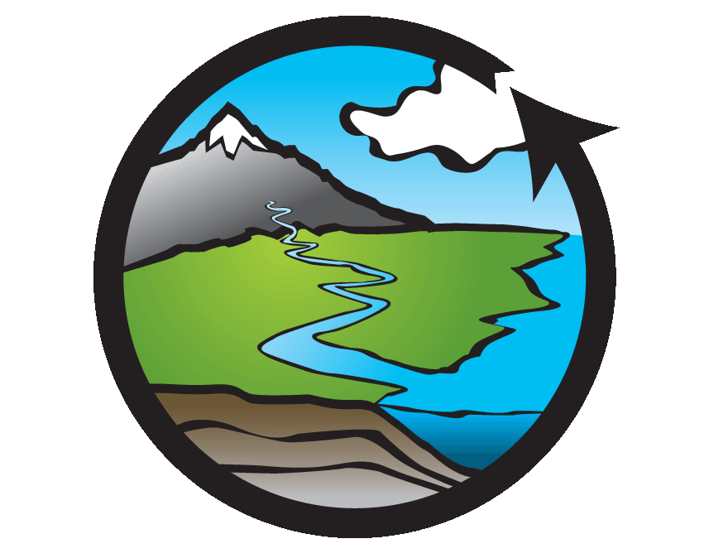

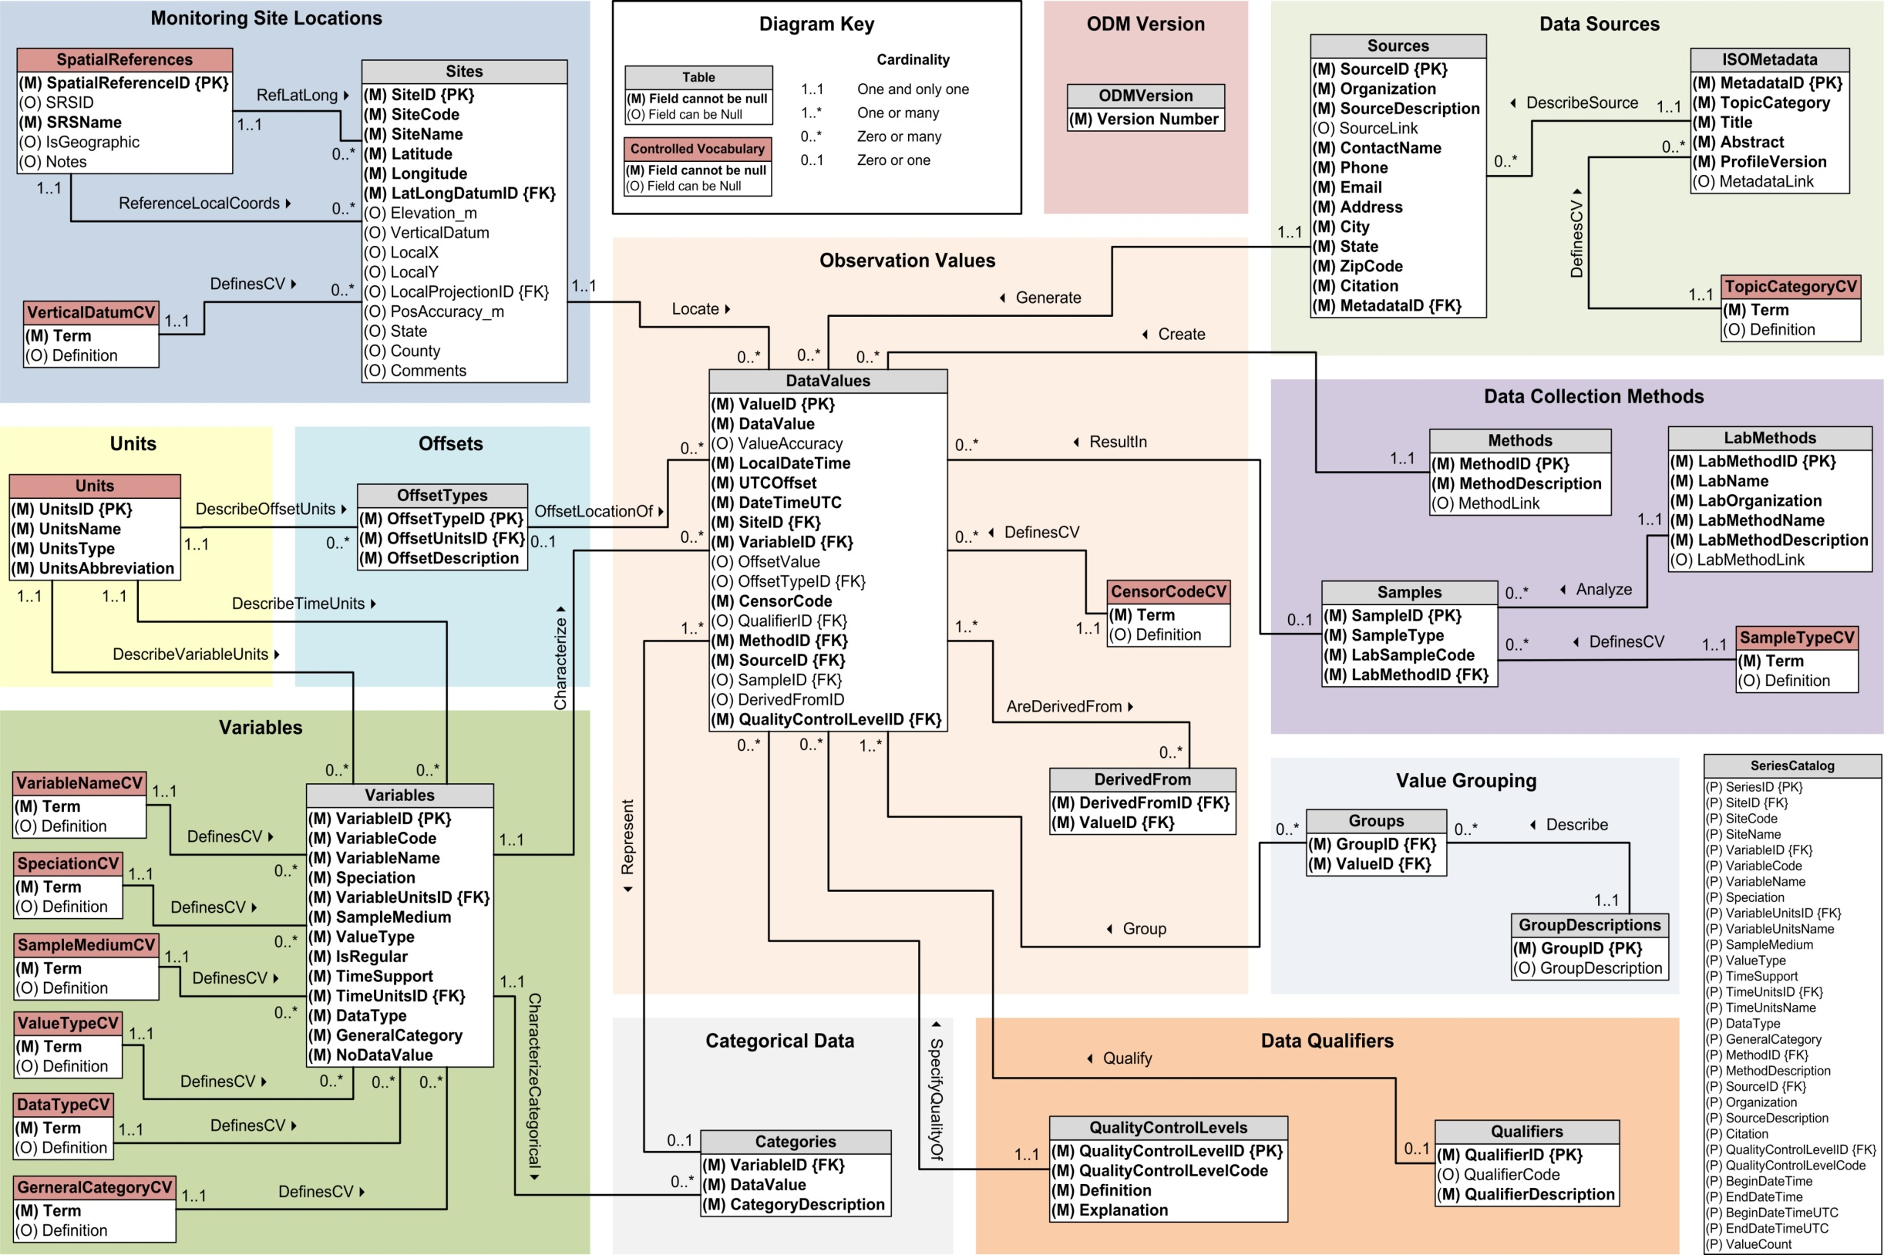
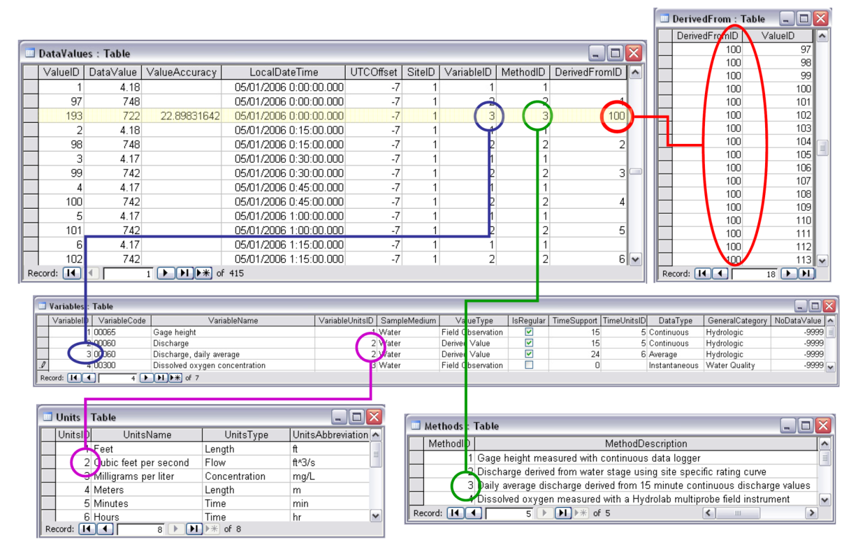
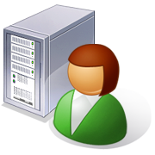
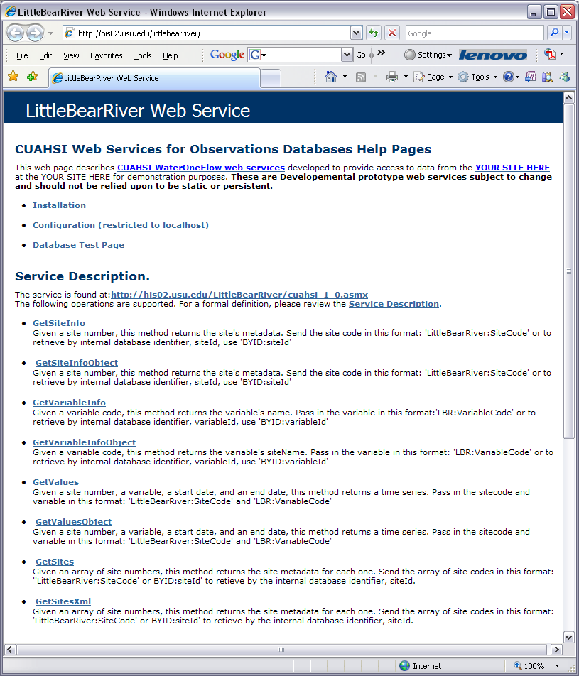
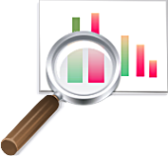
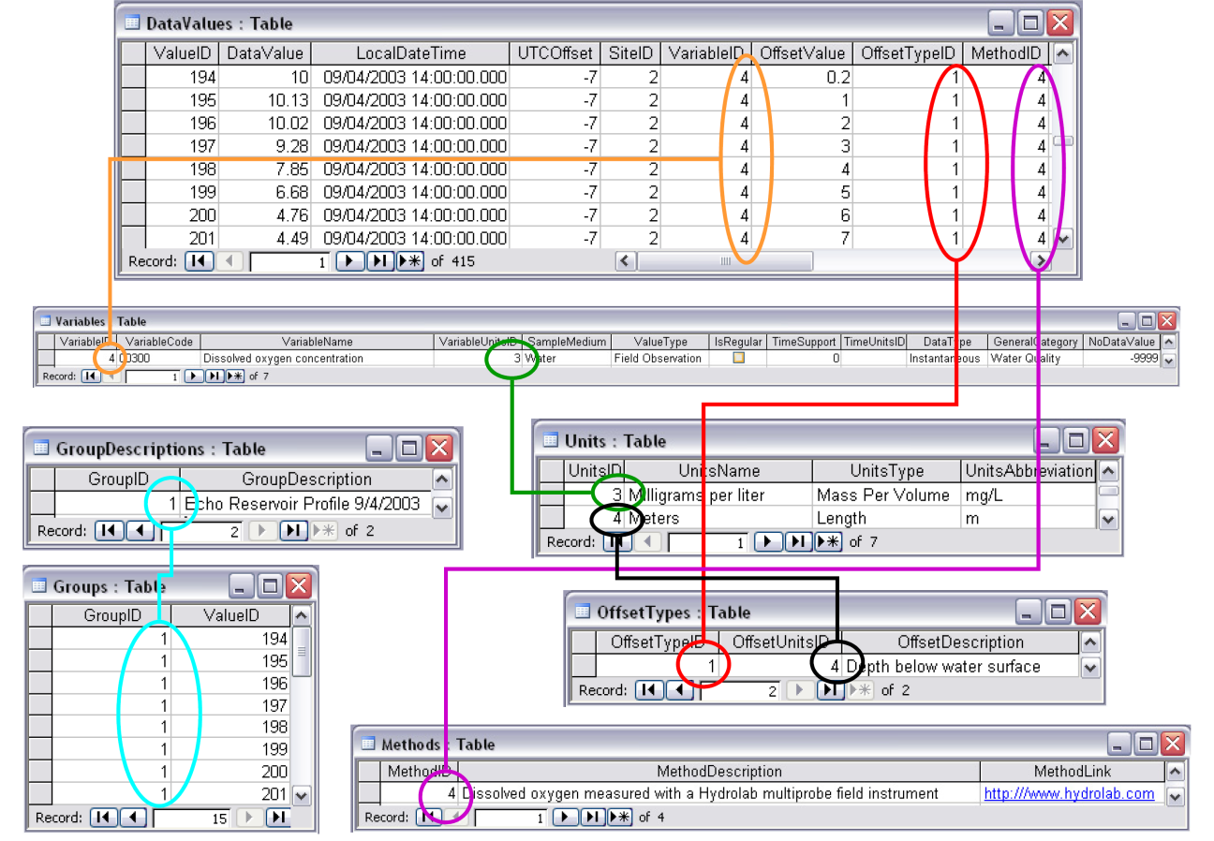
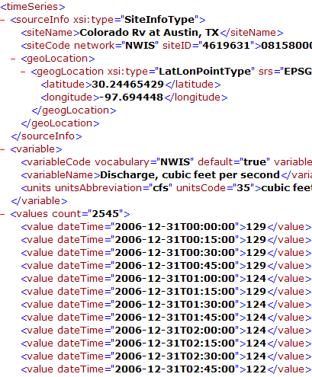
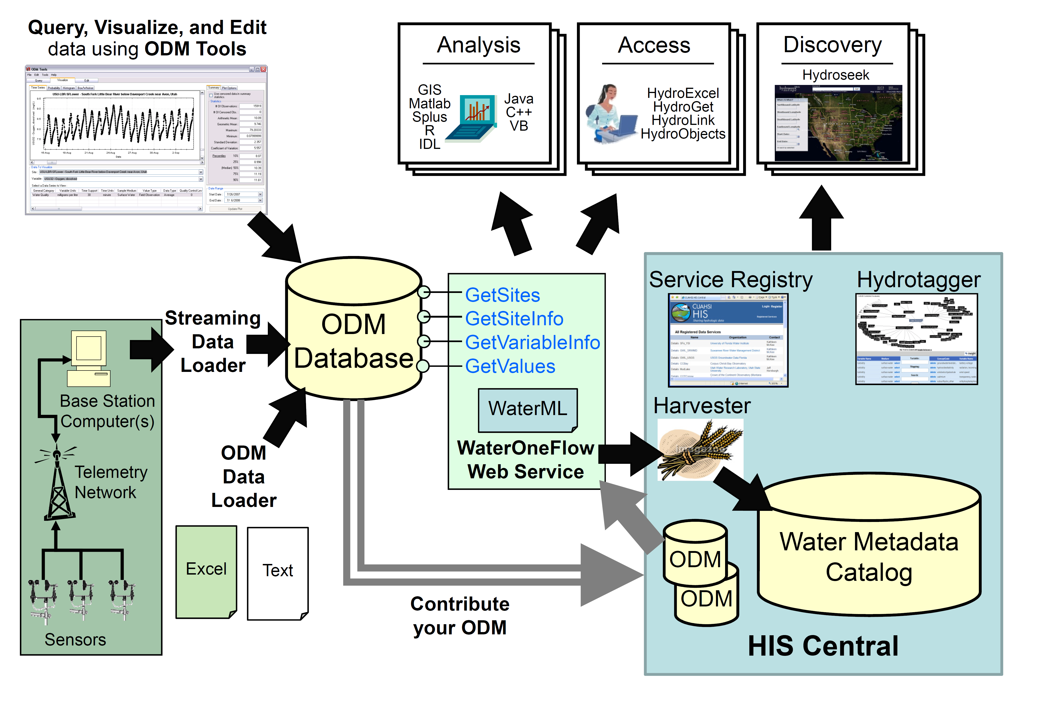
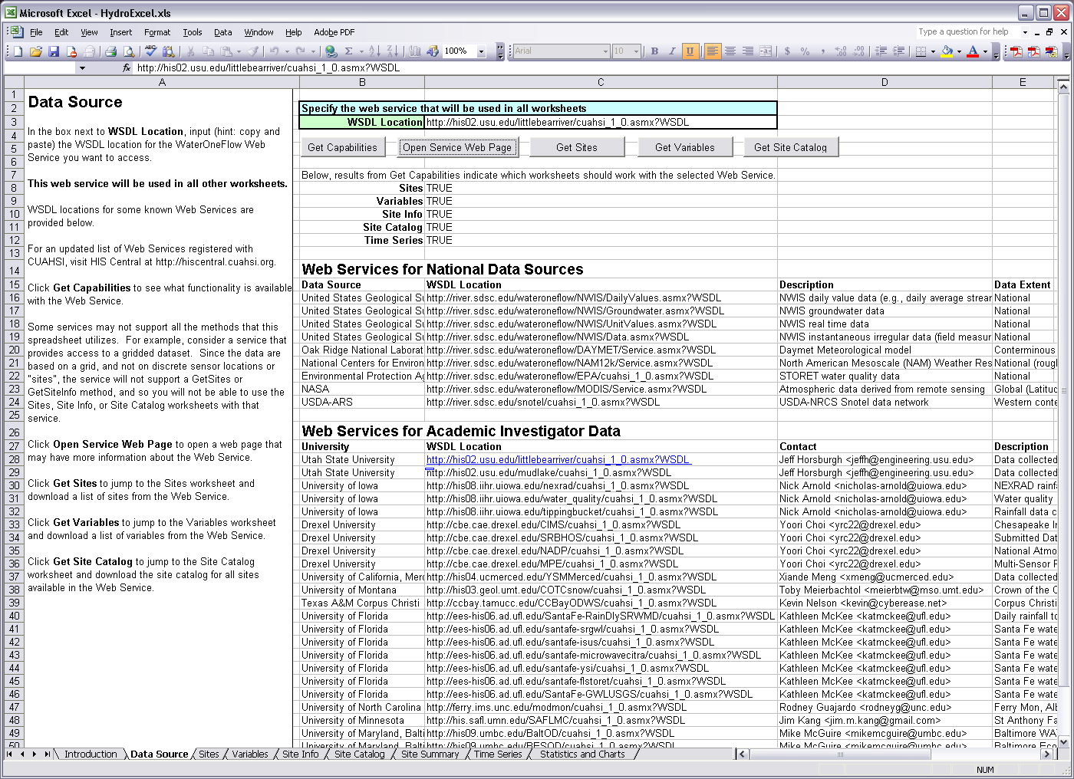
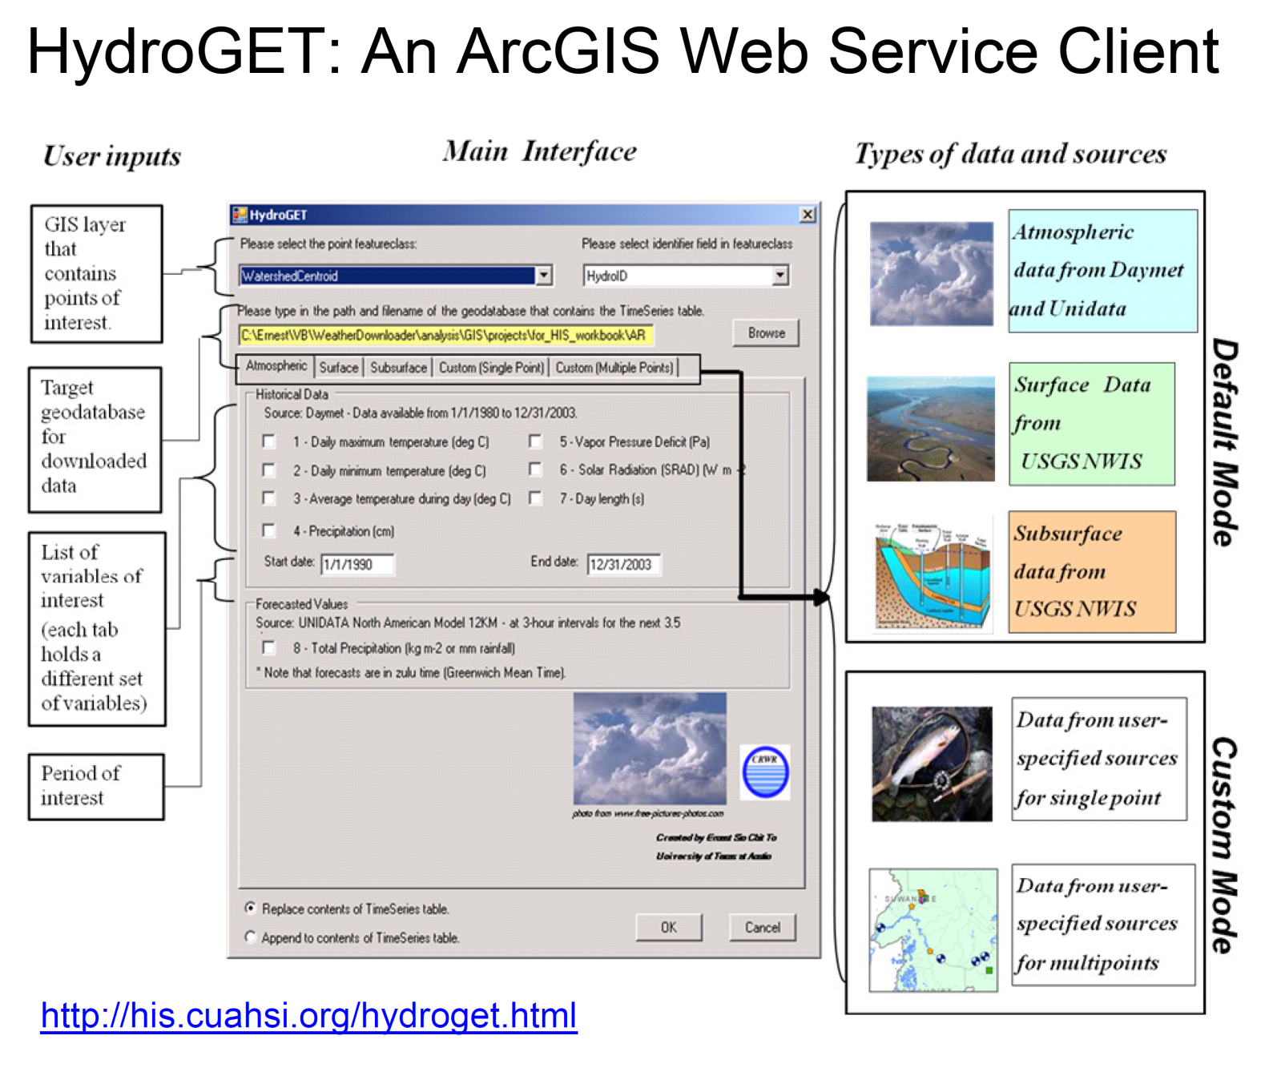
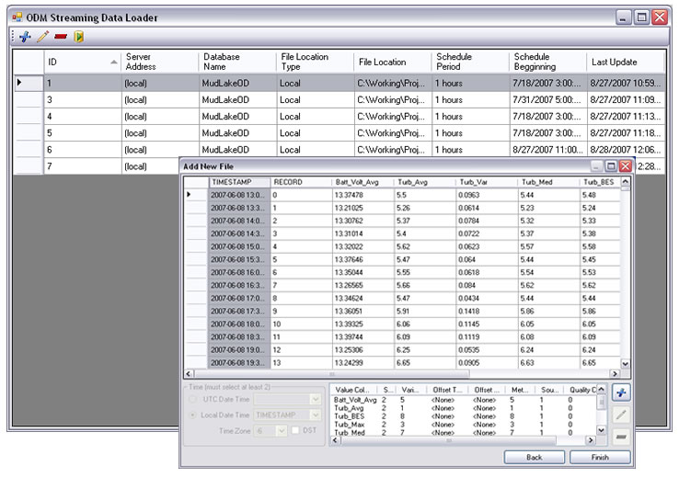
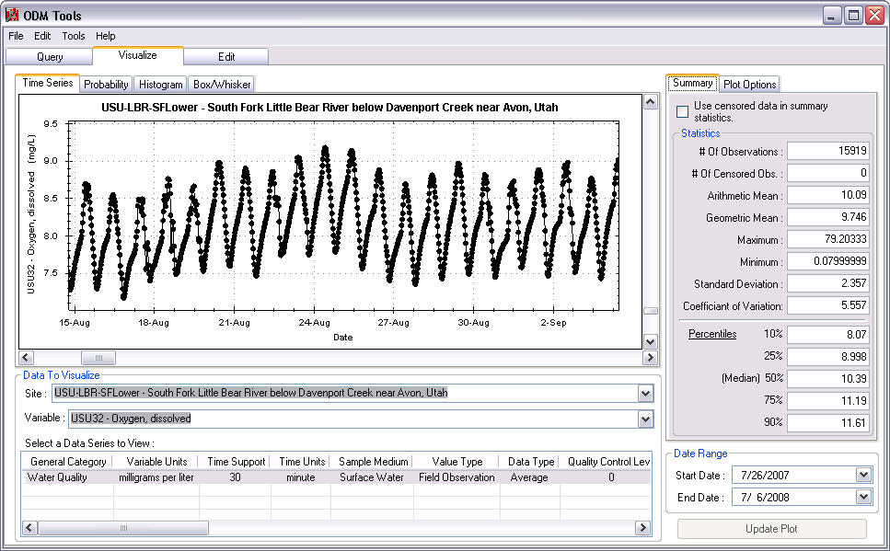
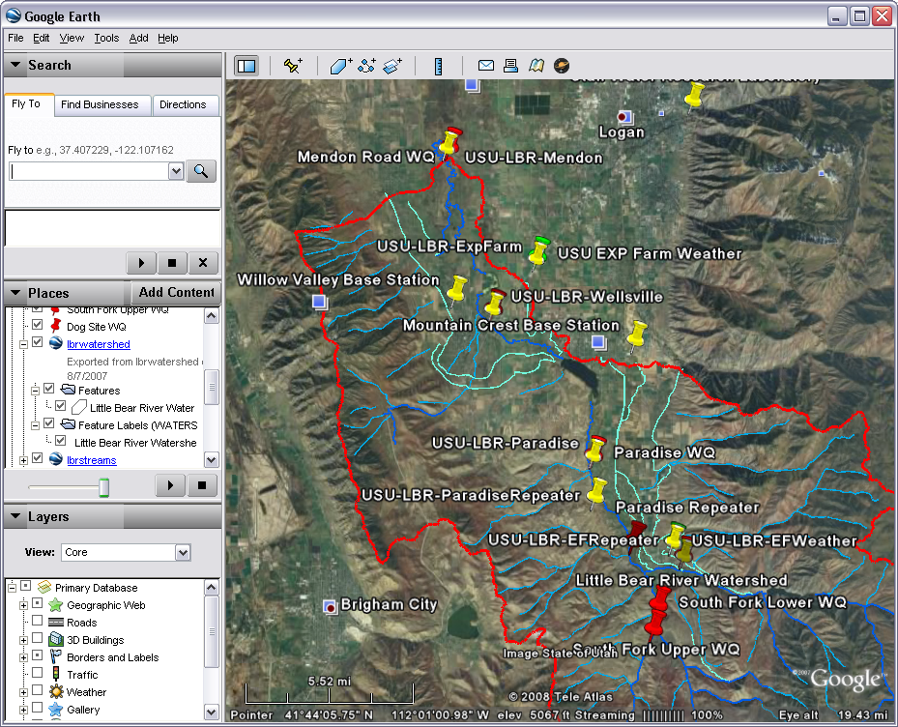

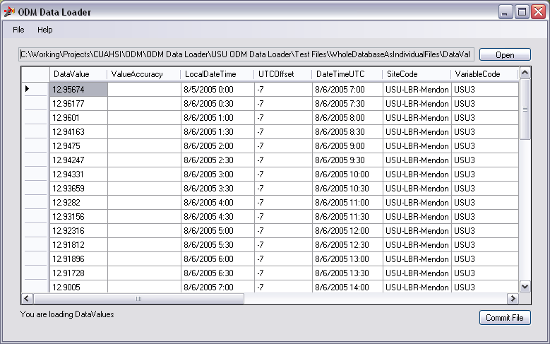
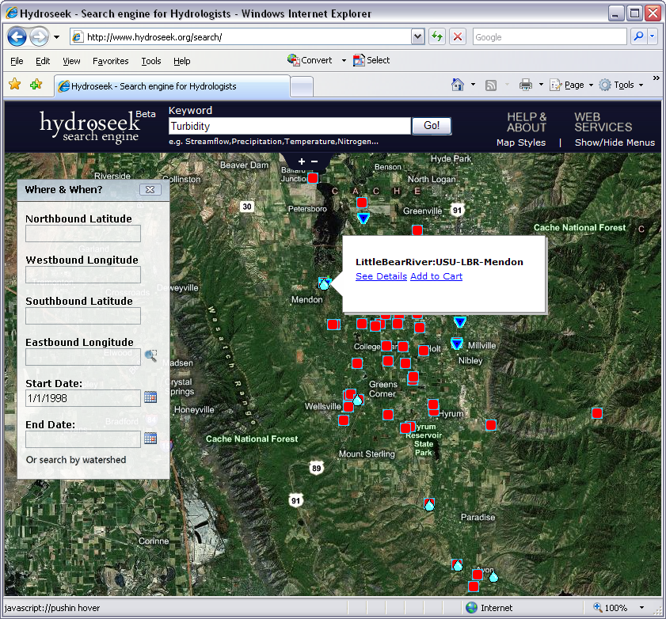
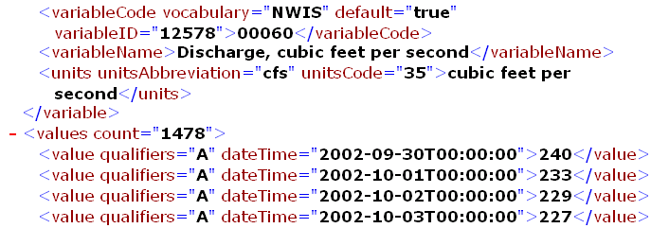
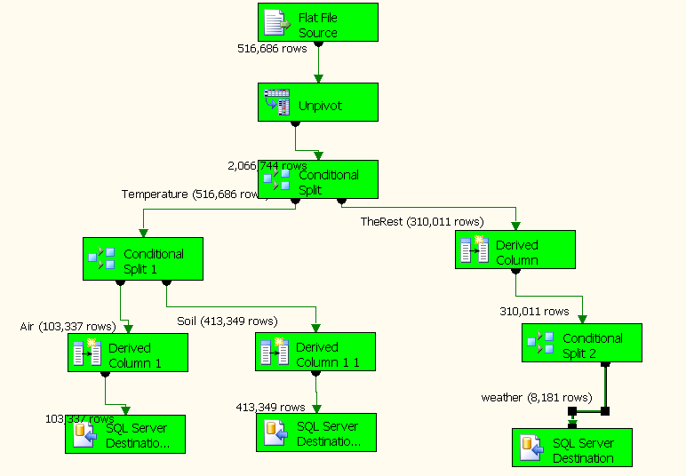

C21A-0504
Accessing and Sharing Data Using the
CUAHSI Hydrologic Information System
CUAHSI HIS
http://his.cuahsi.org
This work is funded by National Science Foundation Grant EAR 0622374
1
Abstract
3
Observations Data Model (ODM)
5
WaterOneFlow and WaterML
The Consortium of Universities for the Advancement of Hydrologic Science, Inc (CUAHSI) has a Hydrologic Information System (HIS) project that is developing infrastructure to support the sharing of hydrologic data through web services and tools for data discovery, access and publication. Centralized data services support access to national datasets such as the USGS National Water Information System (NWIS) and STORET, in a standard way. Distributed data services allow users to establish their own server and publish their data through CUAHSI HIS web services. Once such a data service is registered within HIS Central, it becomes searchable and accessible through the centralized discovery and data access tools. The HIS is founded upon an information model for observations at stationary points that supports its data services. This is implemented as both XML and a relational database schema for transmission and storage of data respectively. WaterML is the XML based data transmission language that underlies the machine to machine communications, while the Observations Data Model (ODM) is a relational database model for persistent data storage. Web services support access to hydrologic data stored in ODM and transmitted using WaterML directly from applications software such as Excel, MATLAB and ArcGIS that have Simple Object Access Protocol (SOAP) capability. A significant value of web services derives from the capability to use them from within a user’s preferred analysis environment, rather than requiring a user to learn new software. This allows a user to work with data from national and academic sources, almost as though it was on their local disk.
ODM provides a standard format within which data from multiple investigators and domains can be stored and manipulated
The WaterOneFlow web services provide a platform, operating system, and programming language independent way of communicating data over the Internet
Daily Average Discharge Example
Daily Average Discharge Derived from 15 Minute Discharge Data
WaterOneFlow
Web Service Call
GetSites
GetSiteInfo
GetVariableInfo
GetValues
Water Chemistry From a Lake Profile
WaterML
Data Consumer
SQL
Queries
2
Publishing Data Using HIS
ODM logical data model. The primary key field for each table is designated with a {PK} label. Foreign keys are designated with a {FK} label. The lines between tables show relationships with cardinality indicated by numbers and labeled with the name and directionality of the relationship.
ODM
Database
Query
Distributed data services allow users to establish their own server and publish their data through CUAHSI HIS web services. Once a data service is registered within HIS Central, it becomes searchable and accessible through the centralized discovery and data access tools.
Response
Web Service Response
4
ODM Utilities and Software
6
Accessing Data Using HIS
A suite of software tools are available for working with ODM
HydroExcel: Get Data Directly into Microsoft Excel
HydroGet: Get Data Directly into ArcGIS
Stream sensor data into ODM using the Streaming Data Loader
Query, Visualize, and Edit data using ODM Tools
Base Station
Computer(s)
Telemetry Network
Sensors
MATLAB: Get Data Directly in Your Analysis Environment of Choice
Hydroseek: Get Data Using Browser Based Keyword Searches
Load data into ODM using the ODM Data Loader
Excel
% create NWIS Class and an instance of the class
createClassFromWsdl('http://water.sdsc.edu/wateroneflow/NWIS/DailyValues.asmx?WSDL');
WS = NWISDailyValues;
% GetValues to get the data
siteid='NWIS:02087500';
bdate='2002-09-30T00:00:00';
edate='2006-10-16T00:00:00';
variable='NWIS:00060';
valuesxml=GetValues(WS,siteid,variable,bdate,edate,'');
Text
ODM
Database
Contact Information
Load data into ODM using SQL Server Integration Services (SSIS)
David G. Tarboton, Utah State University, 4110 Old Main Hill, Logan, UT 84322-4110, (435) 797-3172, david.tarboton@usu.edu
Jeffery S. Horsburgh, Utah State University, 8200 Old Main Hill, Logan, UT 84322-8200, (435) 797-2946, jeff.horsburgh@usu.edu
Supports search by location and type of data across multiple observation networks including NWIS and STORET
Timothy L. Whiteaker, The University of Texas at Austin, Center for Research in Water Resources, Austin, TX 78712, twhit@mail.utexas.edu
Ilya Zaslavsky, San Diego Supercomputer Center, University of California, San Diego, San Diego, CA 92093, zaslavsk@sdsc.edu
David R. Maidment, The University of Texas at Austin, Center for Research in Water Resources, Austin, TX 78712, maidment@mail.utexas.edu

