Slide 1



Components of an Integrated Environmental Observatory Information System
Cyberinfrastructure to Support Publication of Water Resources Data
Jeffery S. Horsburgh, David G. Tarboton,
David R. Maidment, and Ilya Zaslavsky
2009 AWRA Summer Specialty Conference
Adaptive Management of Water Resources

Slide 2
Background
Recently, community initiatives have emerged for the establishment of cooperative large-scale environmental observatories
  Moving beyond small, place-based research
  Coordinated, intensive field studies that are generating vast quantities of observational data
  Instrumented watersheds and field sites
  Platforms for water related research

Slide 3
Environmental Observatories
WATer and Environmental Research Systems (WATERS)
http://www.watersnet.org
Goal:
  Create a national capability to better predict and manage the behavior of water and its nutrients, contaminants, and sediments everywhere in the United States
Hypotheses/drivers:
  Current hydrological process understanding is constrained by:
    The kinds of measurements that have heretofore been available
    The methods that have been used to organize, manage, analyze, and publish data

Slide 4
“The Link”
Environmental Observatories → Adaptive Management
Observatories/Hydrologic Science
  We cannot verify our understanding of hydrologic processes without measurements
Resource Management
  We cannot manage what we cannot measure
Common data-related failures in both cases
  We can’t always measure what we need (cost, technology)
  Monitoring data are never made widely available, analyzed, or synthesized

Slide 5
Shared Challenges
A need for Enabling Technology - Infrastructure for:
  Data collection
  Data management
  Data publication
  Data discovery, visualization, and analysis
Shared infrastructure?
  The same data infrastructure that supports observatories could support adaptive management programs

Slide 6
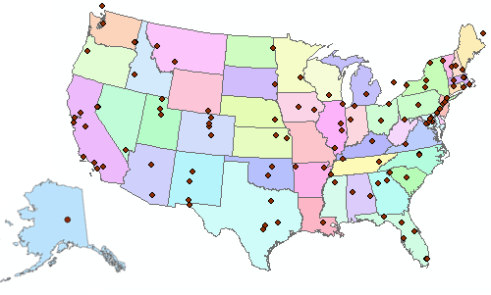

Consortium of Universities for the Advancement of Hydrologic Science, Inc.
110 US University members
6 affiliate members
12 International affiliate members
(as of March 2009)
An organization representing more than one hundred United States universities, receives support from the National Science Foundation to develop infrastructure and services for the advancement of hydrologic science and education in the U.S.
http://www.cuahsi.org/

Slide 7
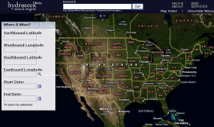


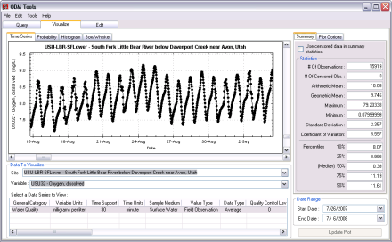
Basic Functionality of an Observatory Information System
Data Collection and Communication
Data Management and Persistent Storage
Data Discovery, Visualization, and Analysis
Edit data
QA/QC procedures
Create metadata
Homogenize data
Automated
Manual
Stream gauging
Groundwater level monitoring
Climate Monitoring
Water quality sampling
Data
Files
Database
Data Publication
Data Services
  GetSites
  GetSiteInfo
  GetVariableInfo
  GetValues
Database

Slide 8
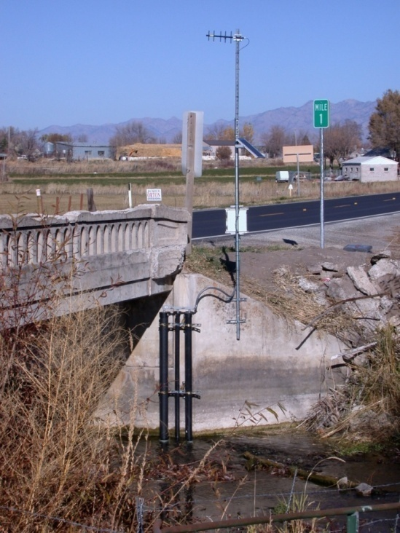
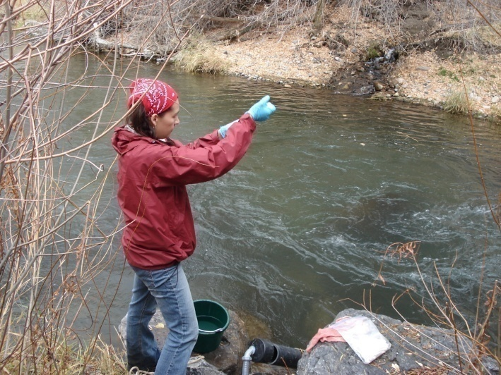
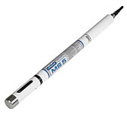
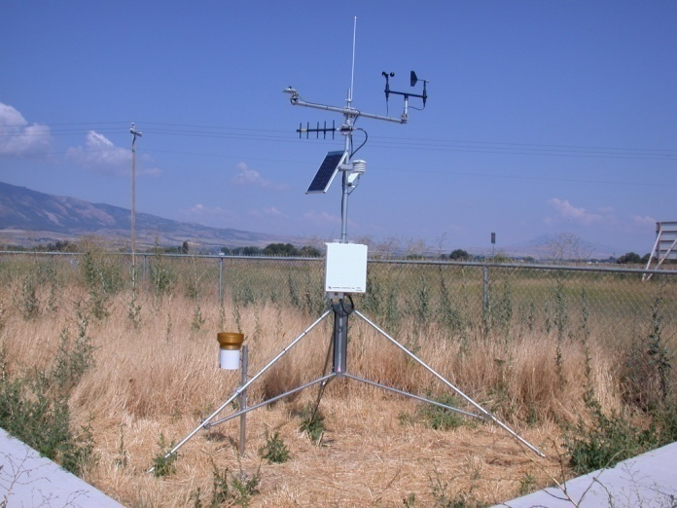
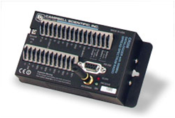
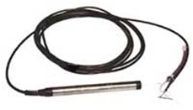

Data Collection and Communication Infrastructure
Automated
  Water quality and streamflow monitoring
  Weather stations
  Telemetry / communication networks
Traditional
  Grab samples
Notes:
This slide provides an overview of the Little Bear River Sensor Network. We have established relationships and have obtained legal access agreements for all of our monitoring and telemetry sites. This has afforded us the opportunity to work with local land owners, state and local government, and local schools to establish these sites.

Slide 9
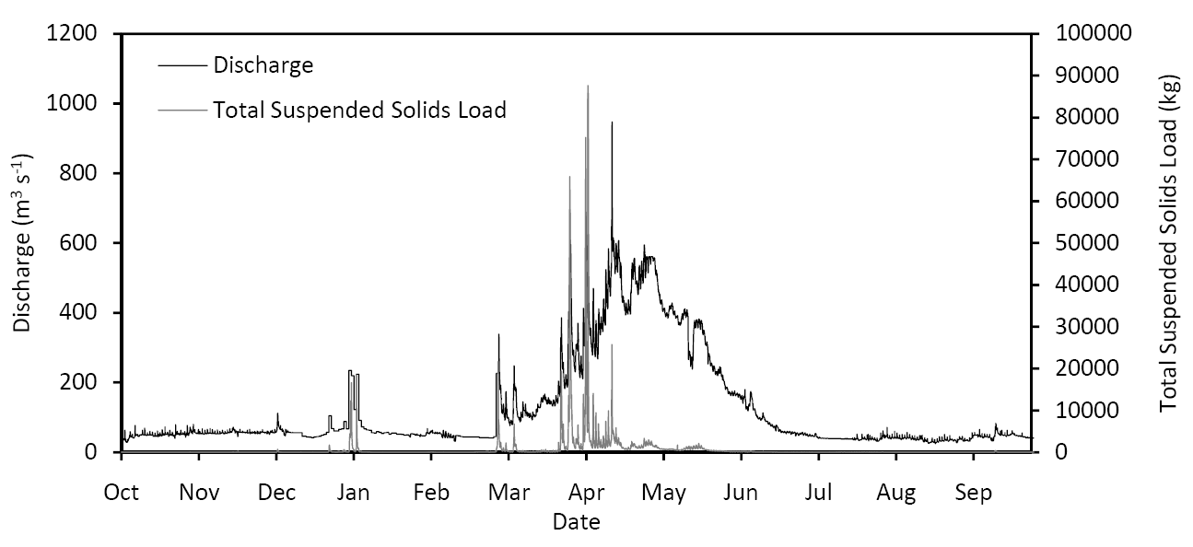
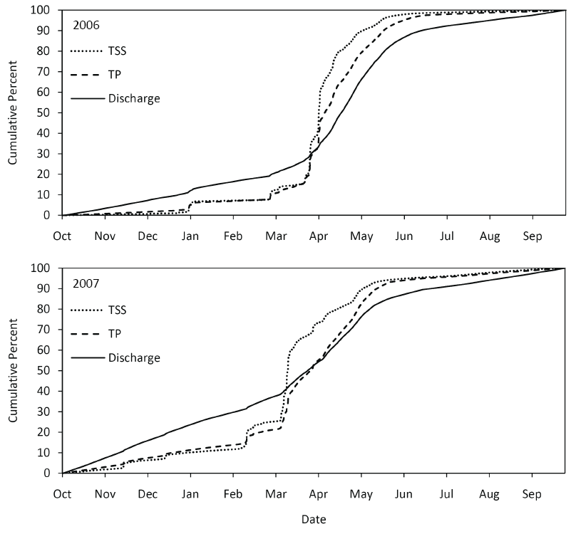
TP and TSS Loading
TSS and TP from turbidity using surrogate relationships
~50-60% of the annual load occurs during one month of the year
Provides information about flow pathways

Slide 10
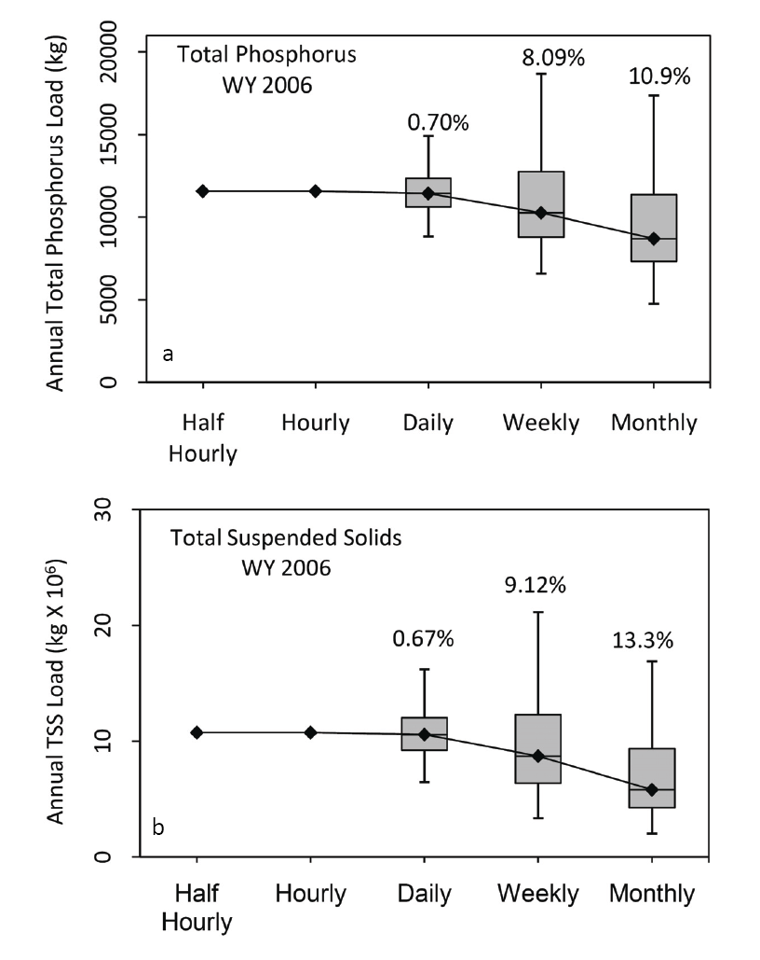
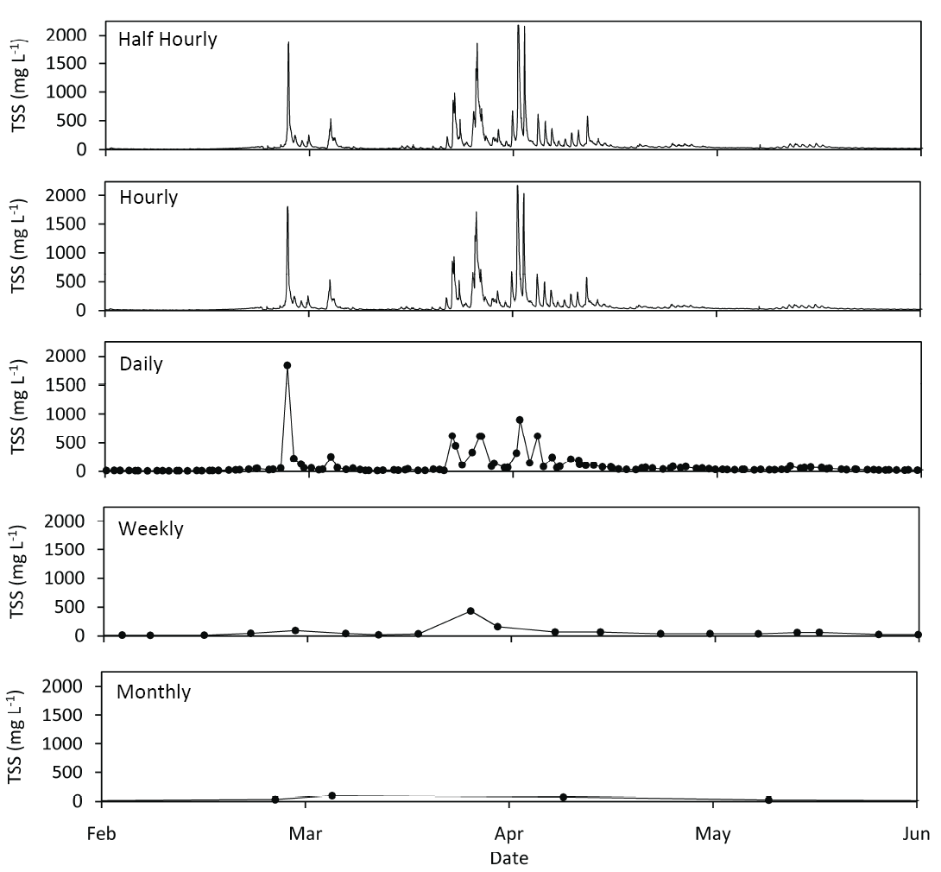
Effects of Sampling Frequency
Spring 2006

Slide 11
Observations Data Model (ODM)
A relational database at the single observation level (atomic model)
Stores observation data made at points
Metadata for unambiguous interpretation
Traceable heritage from raw measurements to usable information
Standard format for data sharing
Cross dimension retrieval and analysis
Streamflow
Groundwater
levels
Precipitation
& Climate
Soil
moisture
Water Quality
Flux tower
data
“When”
Time, T
t
A data value
v_{i} (s,t)
“Where”
s
Space, S
V_{i}
“What”
Variables, V

Slide 12
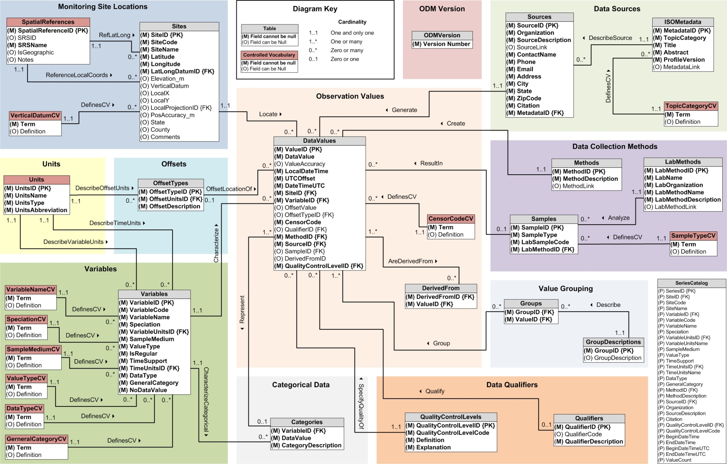
Horsburgh, J. S., D. G. Tarboton, D. R. Maidment and I. Zaslavsky, (2008), A Relational Model for Environmental and Water Resources Data, Water Resources Research, 44: W05406, doi:10.1029/2007WR006392.

Slide 13
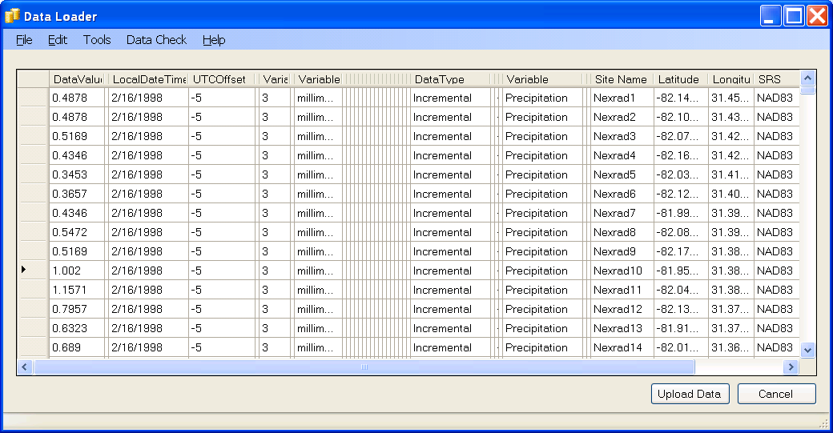
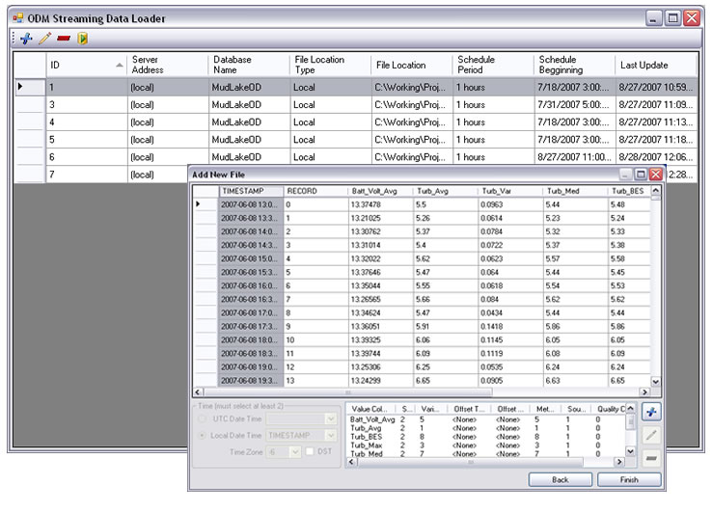
Loading Data Into ODM
Interactive ODM Data Loader
  Loads data from spreadsheets and comma separated tables in simple format
Streaming Data Loader (SDL)
  Loads data from datalogger files on a prescribed schedule.
  Interactive configuration
ODM Data Loader
ODM SDL

Slide 14
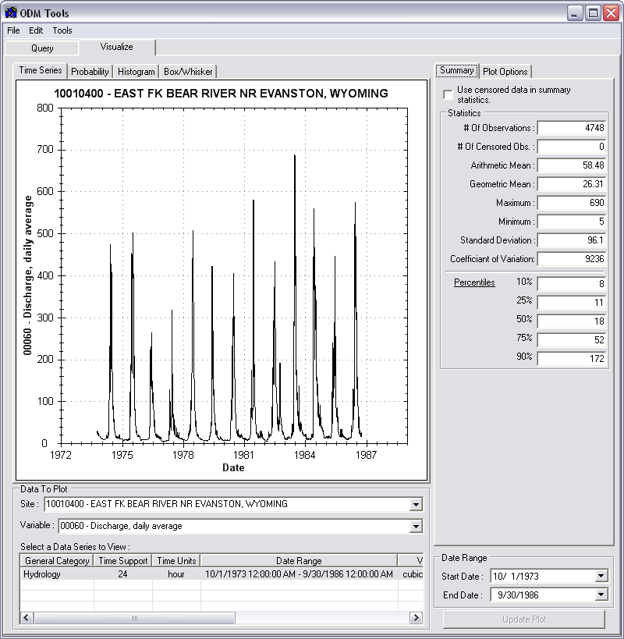
Managing Data Within ODM - ODM Tools
Query and export – export data series and metadata
Visualize – plot and summarize data series
Edit – delete, modify, adjust, interpolate, average, etc.

Slide 15

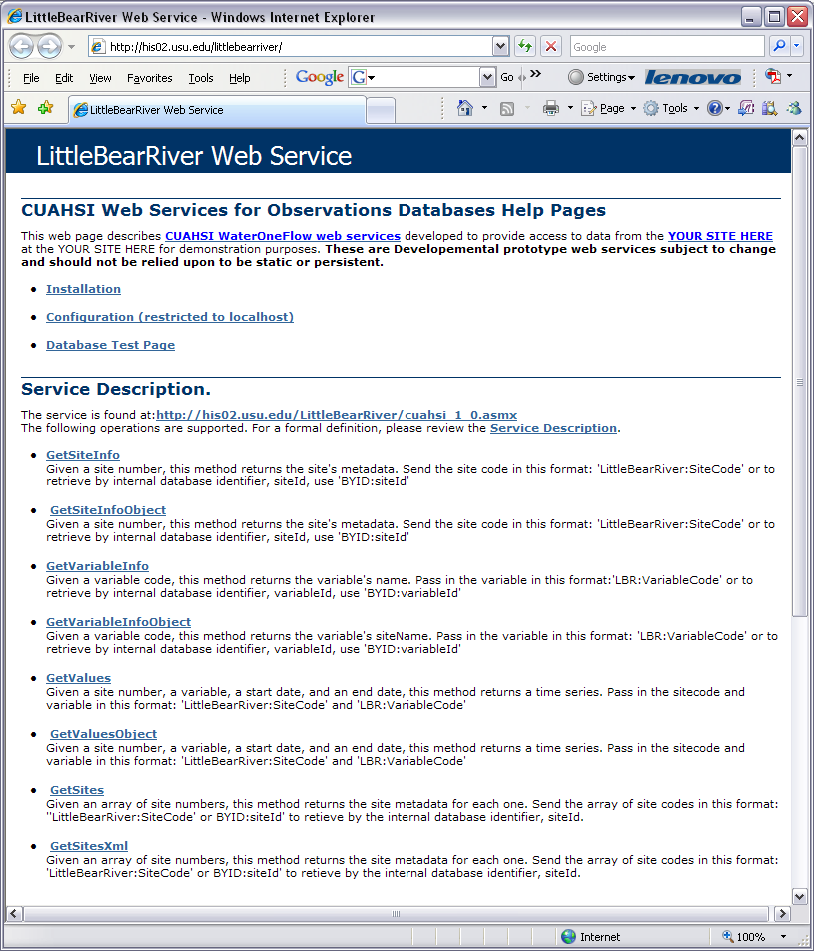
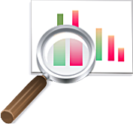
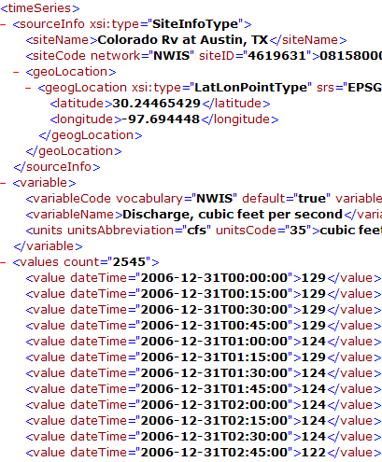
Data Publication
CUAHSI WaterOneFlow Web Services
“Getting the Browser Out of the Way”
GetSites
GetSiteInfo
GetVariableInfo
GetValues
Standard protocols provide platform independent data access
WaterML
SQL
Queries
Data Consumer
ODM
Database
Query
Response
Notes:
First, we have implemented the CUAHSI WaterOneFlow web services for ODM on top of our ODM database. This provides low level, machine access to the data in our ODM database via the web services anywhere an Internet connection is available. This allows users who know how to use the web services to access our data directly in their programming environment of choice (i.e., Visual Basic, Excel/VBA, MatLab, etc.). Additionally, applications that know how to consume the web services can also access our data directly.

Slide 16
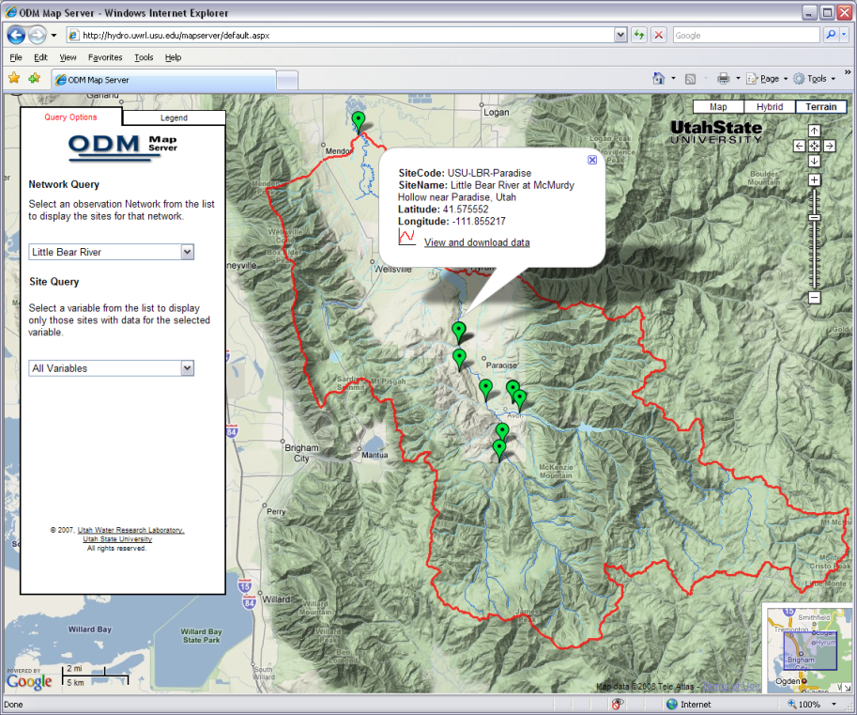
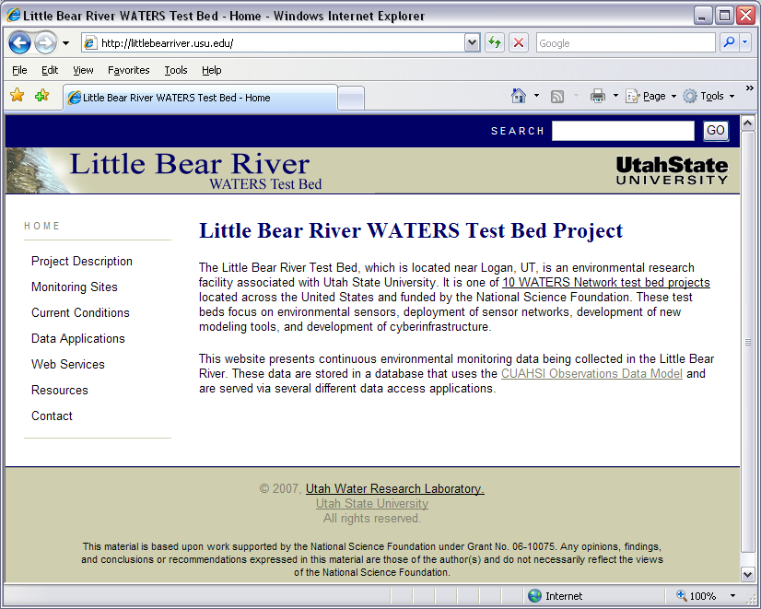
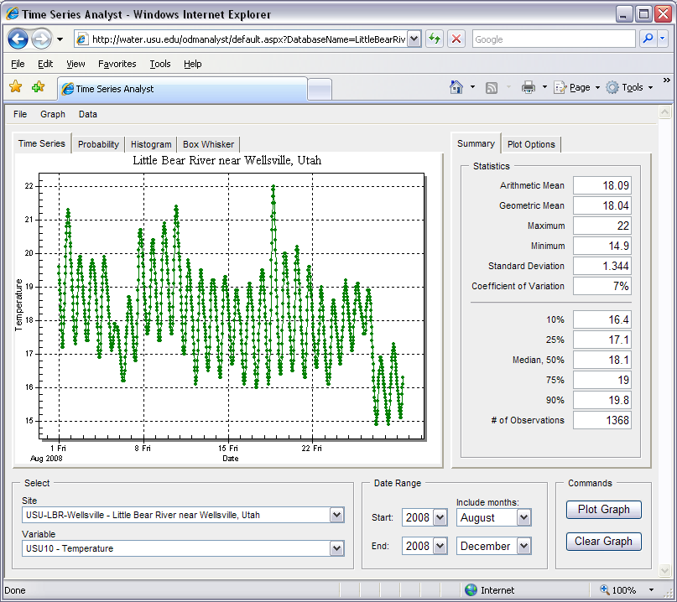
Data Discovery, Visualization, and Analysis
http://littlebearriver.usu.edu
Open and free distribution of the data via simple to use, Internet-based tools
Extending the reach of the data to less technical users

Slide 17

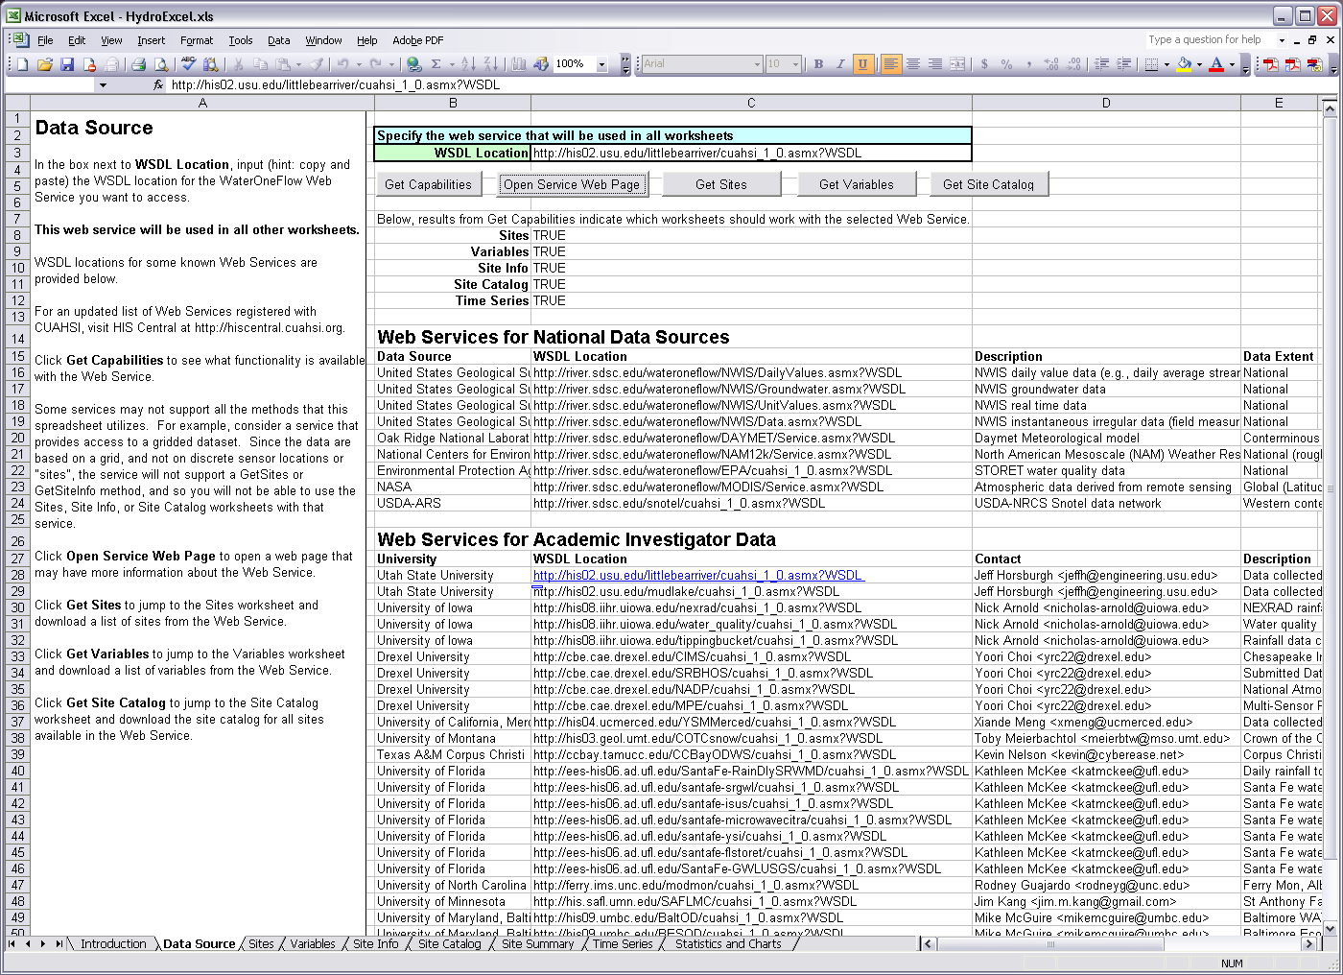
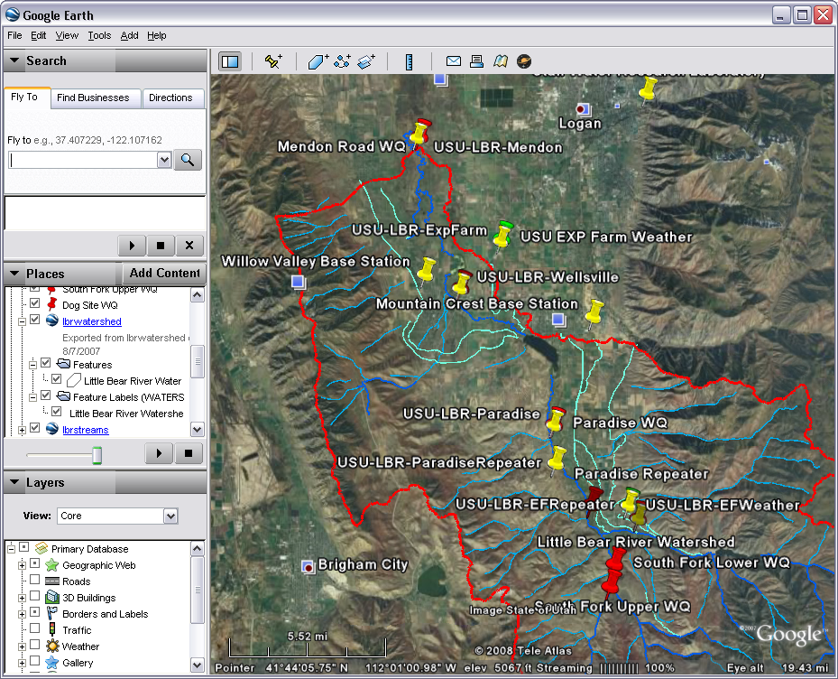
Direct analysis from your favorite analysis environment - e.g., Excel, MATLAB

Slide 18
Summary
Common data-related failure in research and management
  Monitoring data are never made widely available, analyzed, or synthesized
CUAHSI HIS (and other tools) - Enabling Technology supporting science and management
  Tools for creating a shared information system available to all stakeholders
  Available software lowers barrier to data sharing and publication
  Web based data access - any time, any where, and sometimes in real time
  Getting the right data to the right people

Slide 19


Questions?
CUAHSI
HIS
Sharing hydrologic data
http://his.cuahsi.org/
Support
EAR 0622374
CBET 0610075

