Slide 1
HydroServer A Platform for Publishing Space-Time Hydrologic Datasets
CUAHSI
HIS
Sharing hydrologic data
http://his.cuahsi.org/
Jeffery S. Horsburgh
David G. Tarboton, Kimberly A. T. Schreuders, David R. Maidment, Ilya Zaslavsky, and David Valentine
Support
EAR 0622374

Slide 2
CUAHSI HIS
The CUAHSI Hydrologic Information System (HIS) is an internet based system to support the sharing of hydrologic data. It is comprised of hydrologic databases and servers connected through web services as well as software for data publication, discovery and access.
Data Discovery and Integration platform
HIS Central
Like search portals Google, Yahoo, Bing
Metadata Services
Metadata Search
Service registration
Service and data theme metadata
Catalog harvesting
Data carts
HydroServer
Data Services
HydroDesktop
Data Publication platform
Water Data Services
Data Synthesis and Research platform
Spatial Data Services
Like web servers
Like HTML
Like browsers

Slide 3
HydroServer Goals
A platform for publishing space-time hydrologic datasets that:
Provides local control of data
Makes data universally available
Is autonomous
HydroServer should be functional independent of the rest of HIS
Texas Hydrologic Information System
INRA Constellation of Experimental Watersheds

Slide 4
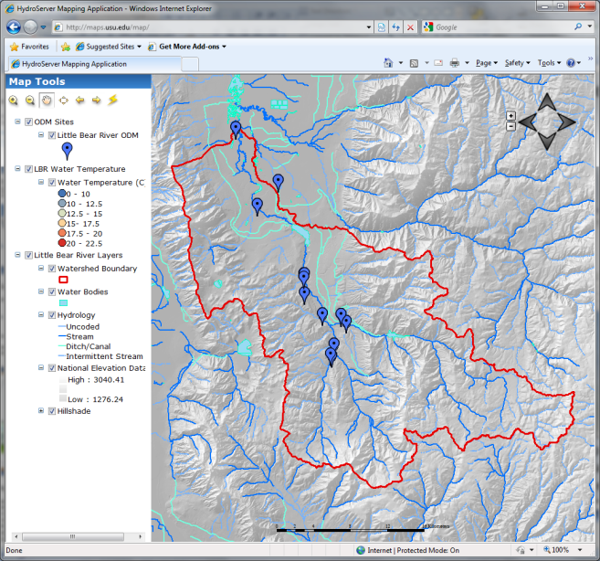
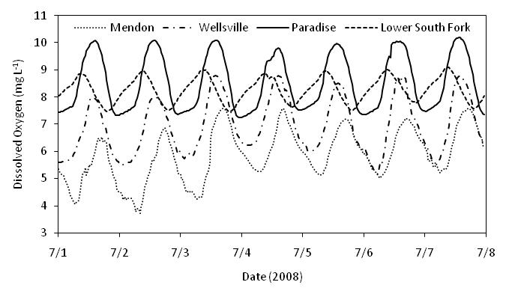
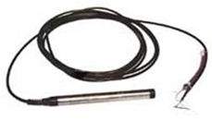
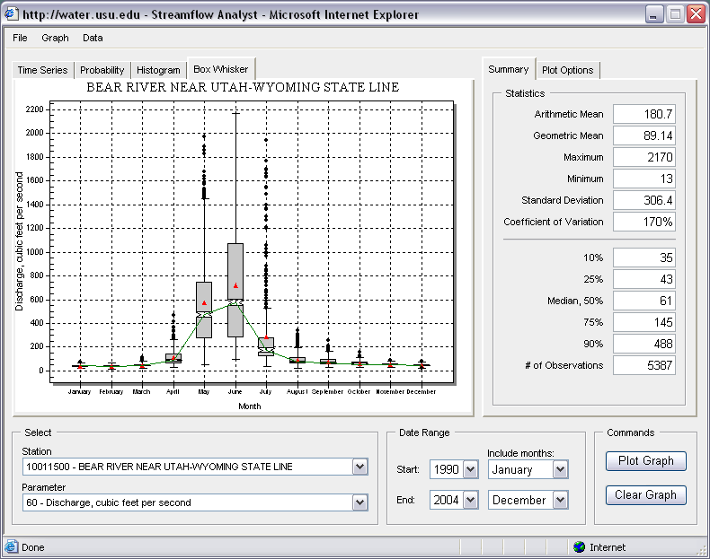
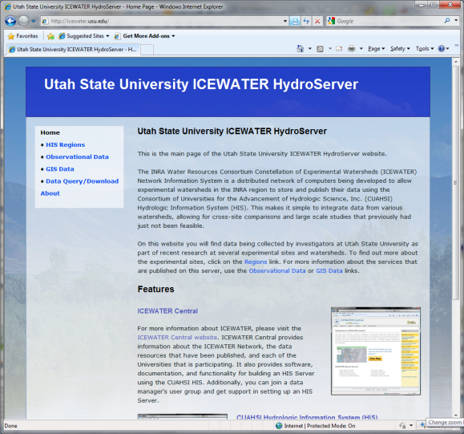
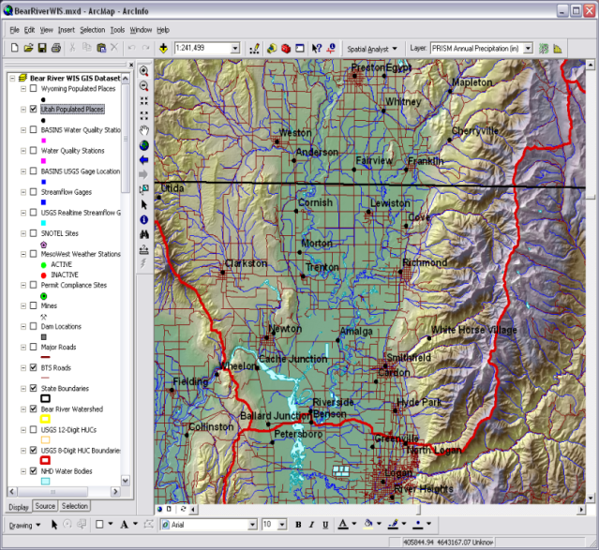
Point Observations Data
Internet Applications
Ongoing Data Collection
Historical Data Files
ODM Database
GetSites
GetSiteInfo
GetVariableInfo
GetValues
GIS Data
WaterML
WaterOneFlow
Web Service
Data presentation, visualization, and analysis through Internet enabled applications
HydroServer

Slide 5
HydroServer Regions
A region is an experimental watershed, research site, etc. for which data are published
Little Bear River Experimental Watershed
Reynolds Creek Experimental Watershed
T.W. Daniels Experimental Forest
Organizing concept for HydroServer
One or more ODM databases/WaterOneFlow services for a region
One or more spatial data services for a region

Slide 6
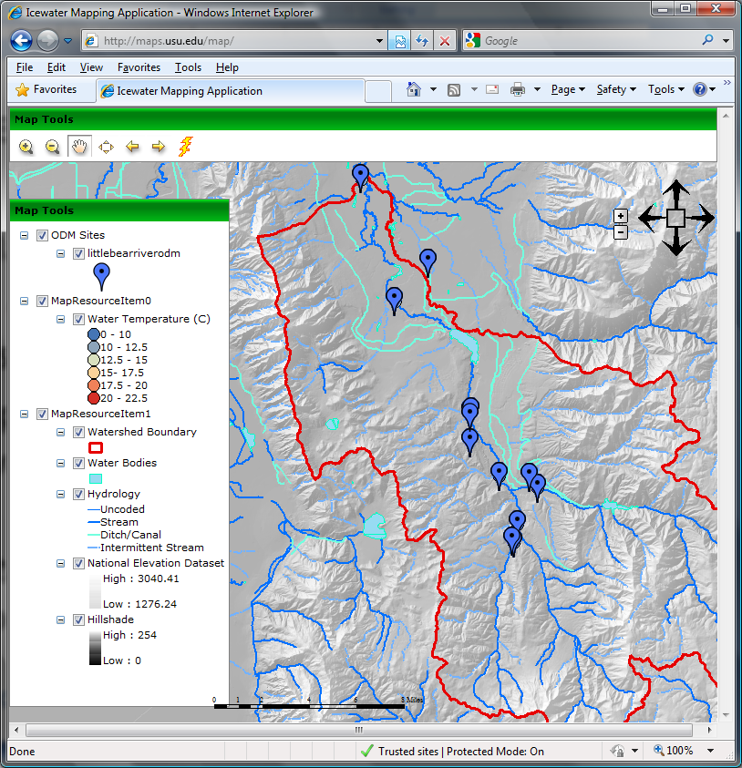
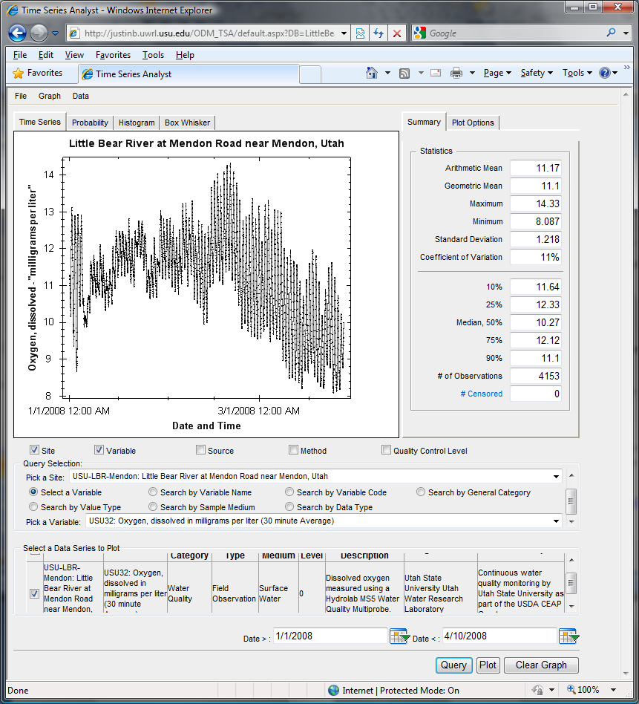
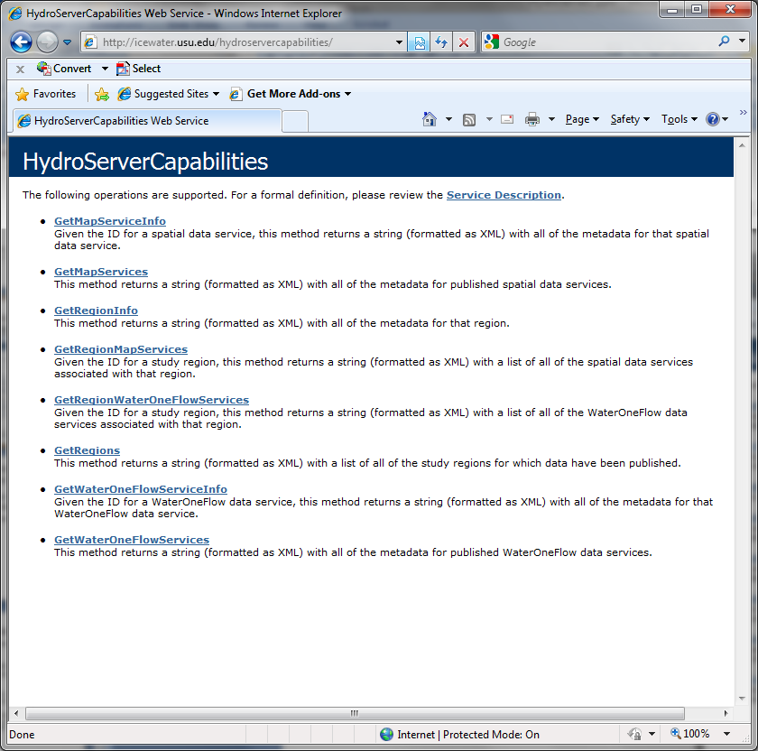
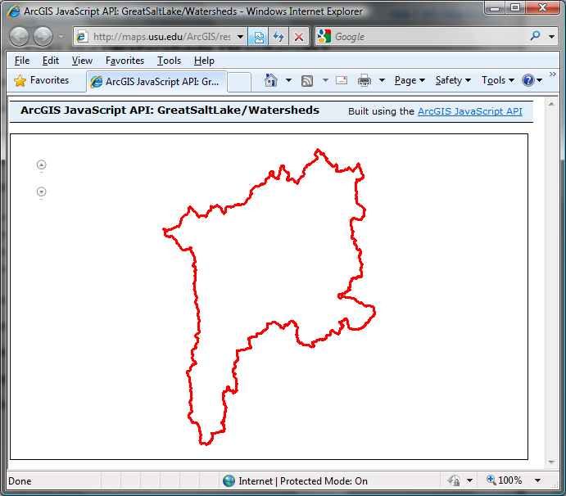
Capabilities Database Configuration Tool
WaterOneFlow
Services
HydroServer
Capabilities
Database
Spatial
Services
WaterOneFlow
WaterOneFlow
WaterOneFlow
ODM
ODM
ODM
ODM Databases and Web Services
ArcGIS Server Spatial Data Services

Slide 7
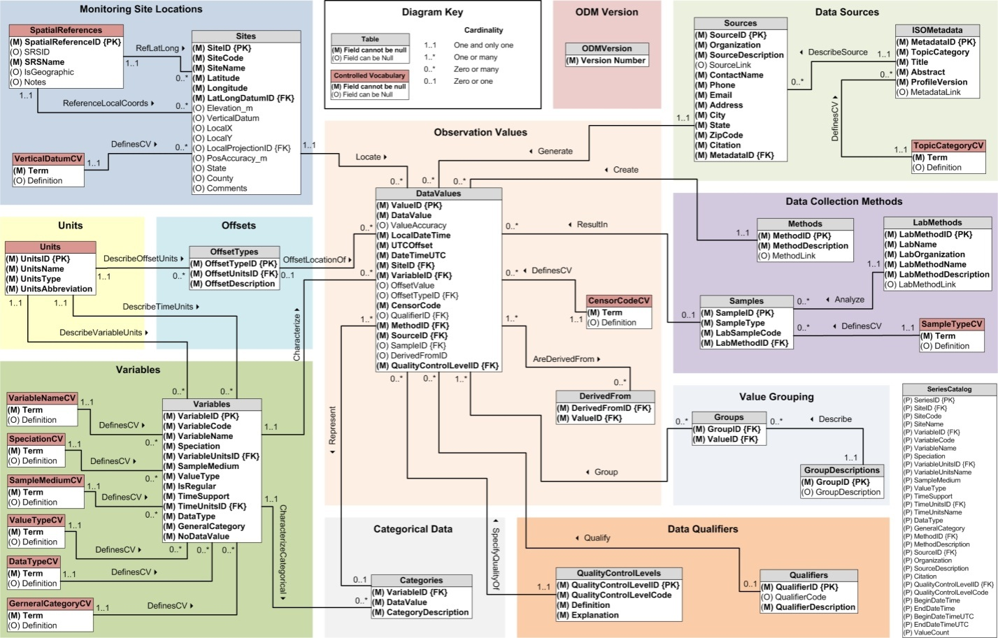
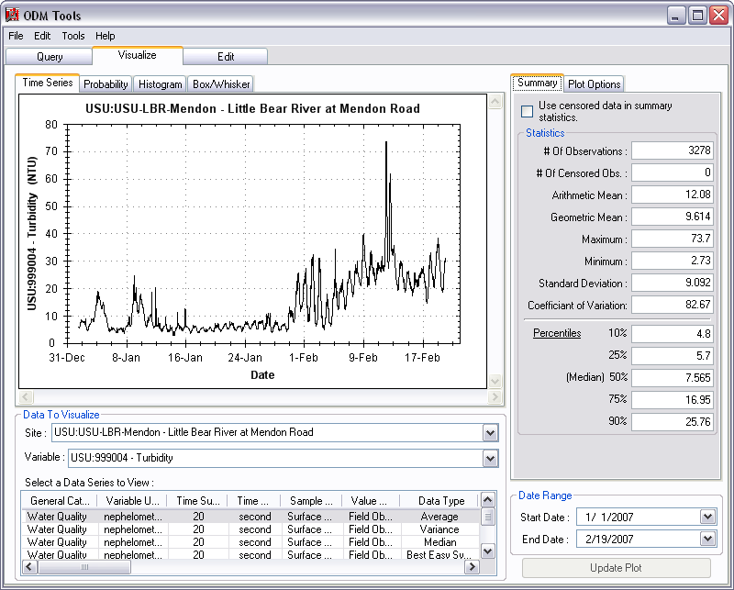
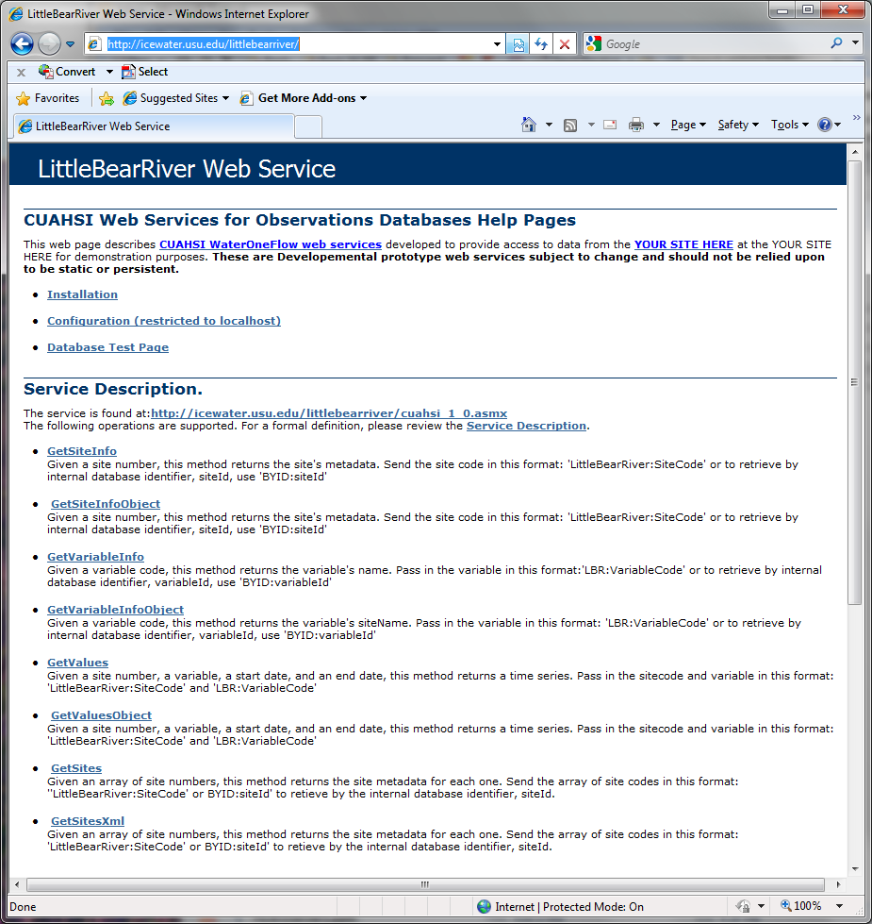
Publication of Point Observations
Observations Data Model (ODM)
ODM Tools
ODM Data Loader
ODM Streaming Data Loader
ODM Controlled Vocabularies
WaterOneFlow web services
Data are transmitted in WaterML format

Slide 8
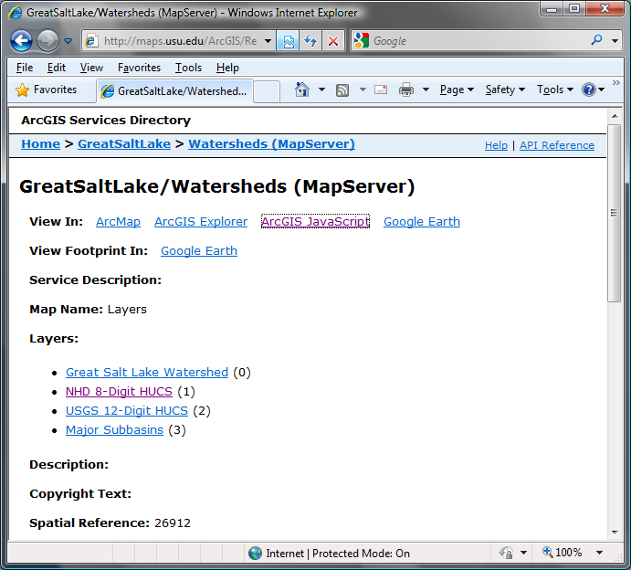
Publication of Spatial (GIS) Datasets
Publishing spatial datasets using ArcGIS Server
Using OGC standards that can be consumed by a number of GIS clients
WMS, WFS, WCS

Slide 9
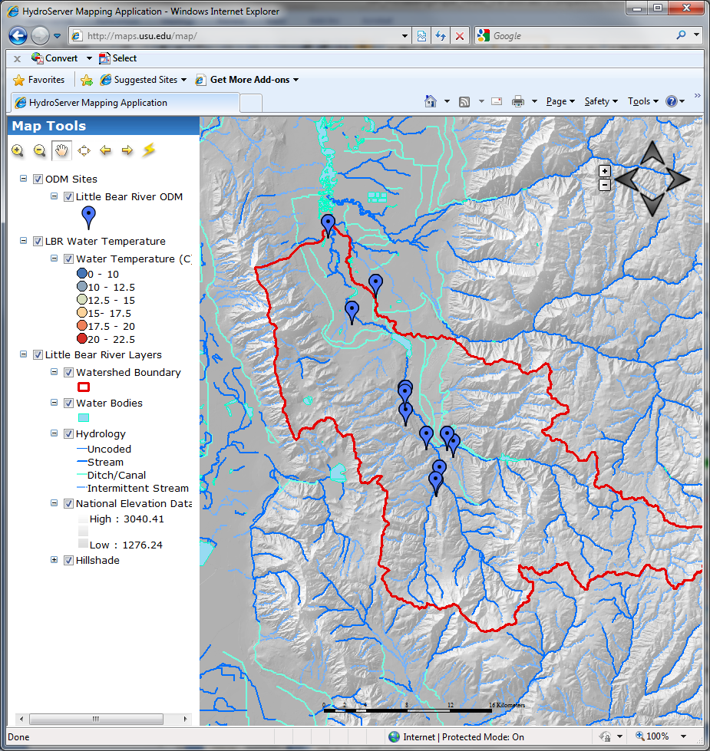
Data Presentation Via a Map Interface
Internet Map Server built using ArcGIS
Web browser client
Combine spatial data and observational data
Launch data visualization tools
Based on a “Region”
http://maps.usu.edu/map/

Slide 10
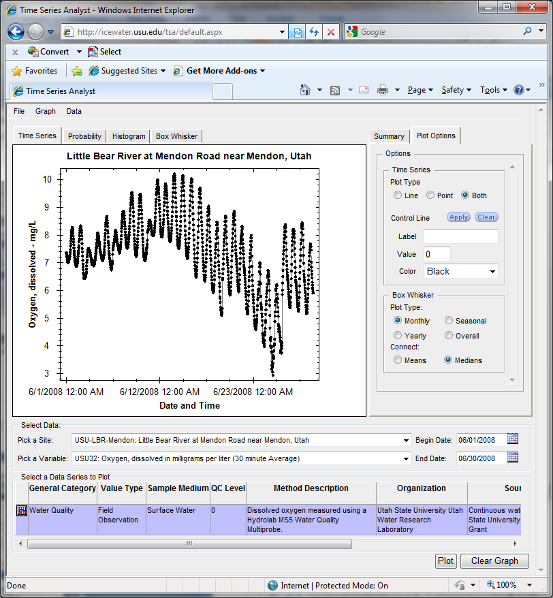
Data Preview, Visualization, and Analysis Time Series Analyst
Web Browser Client
Multiple ODM Database Support
Variety of plot types
Descriptive statistics
Linked to the map application
Data preview and download
http://icewater.usu.edu/tsa/

Slide 11
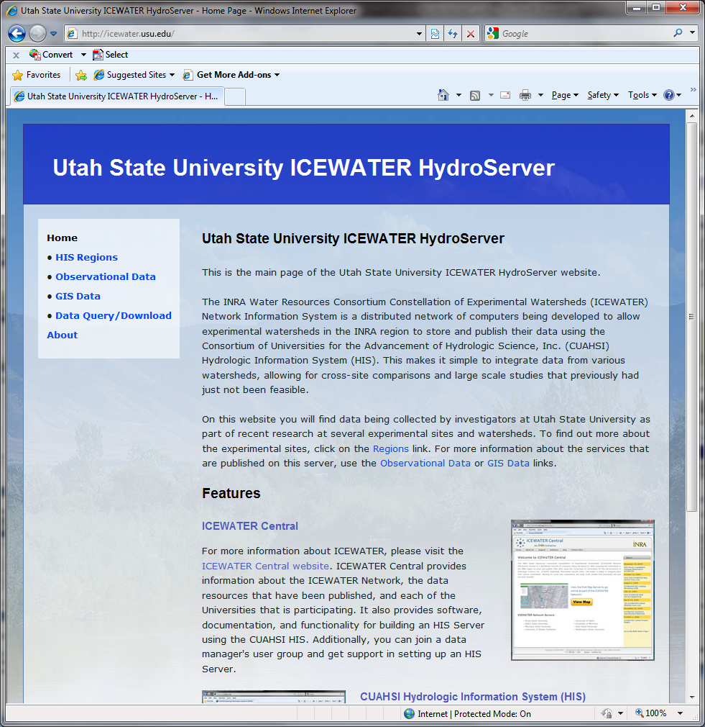
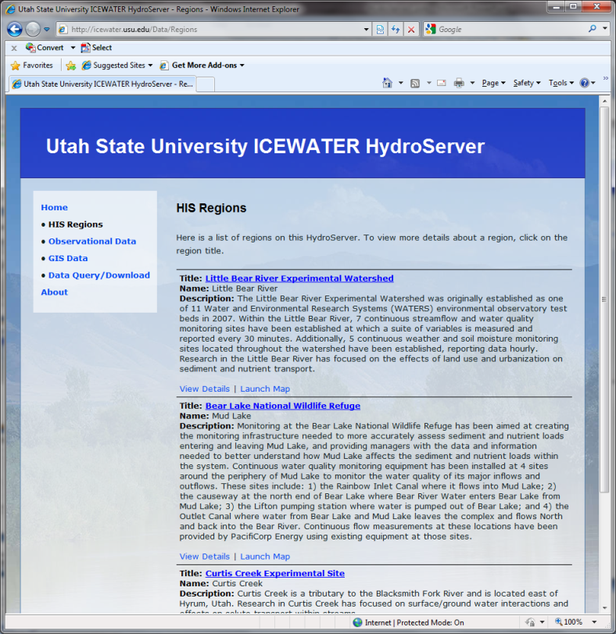
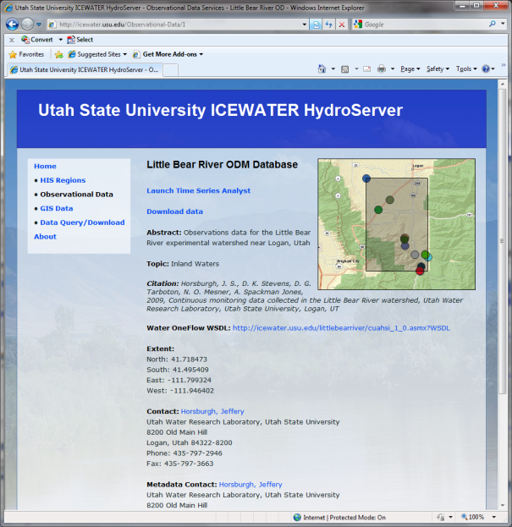
HydroServer Website
HydroServer home page
Observational data services
GIS data services
Online map
Time Series Analyst
Data Query and Download
http://icewater.usu.edu

Slide 12
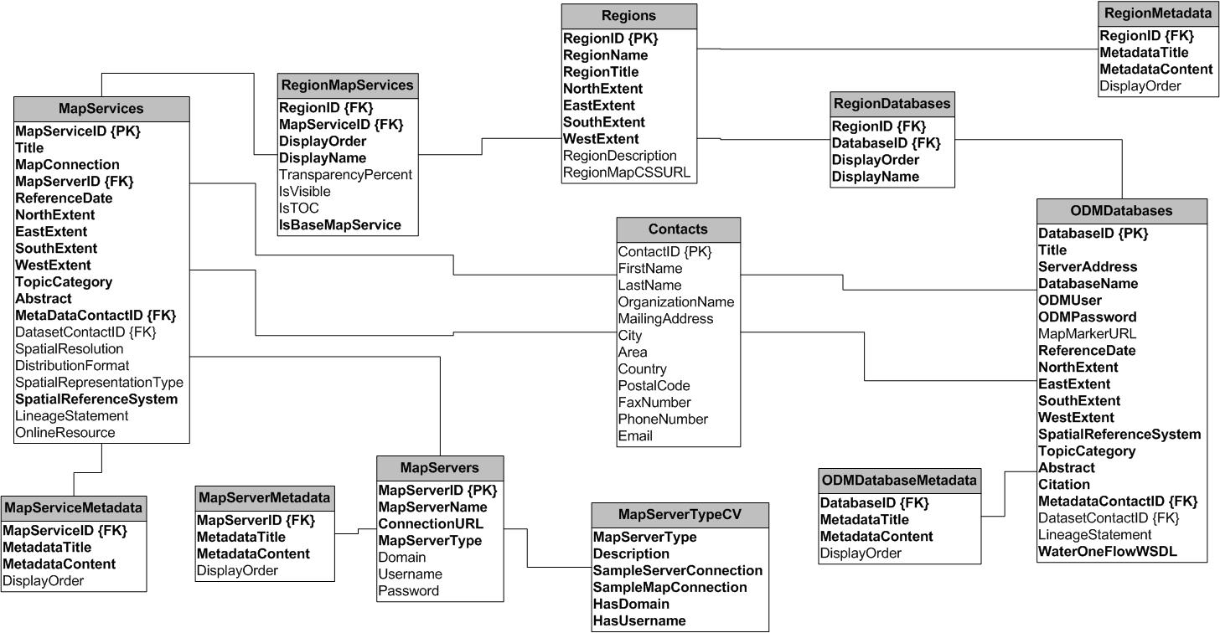
HydroServer Capabilities Database
HydroServer Capabilities Database Configuration Tool
Simple Windows application for creating metadata records in your database
Associating Regions with services and maps

Slide 13
HydroServer Capabilities Web Service
Publish capabilities of each HydroServer
Published observational data services
Published spatial data services
Information transmitted in XML format
Supports automatic cataloging of available services at HIS Central
Makes HydroServers self describing

Slide 14
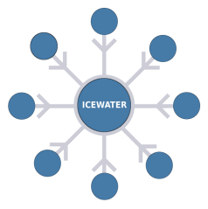
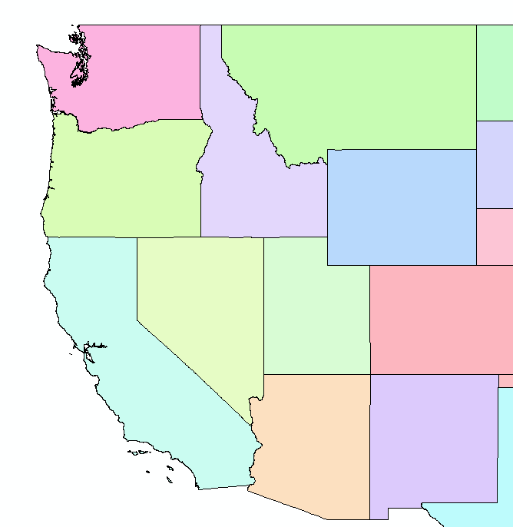
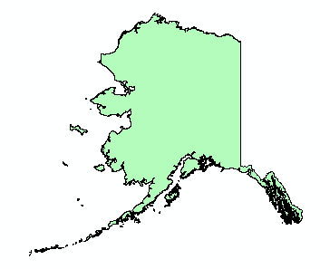
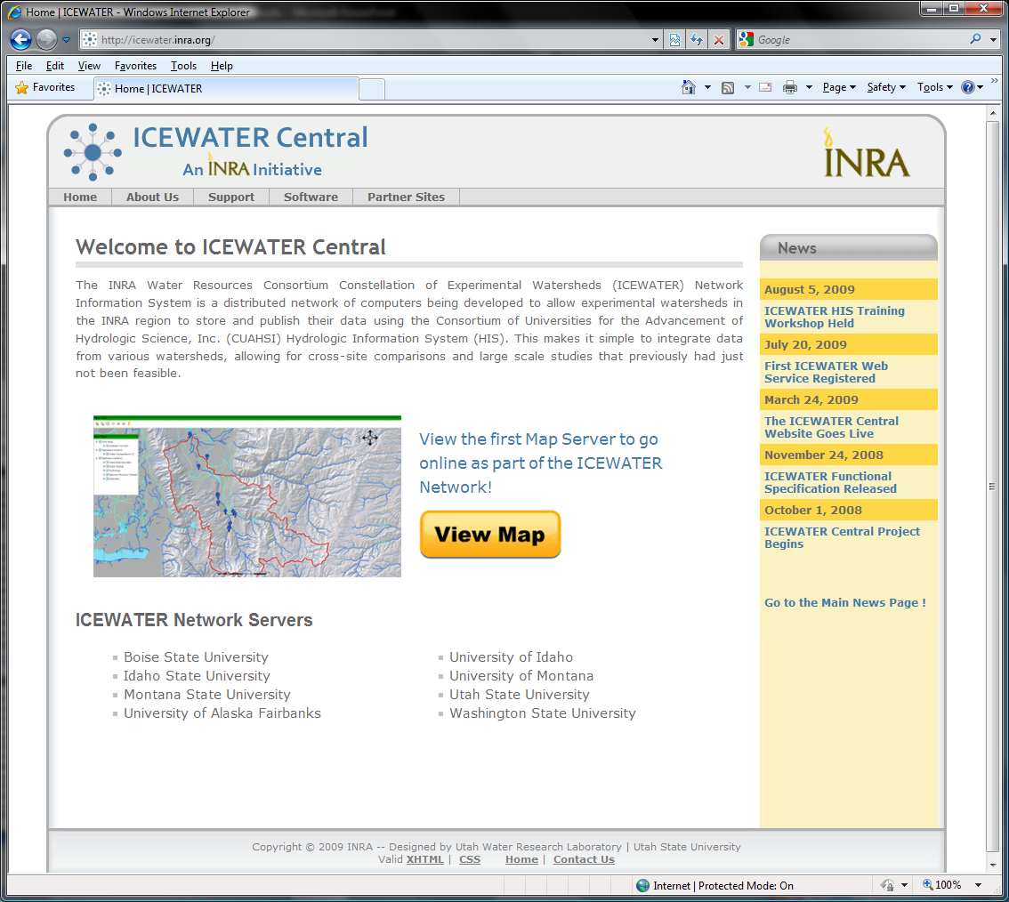
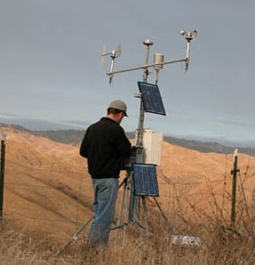
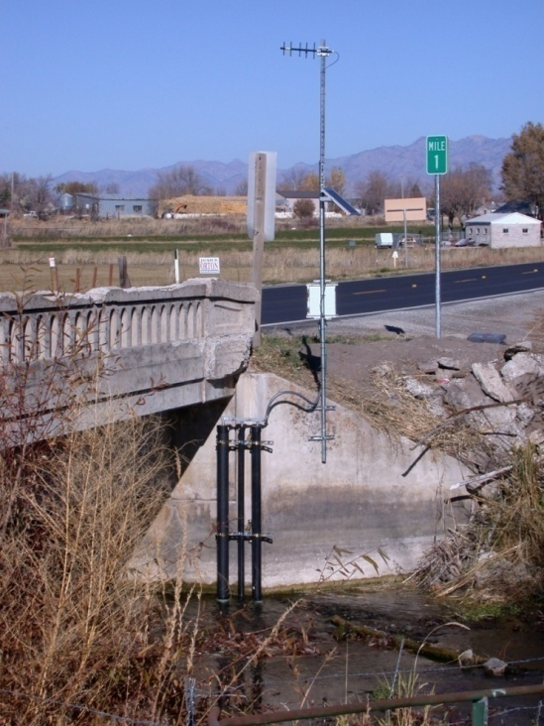
ICEWATER – A Regional HIS
ICEWATER – INRA Constellation of Experimental WATERsheds
Coalition of 8 universities
Point Observations
Stream gages
Water quality sampling
Weather stations
Soil moisture
Snow monitoring
Groundwater level/quality
Spatially Distributed Data
Land use/cover
Terrain
Hydrography
WA
MT
OR
ID
WY
AK
NV
UT
CO
CA
AZ
NM
http://icewater.inra.org

Slide 15
Conclusions
HydroServer provides a self contained autonomous data publication system
Local control of data
Downloadable user (data publisher) configurable software stack that contains:
ODM and associated tools
WaterOneFlow web services
Geographic data sharing using WFS, WCS, WMS from ArcGIS server
Time Series Analyst
ArcGIS server based web map application
HydroServer Capabilities web service that publishes metadata about regions and services (observational and spatial)

Slide 16
How do I Create a HydroServer?
Get a Windows Server Machine with IIS and .Net Framework
Install Microsoft SQL Server
Install HydroServer Software from his.cuahsi.org
ODM and Utilities
WaterOneFlow web services
HydroServer Website, TSA, Map, Capabilities
Install ArcGIS
Create Services and Document them in Capabilities database
Register Services With HIS Central and register variables with the Ontology

Slide 17
HydroServer Future Considerations
Security and Data Access Control
More generic data model
Flexibility in attributes
Moving platforms
Additional data types
Tighter integration with Hydrologic Ontology
Enhanced spatial data sharing
What features and functionality does HydroServer need to better serve the community?

Slide 18
Questions?
CUAHSI
HIS
Sharing hydrologic data
http://his.cuahsi.org/
Support
EAR 0622374

