Slide 1
Adventures in Monitoring: maintaining sensor networks and managing the flood of data
Amber Spackman Jones
Jeffery S. Horsburgh

Slide 2
Research Objectives
Design observing infrastructure to enable high frequency estimates of constituent fluxes using surrogates.
Use high frequency discharge and turbidity to better quantify TSS and TP fluxes.
Use high frequency sensor data at multiple sites to improve understanding of hydrology and water quality.
Notes:
We’ve been conducting research on the Little Bear River for several years now
The focus of our work has been:

Slide 3
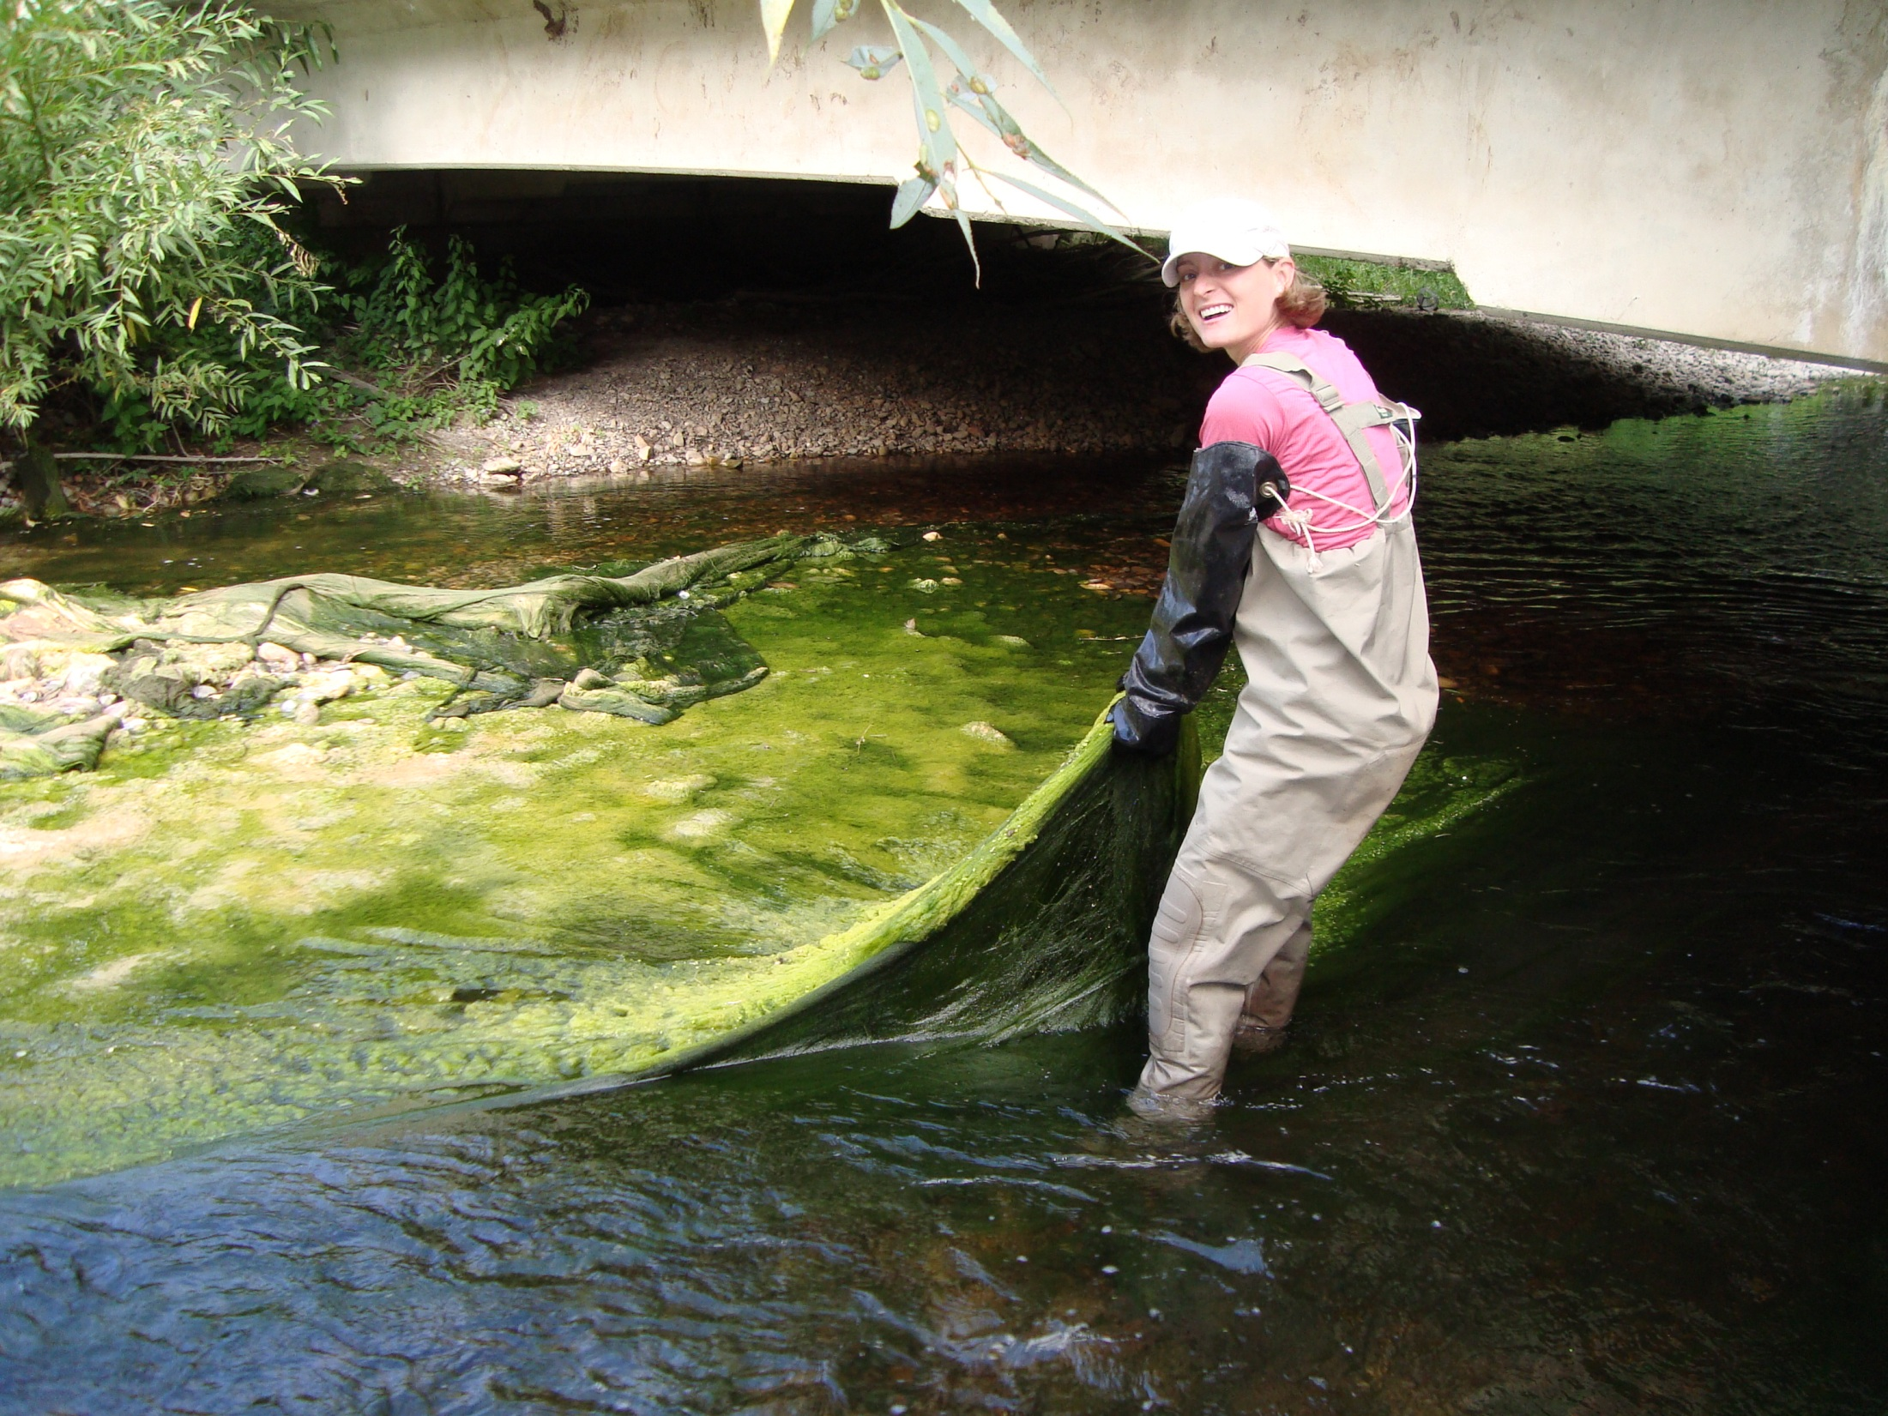
Little Bear River
Water Quality Issues: Nutrients (primarily P) Sediment

Slide 4
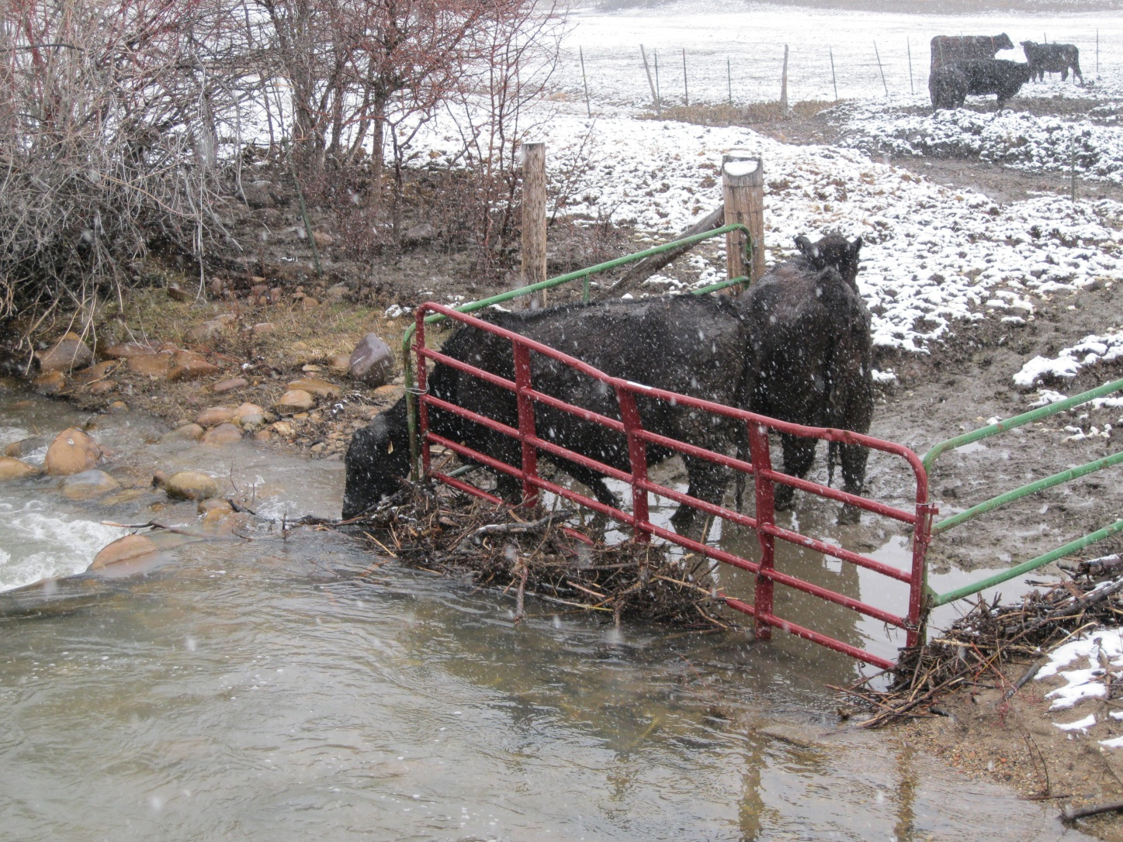
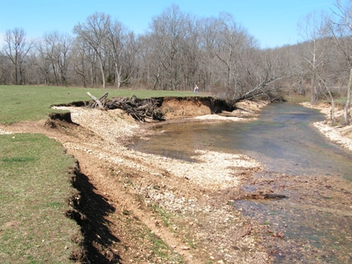
Little Bear River
Pollution Sources: Agriculture Wastewater Treatment
Notes:
P sources include fertilized fields, animal waste, WWTP and p-rich soils

Slide 5
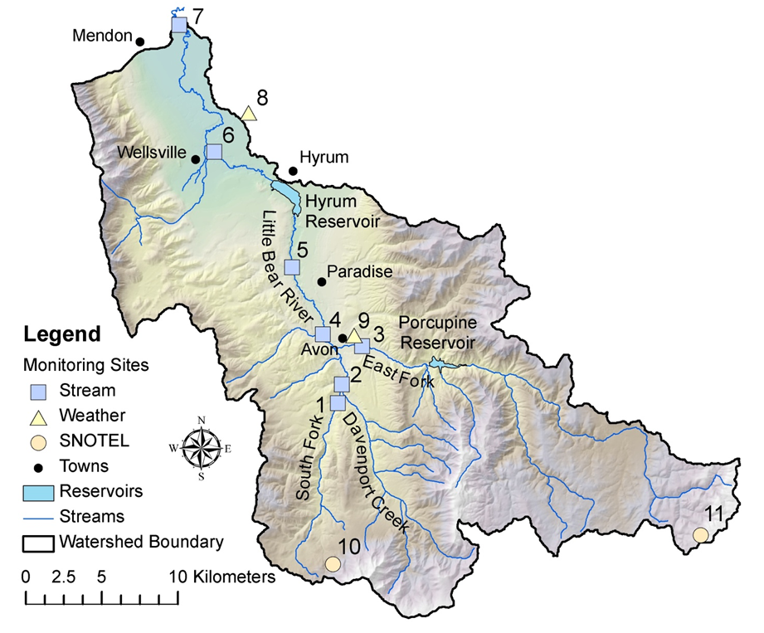
Little Bear River Sensor Network
7 water quality and streamflow monitoring sites
Temperature
Dissolved Oxygen
pH
Specific Conductance
Turbidity
Water level/discharge
4 weather stations
Temperature
Relative Humidity
Solar Radiation
Precipitation
Barometric Pressure
Wind speed and direction
Snow Depth
Notes:
In order to look at water quality at high temporal and spatial resolutions, established a network of sensors in the watershed.
-Semi-arid watershed, snowmelt driven
-Upper watershed drains higher elev forest and range lands
-Lower watershed drains lower gradient ag land and includes some small towns
-740 km2, 430-1000 mm prec/year, Q= 0.5-12 m3/s in upper watershed

Slide 6
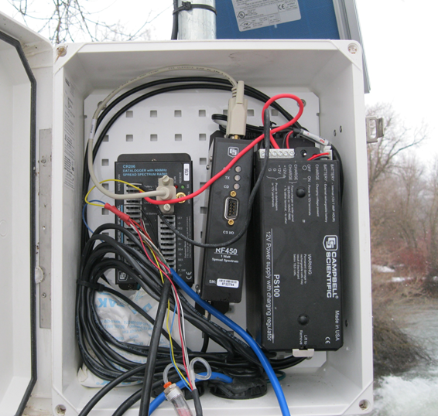
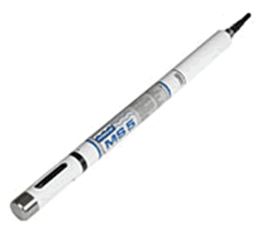
Sensor Technology
Monitor at high frequency
Monitor in real time
Monitor for extended time periods
Sensors aren’t stand alone… supporting infrastructure required!

Slide 7
The Data Deluge
5 years of half hourly data = 70,000 observations
x 7 sites = 490,000 observations
x 10 variables/site = 4,900,000 observations
+ different versions of the data (provisional and verified) = 9,800,000 observations
+ 4 weather stations with 10 variables =12,600,000 observations
+ derived data …
Some infrastructure is necessary to manage and disseminate the data!
Notes:
As sensors make measurements… results in a deluge of data.

Slide 8
Horsburgh, J. S., A. Spackman Jones, D. G. Tarboton, D. K. Stevens, and N. O. Mesner (2010), A sensor network for high frequency estimation of water quality constituent fluxes using surrogates, Environmental Modelling & Software, 25, 1031-1044, doi:10.1016/j.envsoft.2009.10.012.
Notes:
Tiers 1 and 2: Observing Infrastructure
Tier 3: Cyberinfrastructure
Some overlap between the two

Slide 9
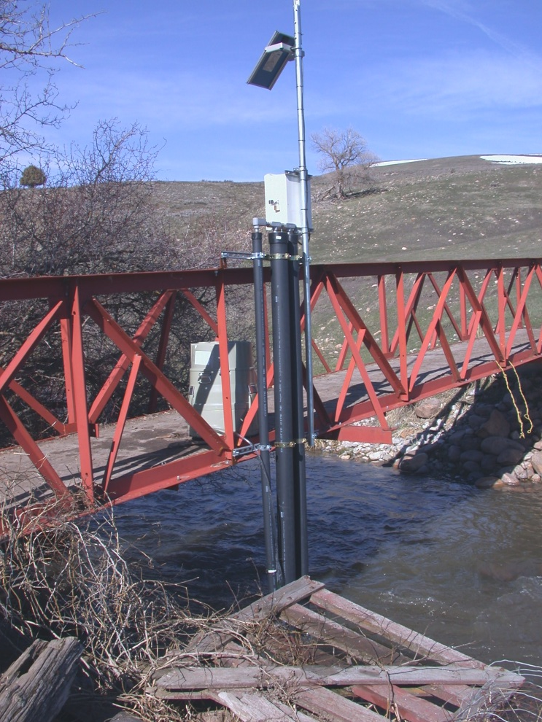
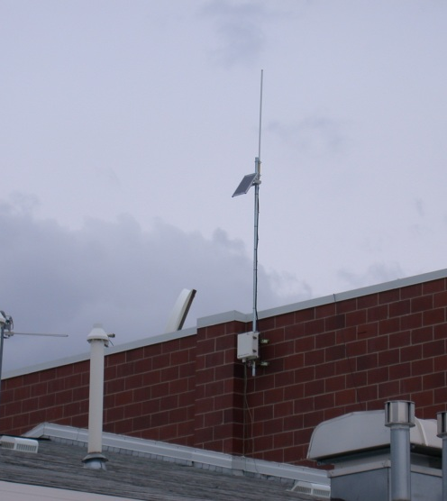
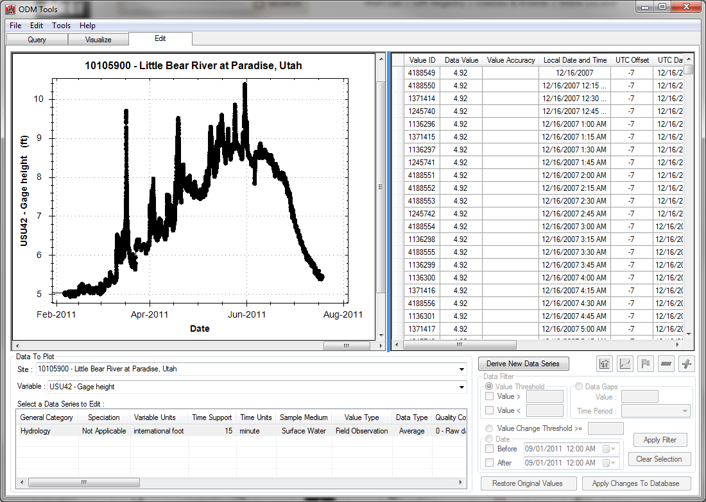
Infrastructure
Observing Infrastructure:
Physical Challenges: site locations, sensor deployment
Dataloggers
Power supply
Communications and Telemetry
Cyberinfrastructure:
Storing data
Accessing data
Sharing data

Slide 10
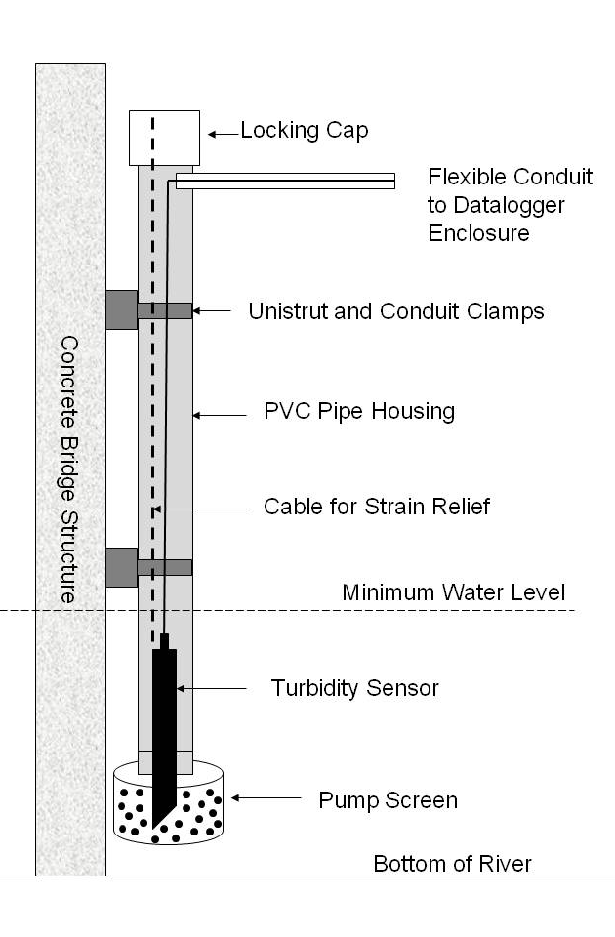
Sensor Deployment
How do we deploy sensors to be
Representative
Secure
Every site is different
Can constrain network design
Considerations:
Access: permission, year-long, etc.
Suitable cross-section
What telemetry options will work?
What power options will work?
How will the sensor be deployed?
Notes:
-sometimes the right sites for the science aren’t accessible
-detailed scoping is required

Slide 11
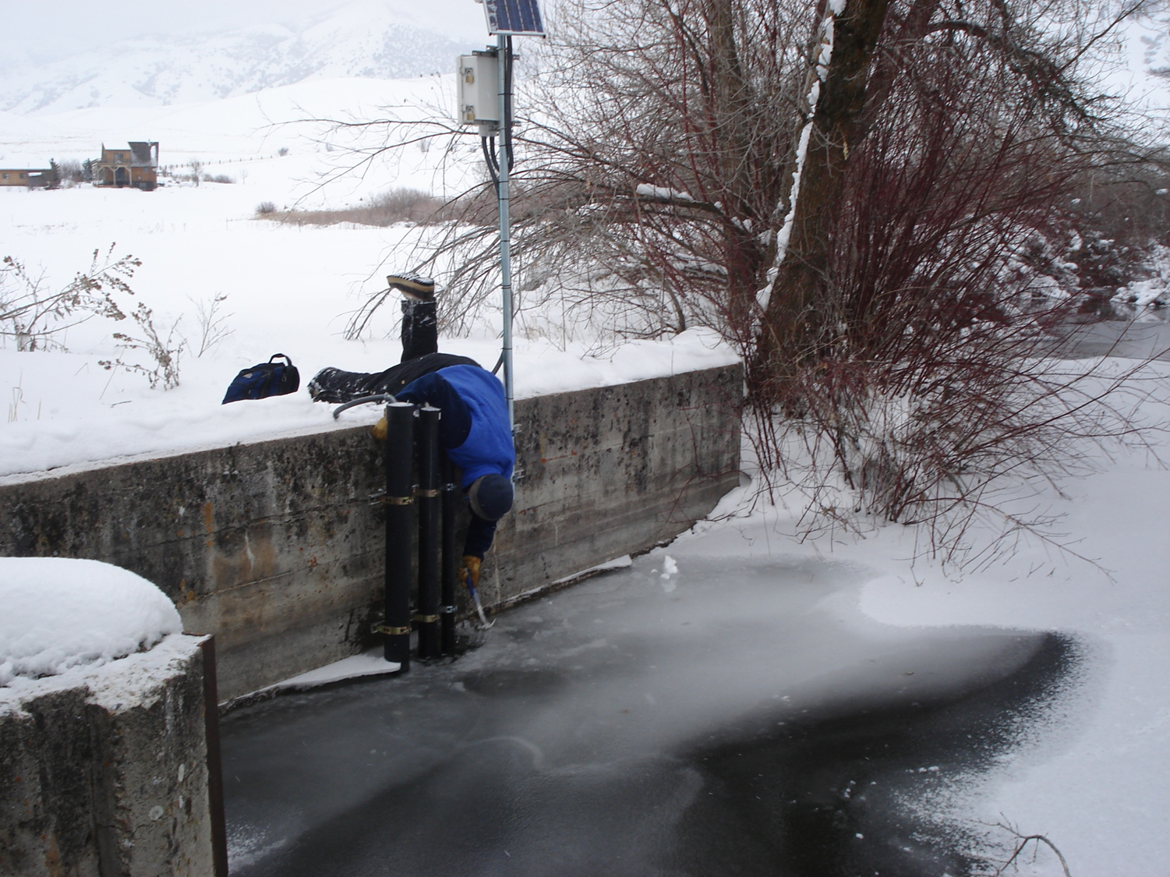
Notes:
Even though we spent a year in selecting sites, determining access, getting permission, determining configuration… have issues.

Slide 12
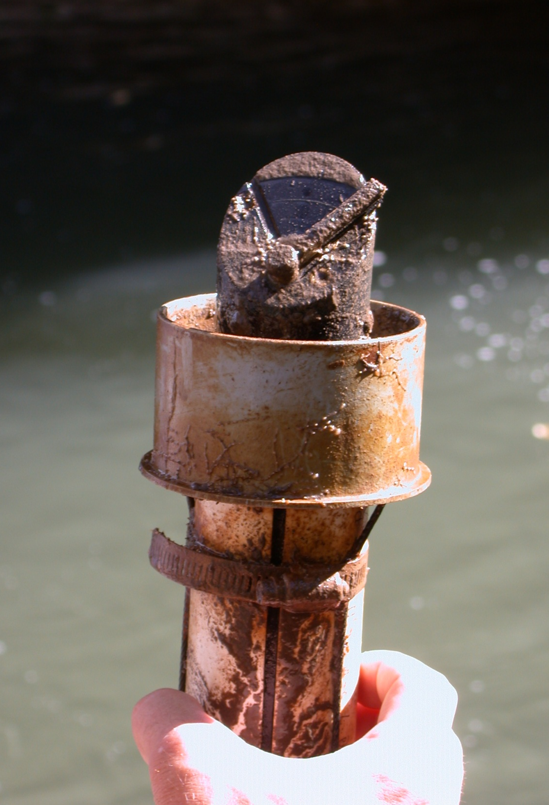
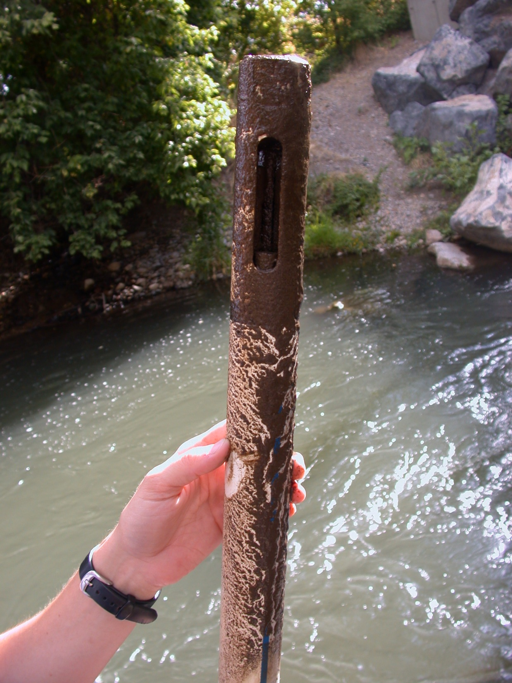

Slide 13
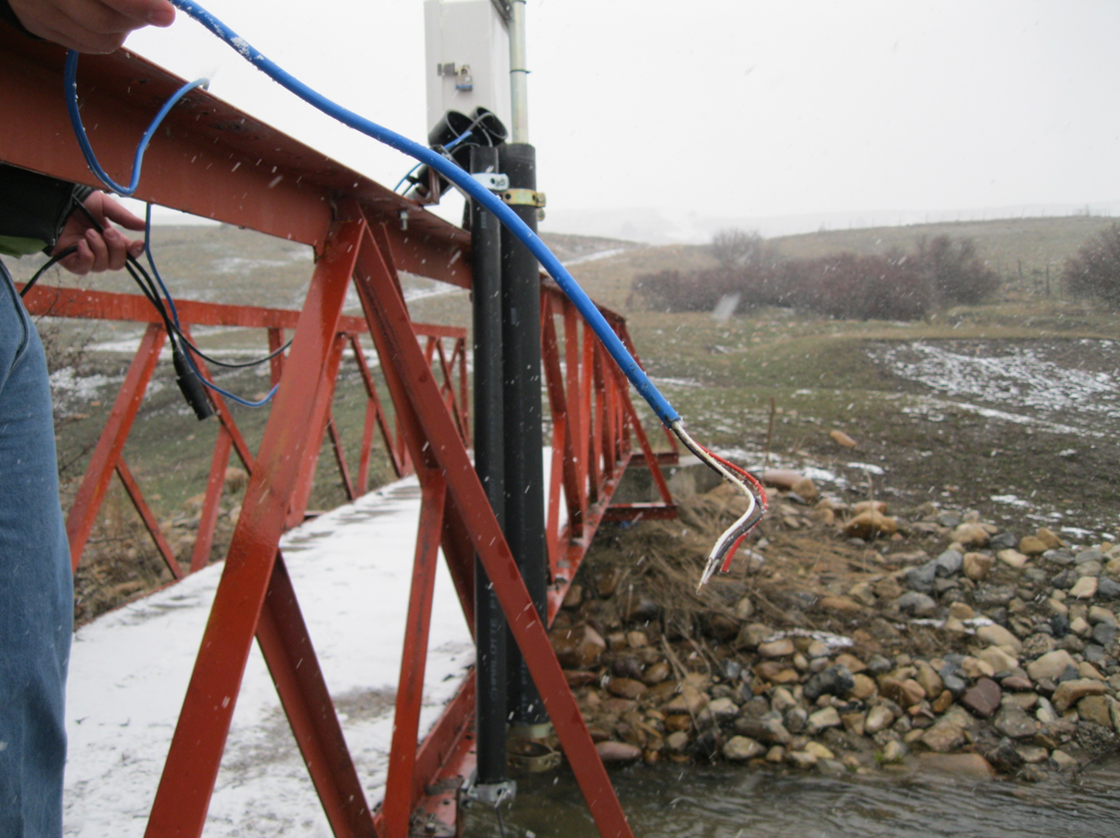
Turbidity sensor used to be right here!

Slide 14
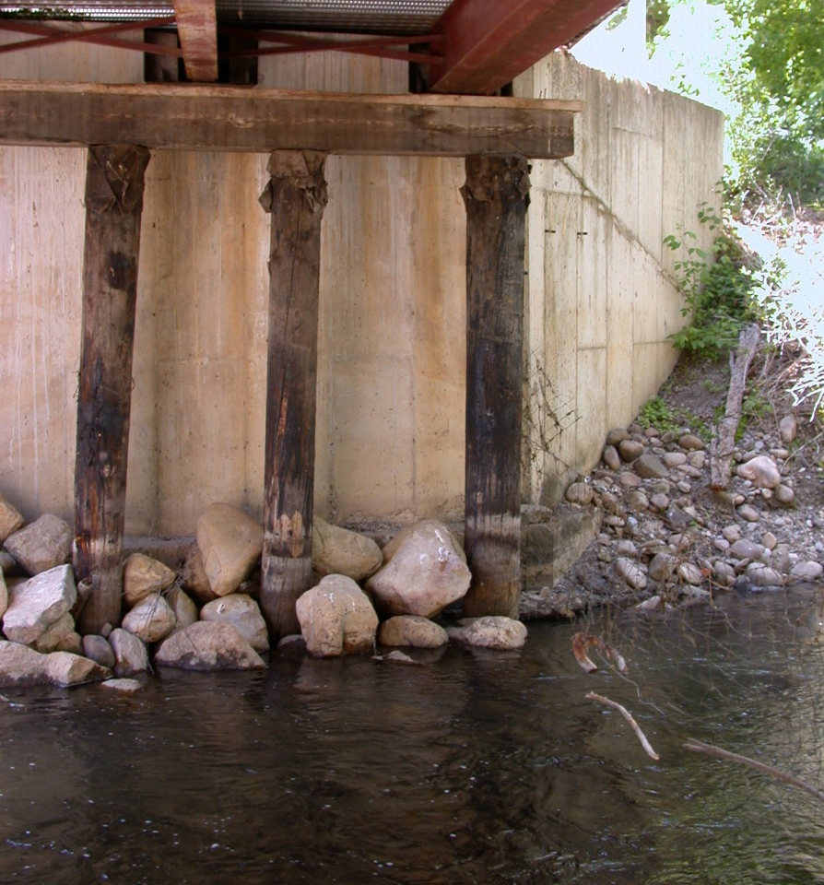
Before
After

Slide 15
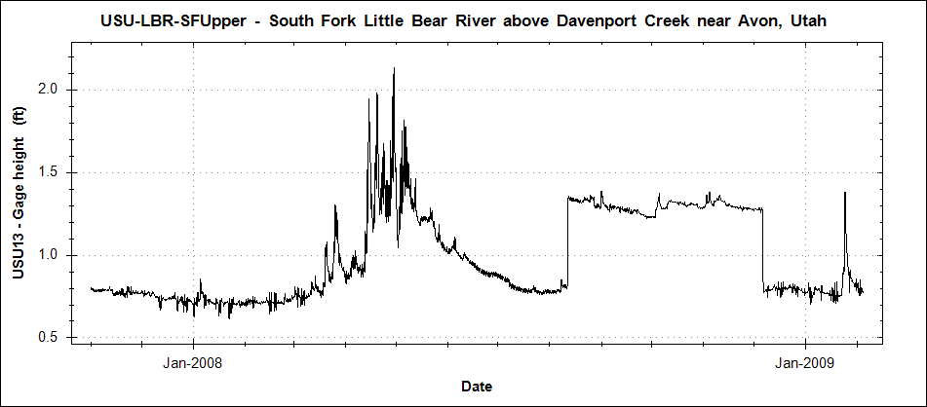
Human Challenges
Farmer drives backhoe into river on neighbor’s property and builds dam for his diversion structure.
Lawyers get involved. Farmer pays for new diversion structure and removes dam.

Slide 16
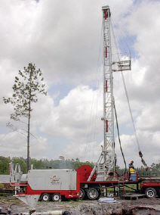
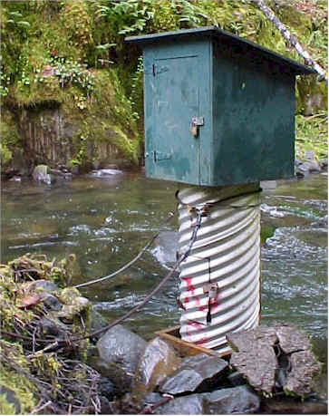
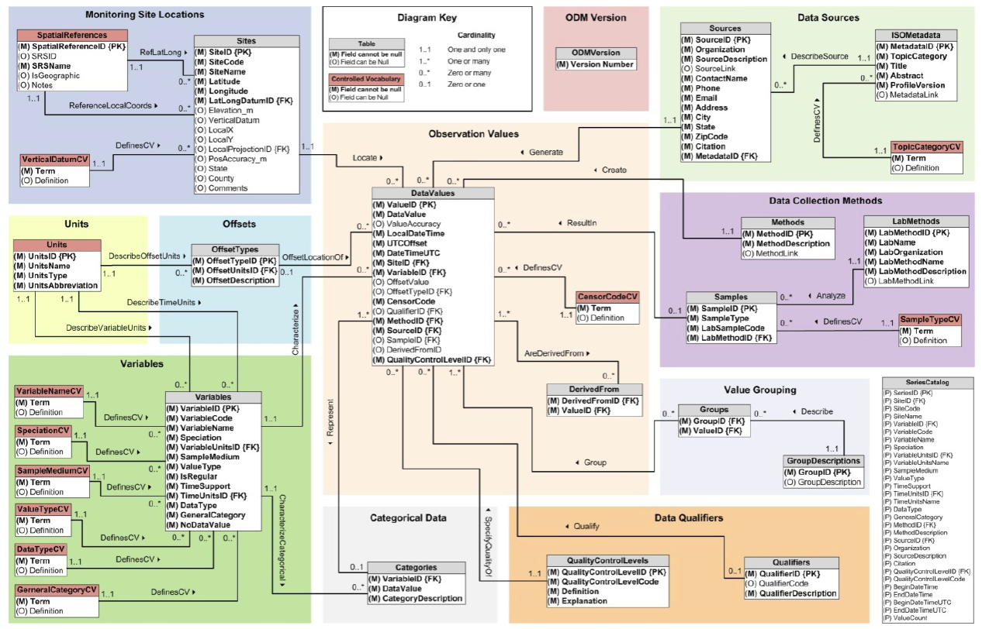
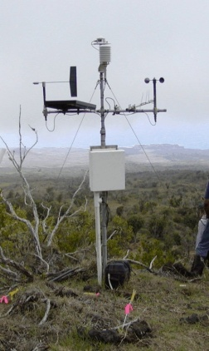
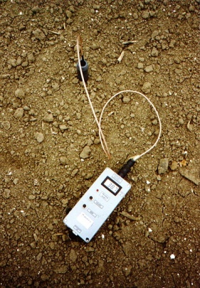
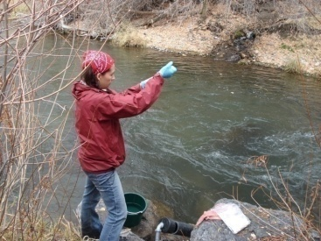
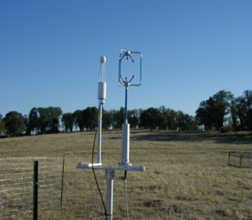
Data Management
Groundwater
levels
Streamflow
Climate
Soil
moisture
Water Quality
Flux tower data
CUAHSI Hydrological Information System (HIS) framework
Observations Data Model (ODM): relational database at the single observation level
Metadata for unambiguous interpretation
Traceable heritage from raw measurements to usable information
Promote syntactic and semantic consistency
Cross dimension retrieval and analysis
Horsburgh, J. S., D. G. Tarboton, D. R. Maidment, and I. Zaslavsky (2008), A relational model for environmental and water resources data, Water Resources Research, 44, W05406, doi:10.1029/2007WR006392.
Notes:
-We have adopted the CUAHSI HIS framework, which was developed specifically to manage, store, and share hydrologic data. See Jeff’s poster for additional details.
-Part of that framework is ODM- relational database structured to provide complete supporting data for each observation.
-Hub and spokes of wheel
-I’m a hydrologist, limnologist, other domain scientist… not a computer scientist!
-But higher spatial and temporal resolutions are resulting in more and more data
-Visualization and analysis of large datasets can be difficult and require specialized software
-You will need to share data… how best to do this… need to include metadata ...

Slide 17
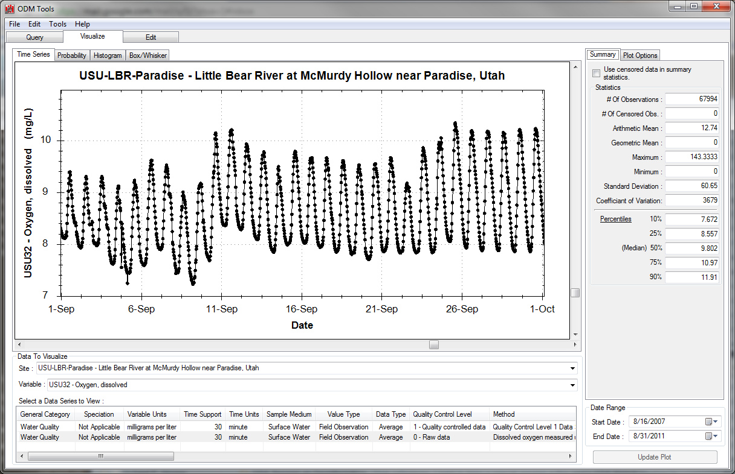
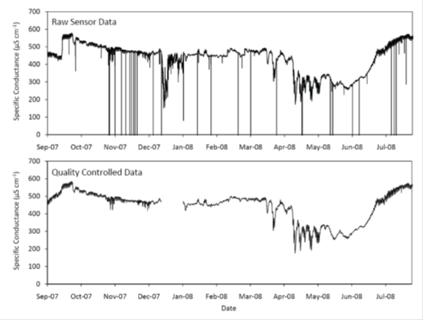
Data Management
ODM Tools is an interactive program supporting:
Query and Export: retrieve data series and metadata
Visualize: plot and summarize data series
Edit: delete, modify, adjust, interpolate, average, etc.
Notes:
ODM Tools can be used to access the data stored in and ODM database.

Slide 18
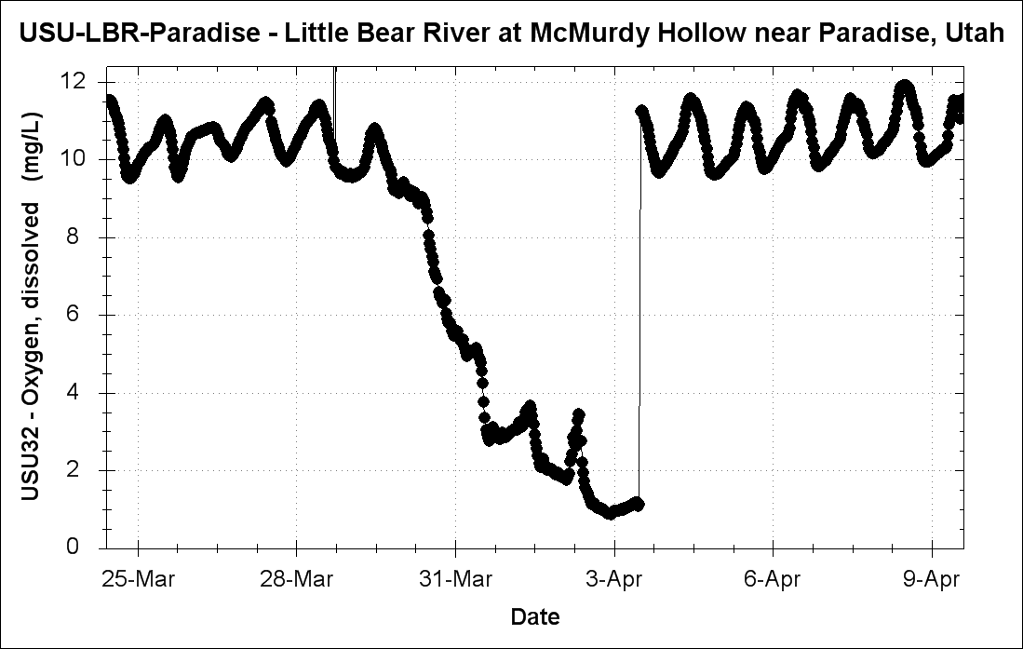
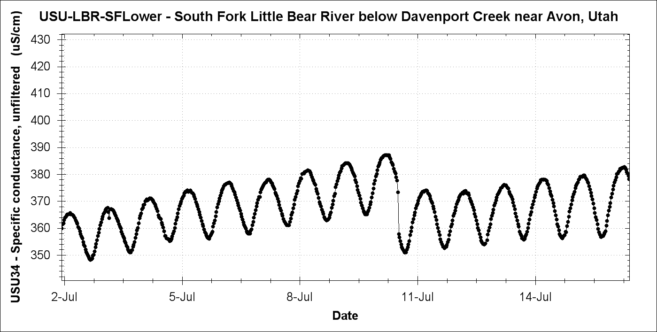
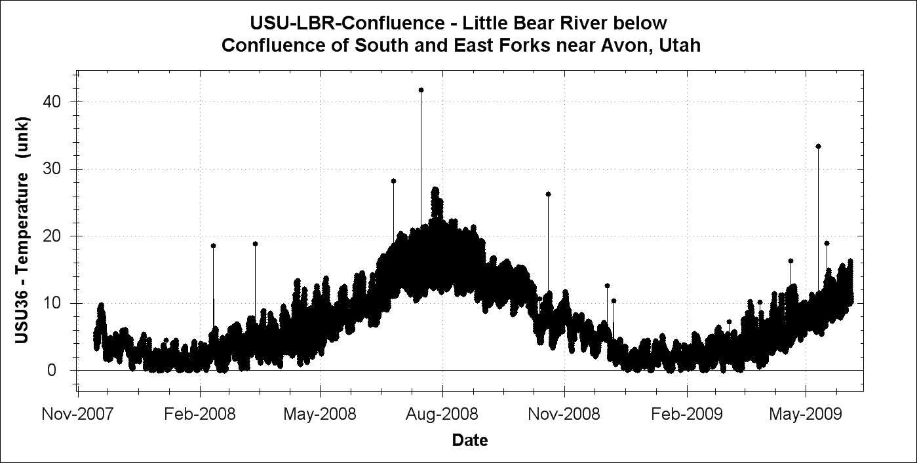
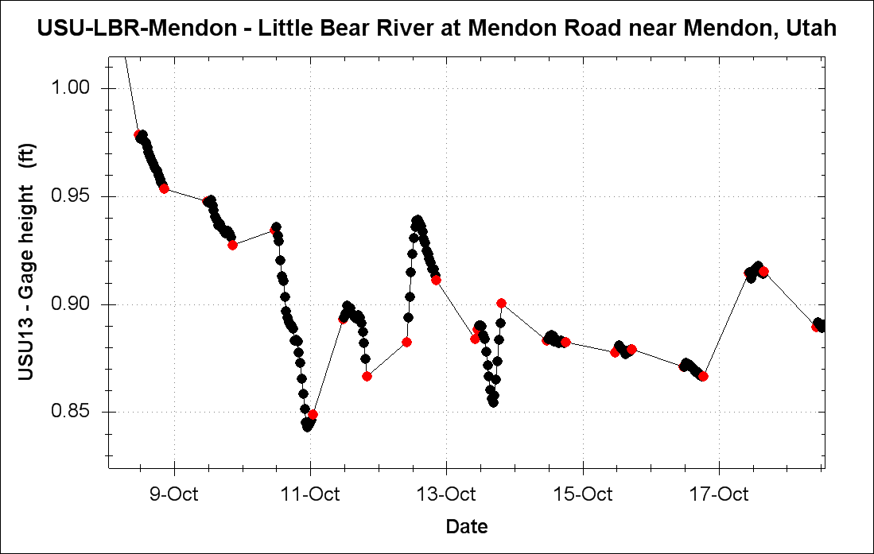
Data QA/QC
Erroneous data (anomalies, sensor drift, gaps) occur due to sensor failure, environmental conditions, servicing, etc.
///
Sensor drift and calibration shift
///
Sediment build-up
Strange anomalies
Dead battery

Slide 19
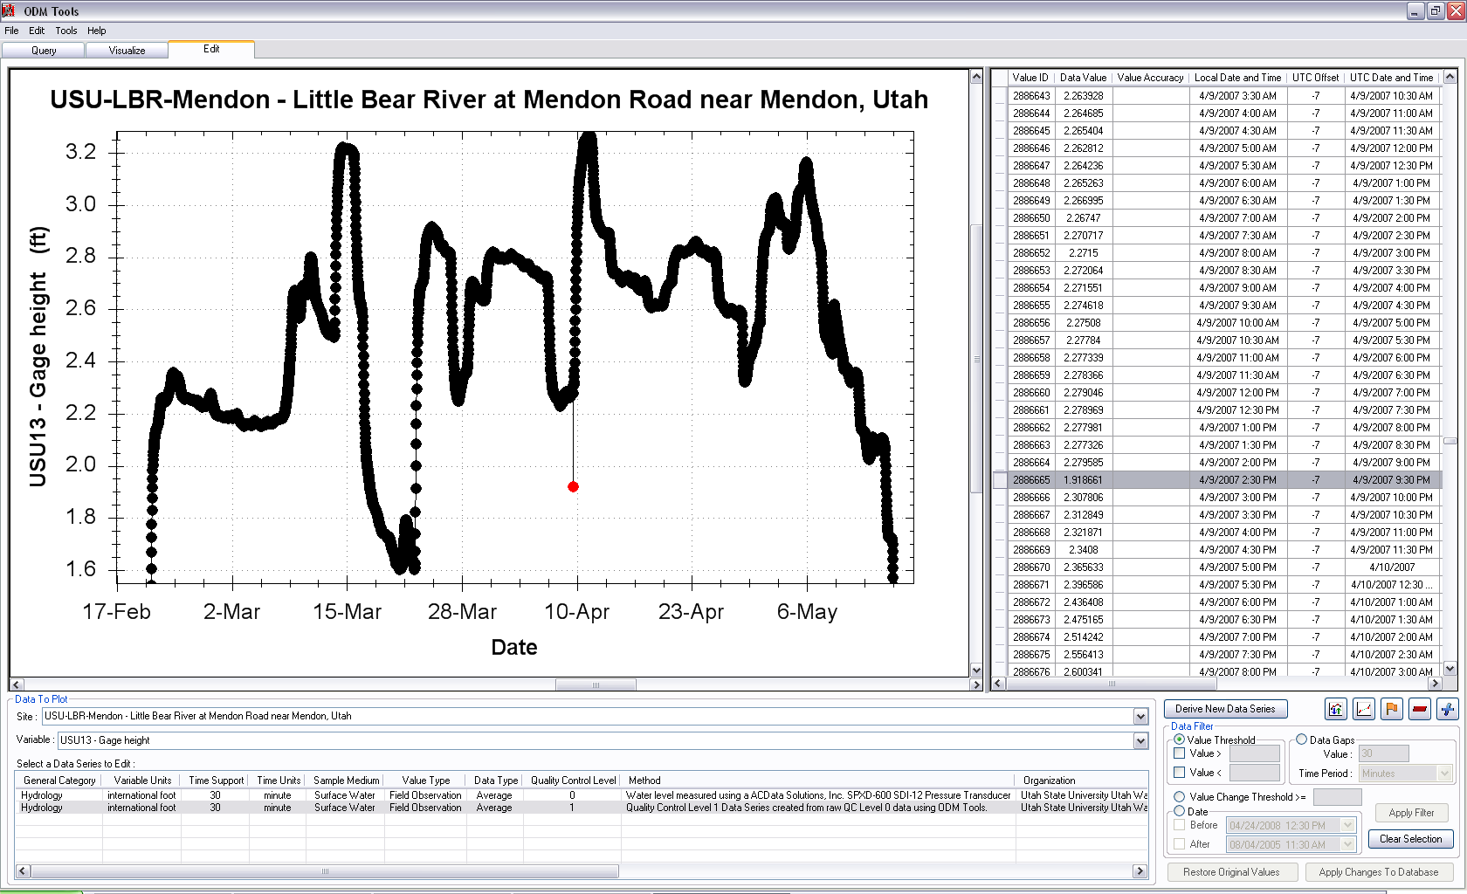
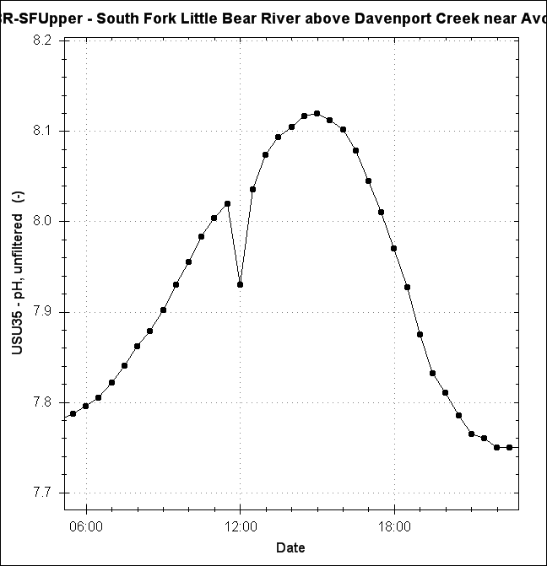
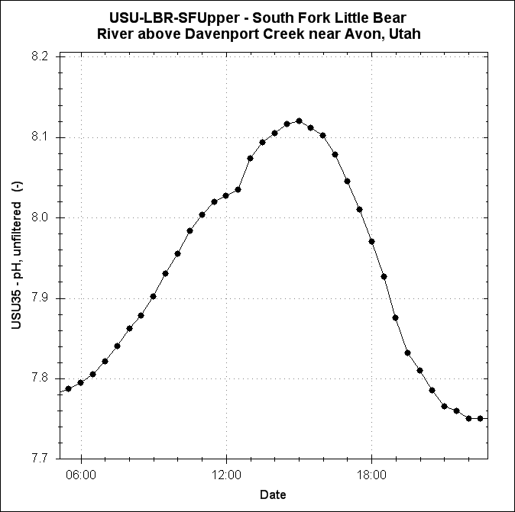
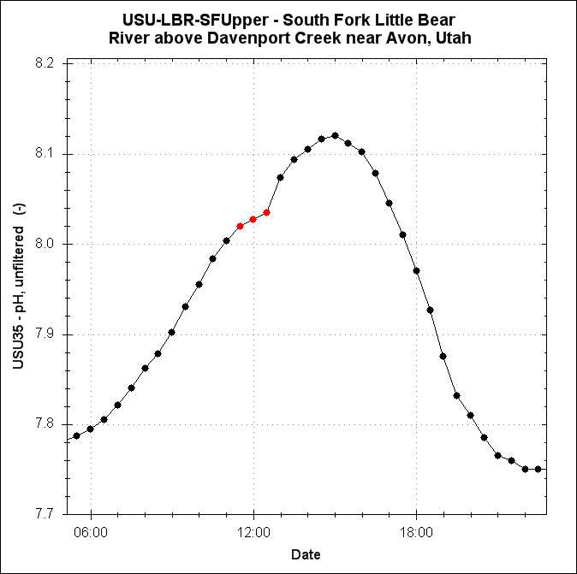
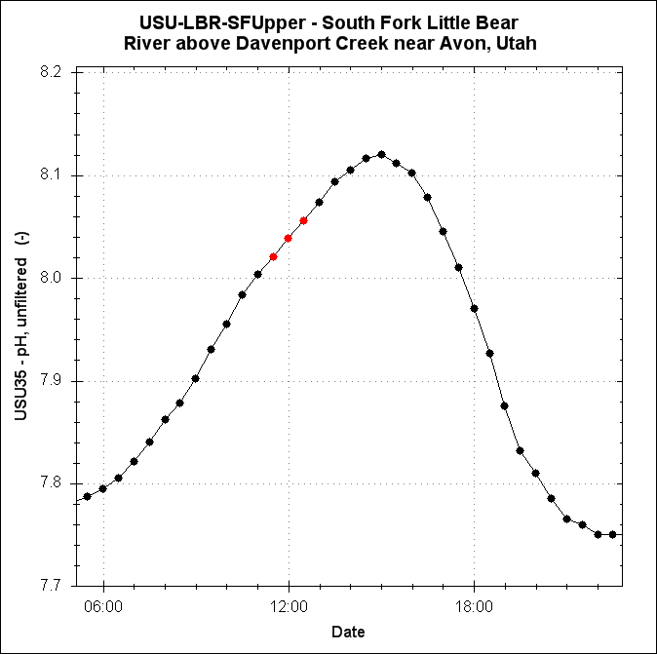
Data QA/QC
ODM Tools has the functionality to adjust data points:
Deleting
Adding data to fill gaps
Interpolating
Linear drift correction
Offsets
Flag Data Points

Slide 20
Data QA/QC
Challenges:
Make data QA/QC more automated
Identifying anomalous points: can train models to filter
Data anomalies may be explained by sensor behavior at other sites and behavior of other variables
Each variable has different characteristic behavior
Need technician or scientist to verify and determine response
Real-time detection vs. delayed response
Tracking QA/QC steps
Notes:
Right now: focused on making data QA/QC more automated. Related research has used models to identify anomalous points. This is complicated by these factors:
Right now our data QA/QC is delayed by months or years... Depending on when we need the data. We are also working on functionality to track the steps we take to make changes reproducible.

Slide 21
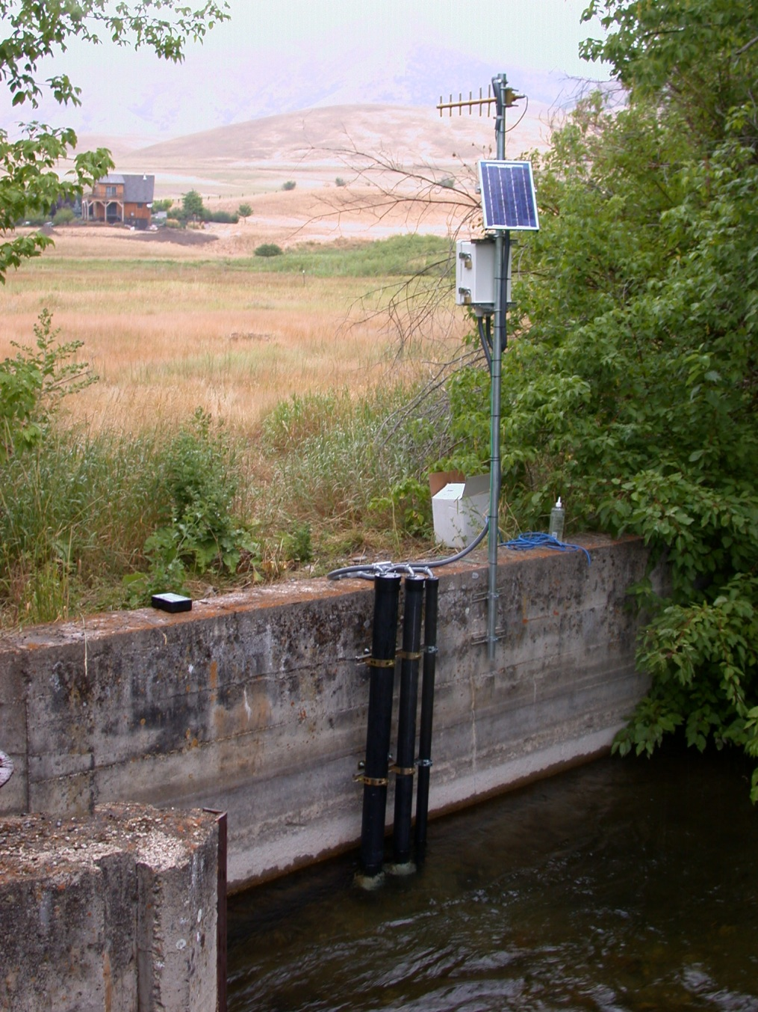
Questions?
Support:
EAR 0622374
CBET 0610075

