Slide 1
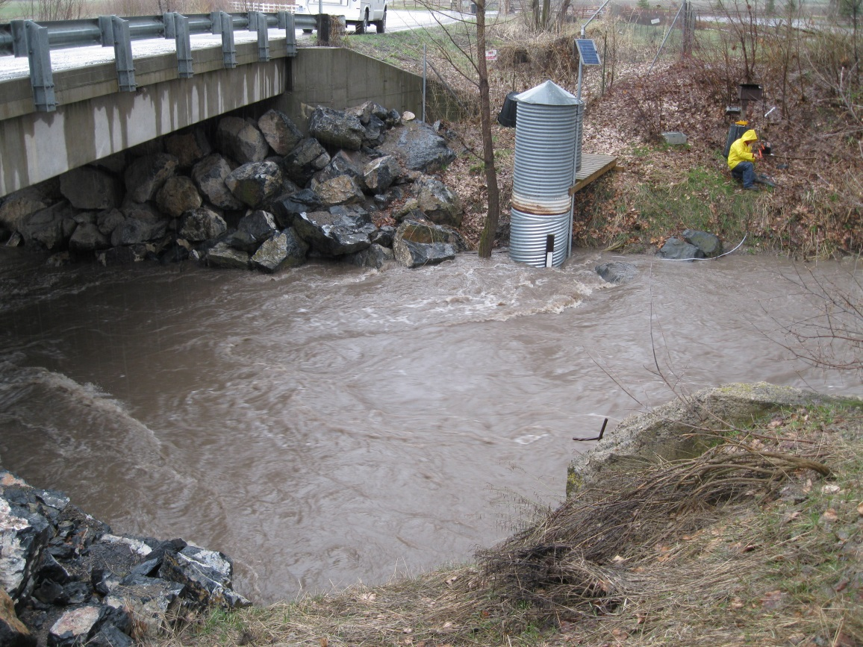
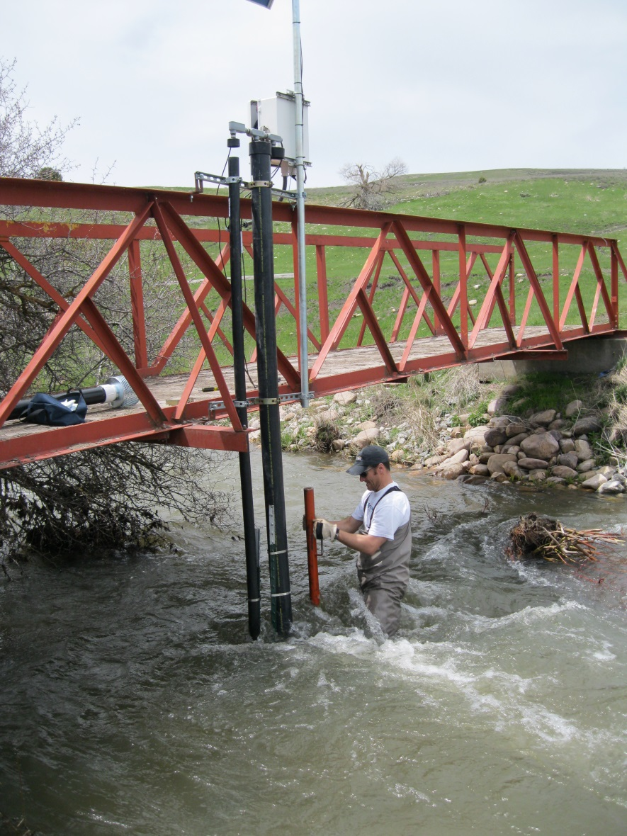
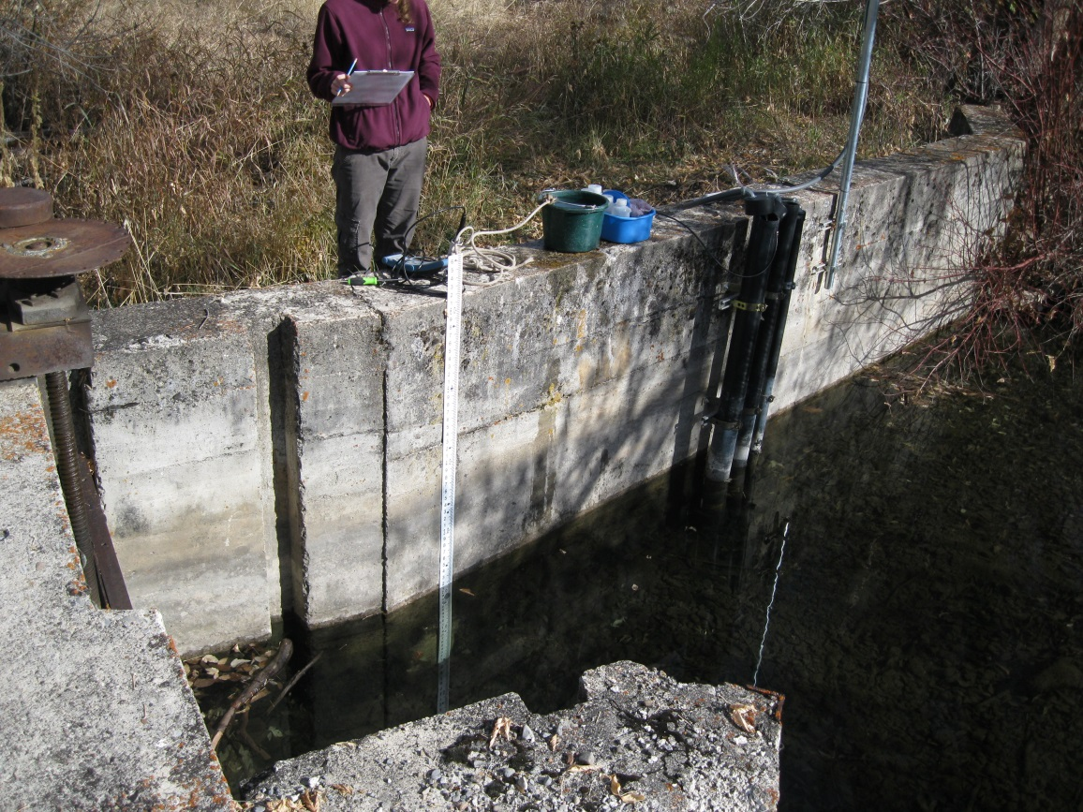
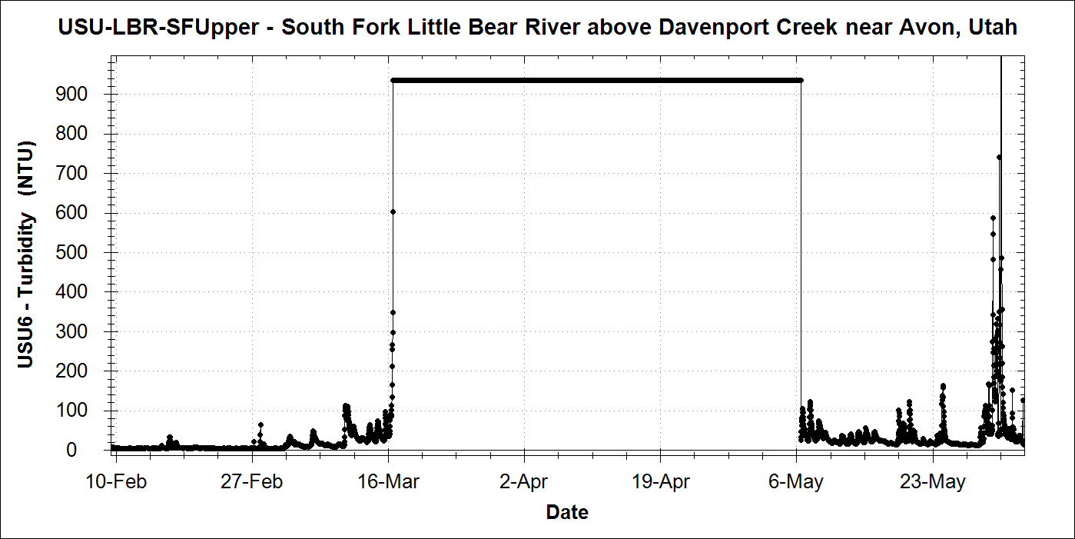
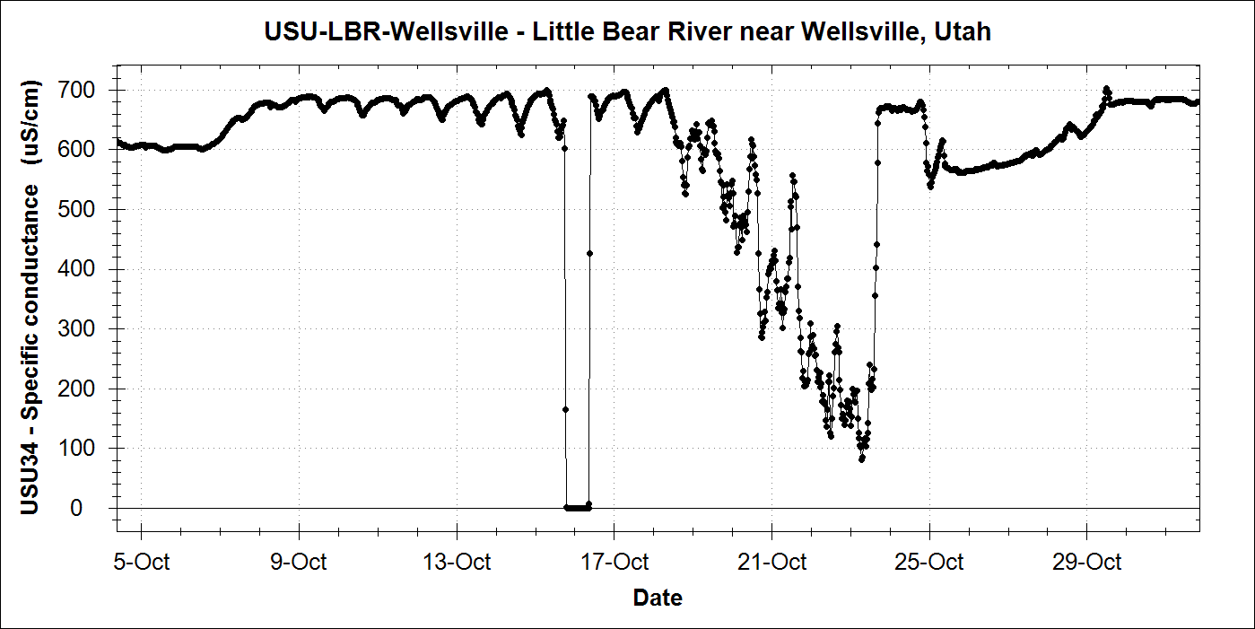
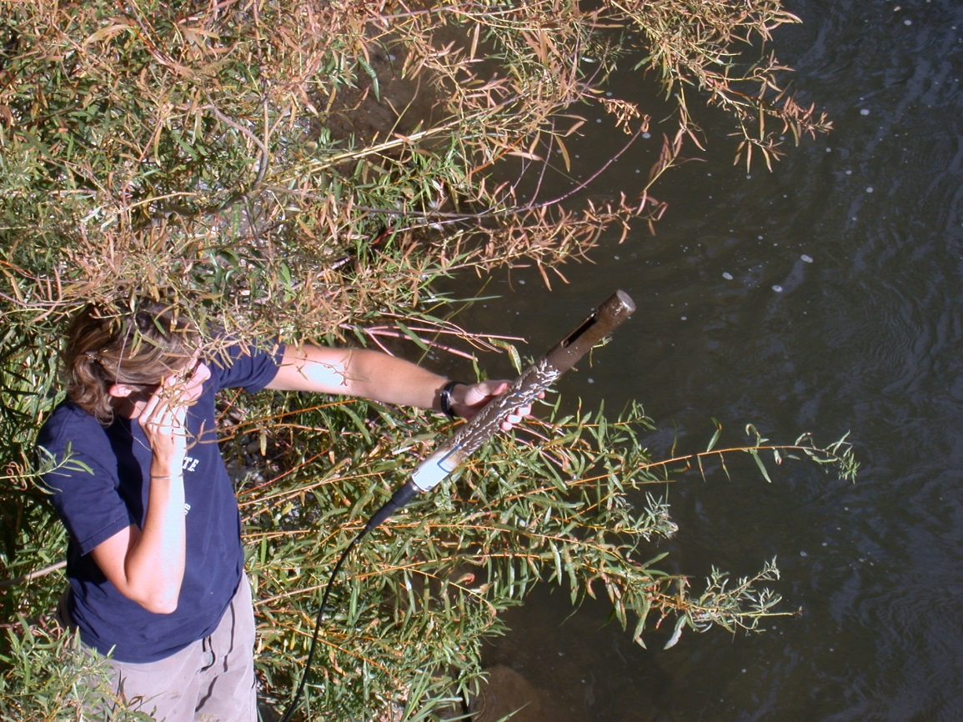
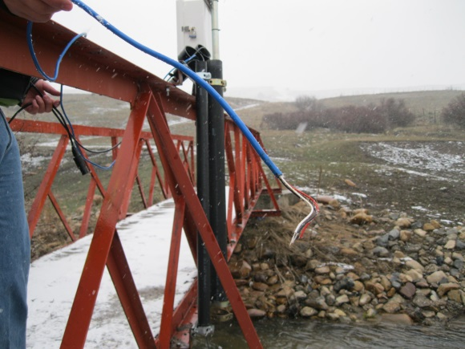
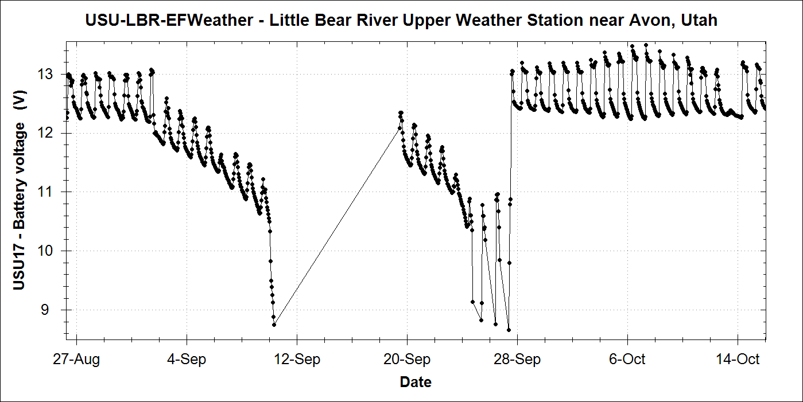
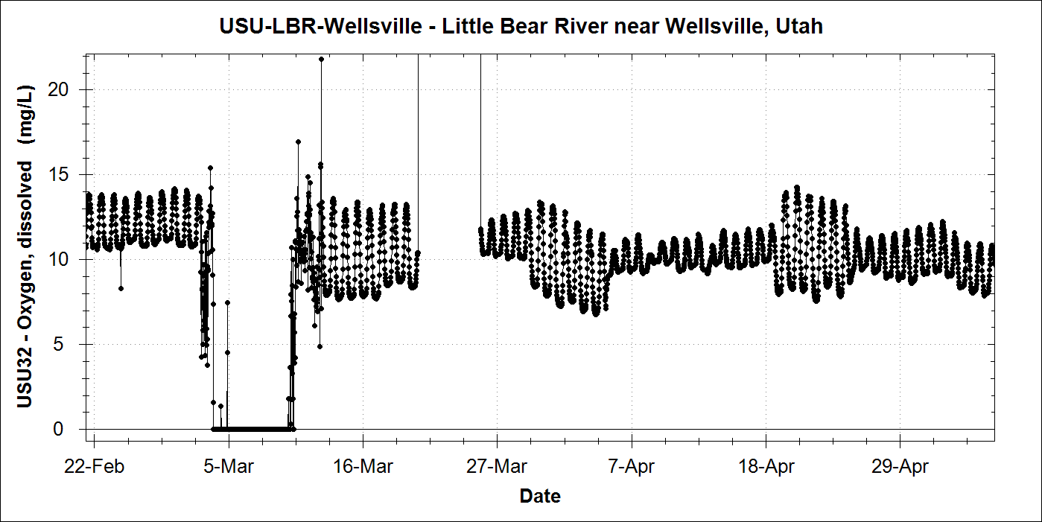
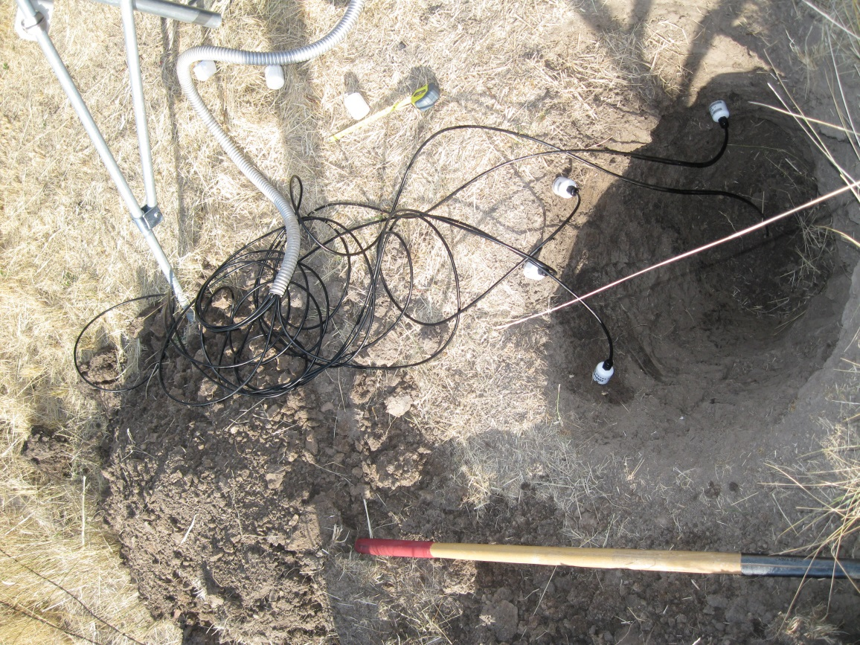
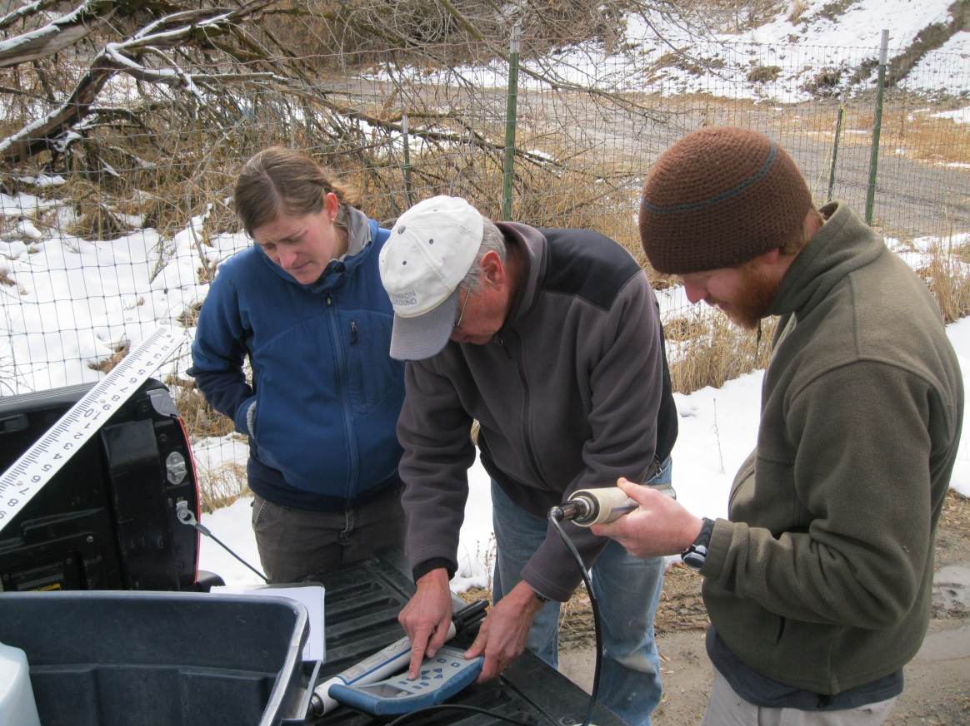
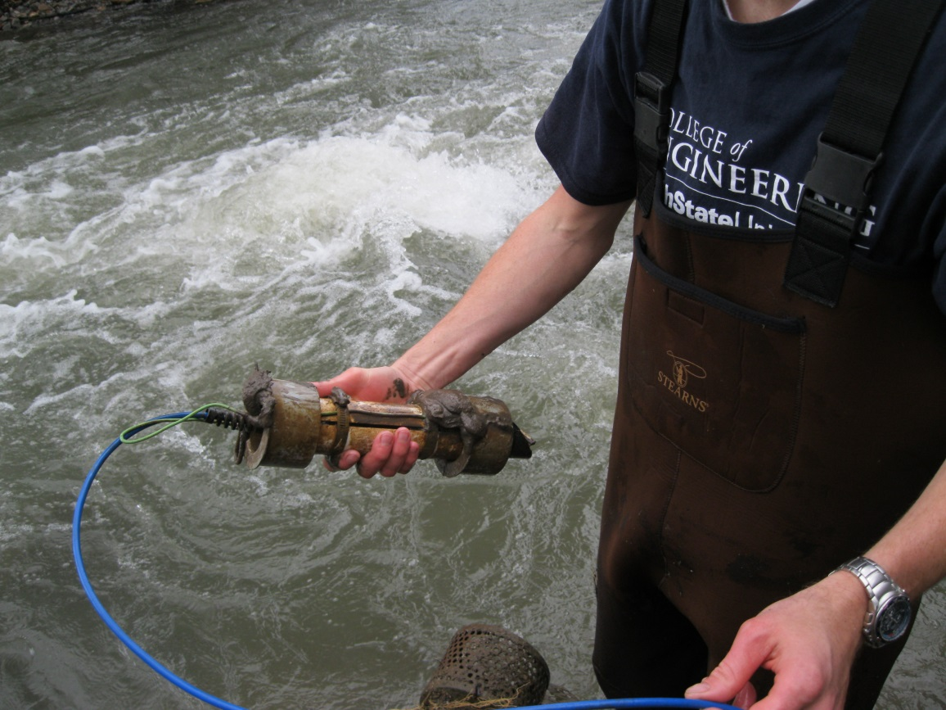
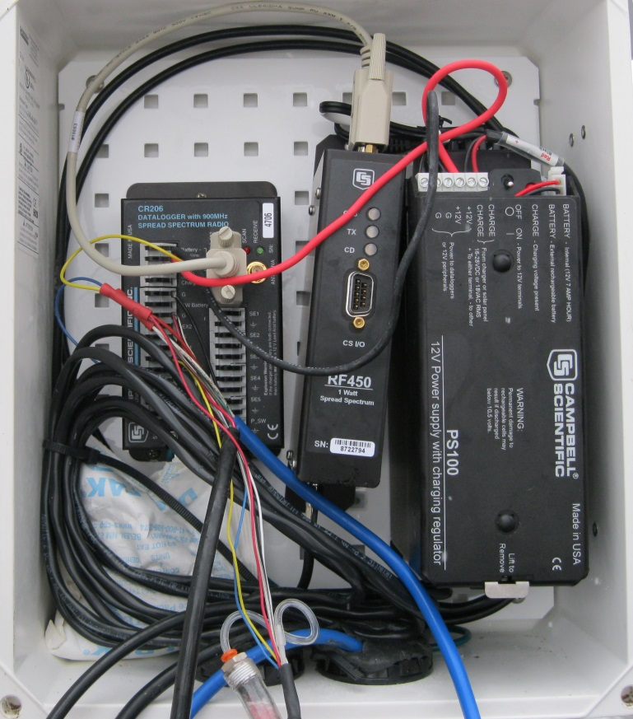
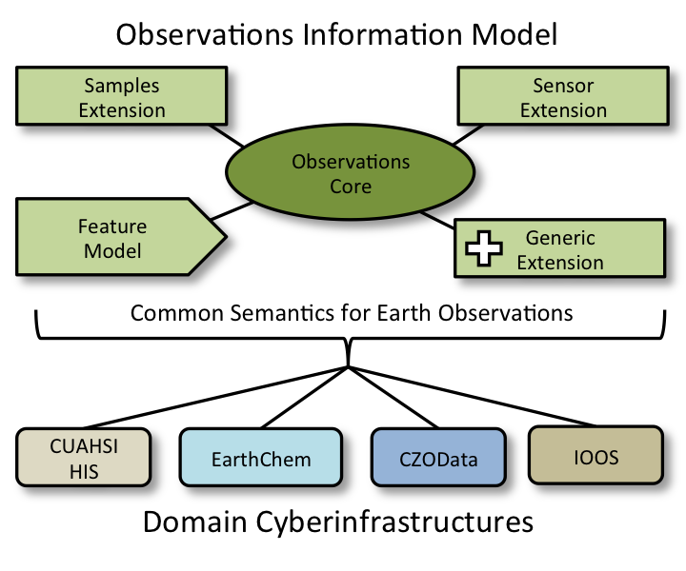
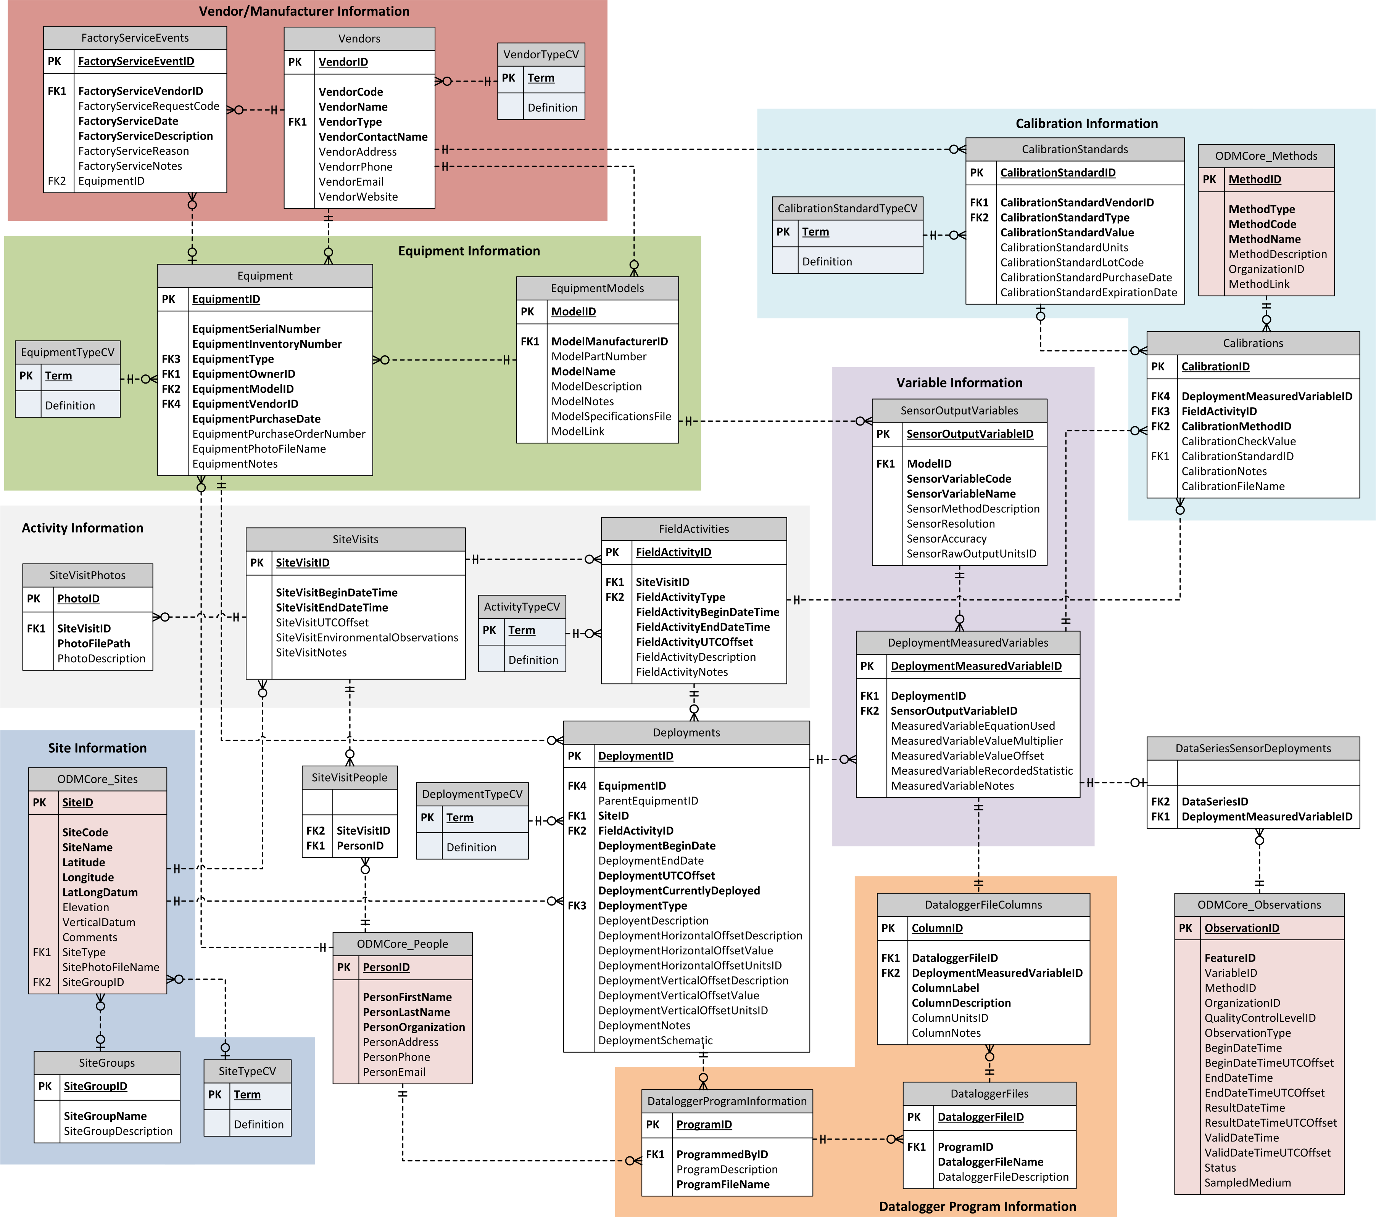
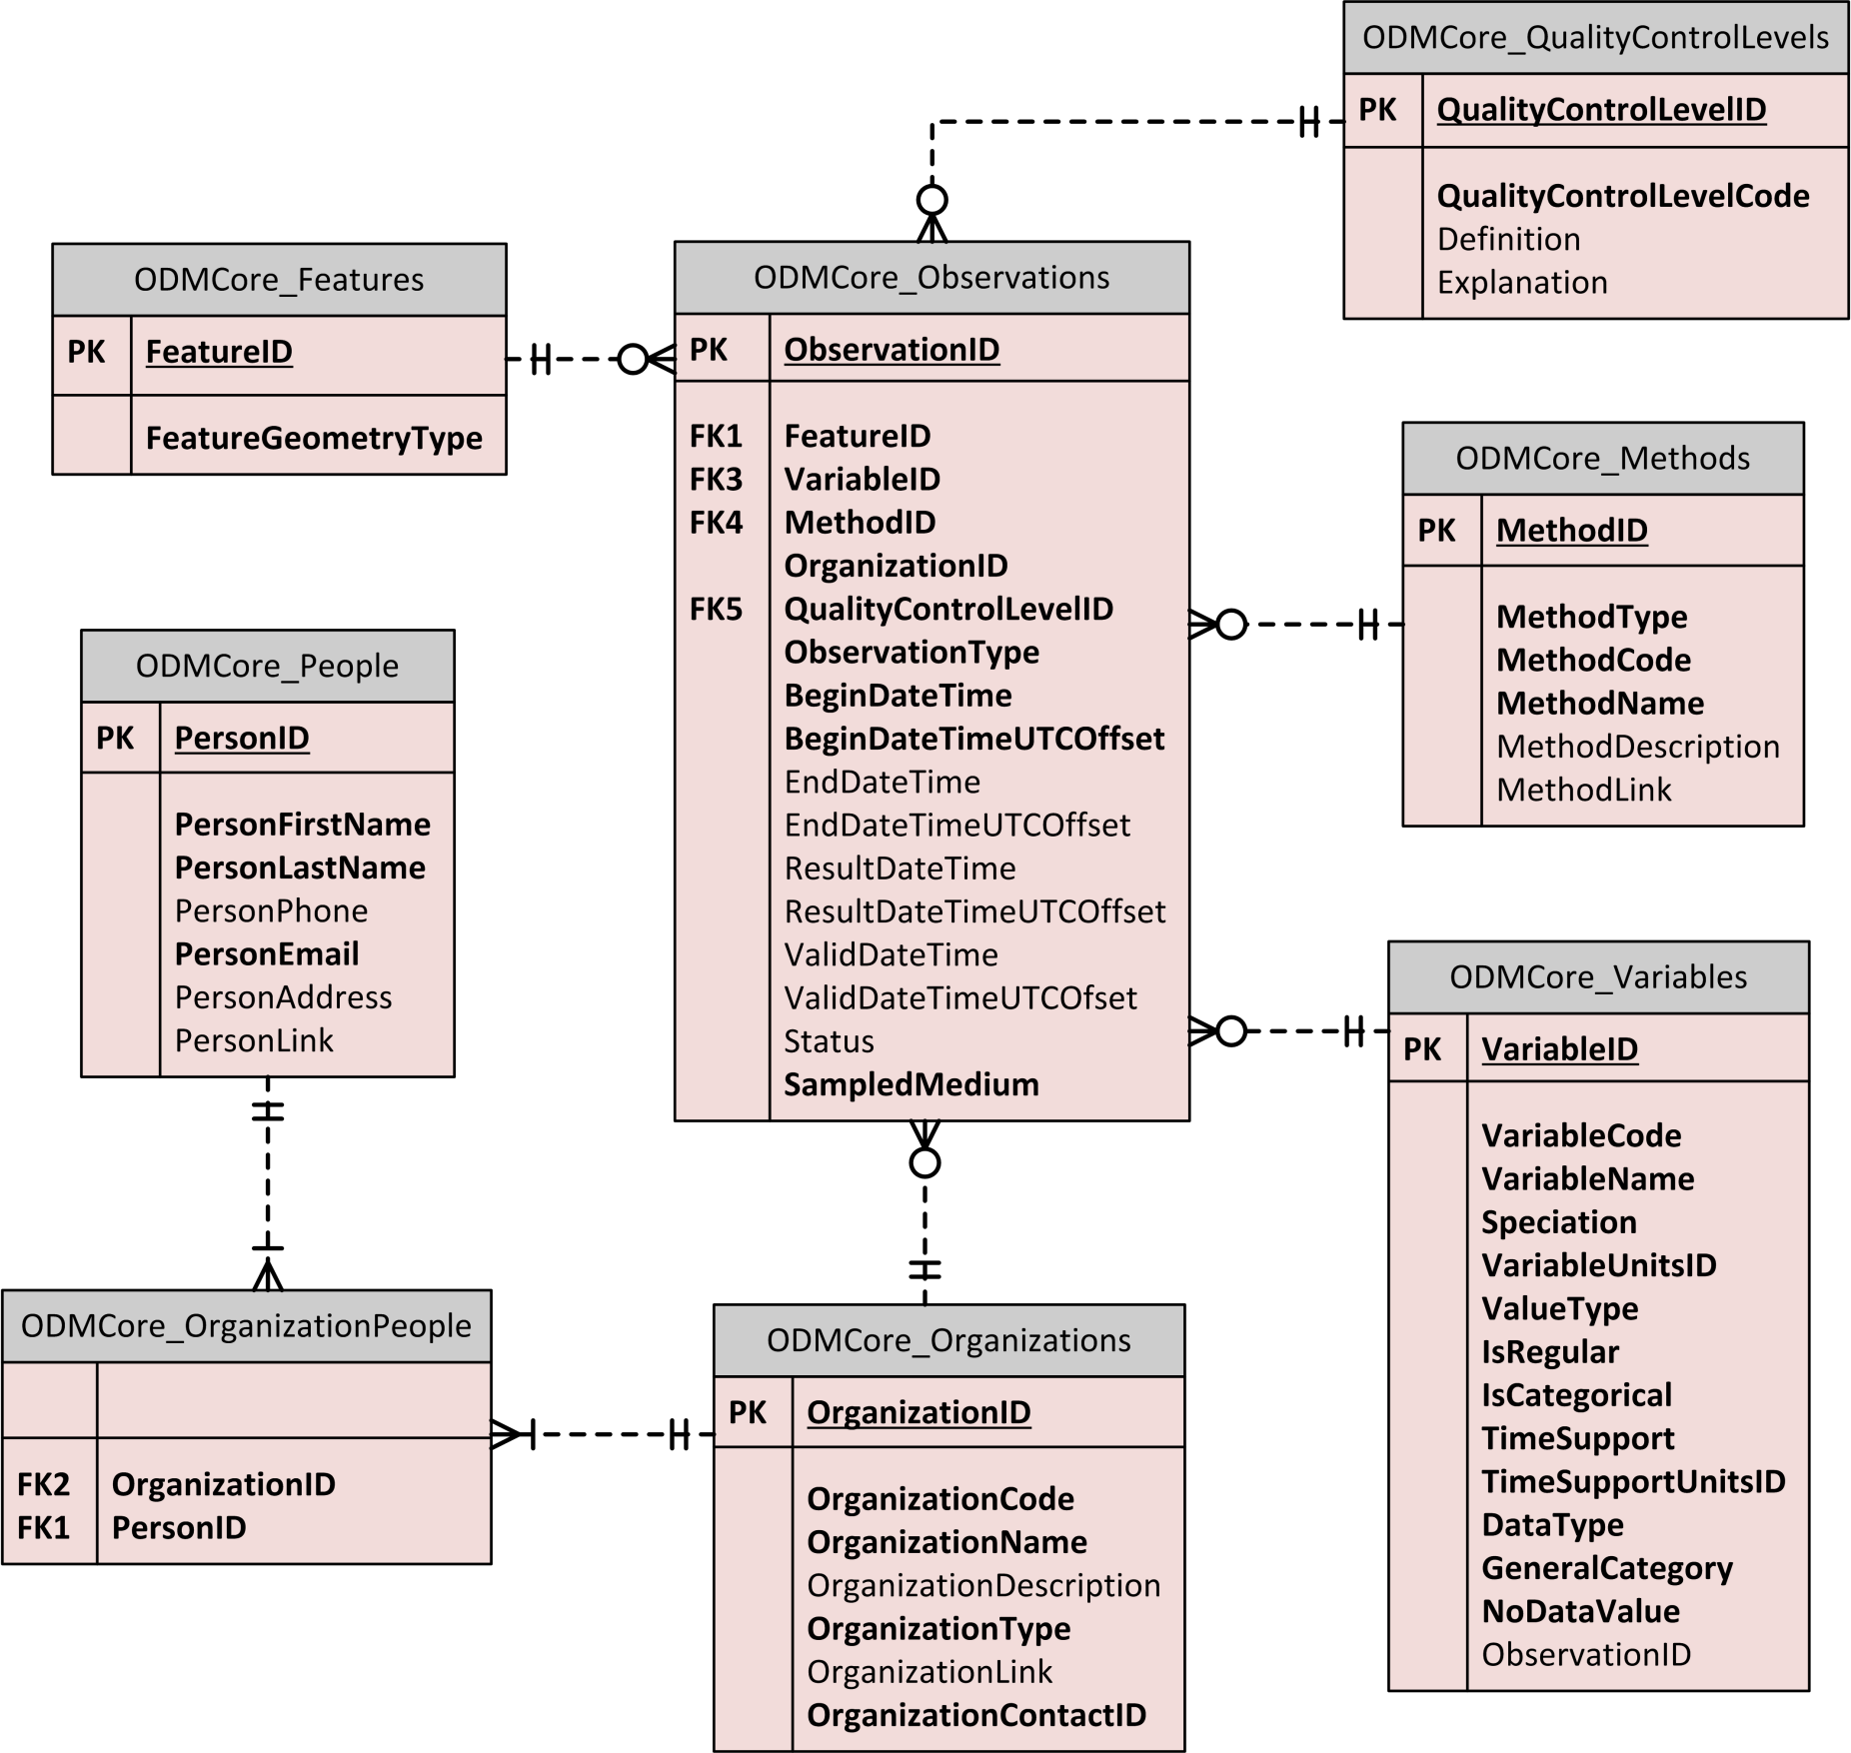
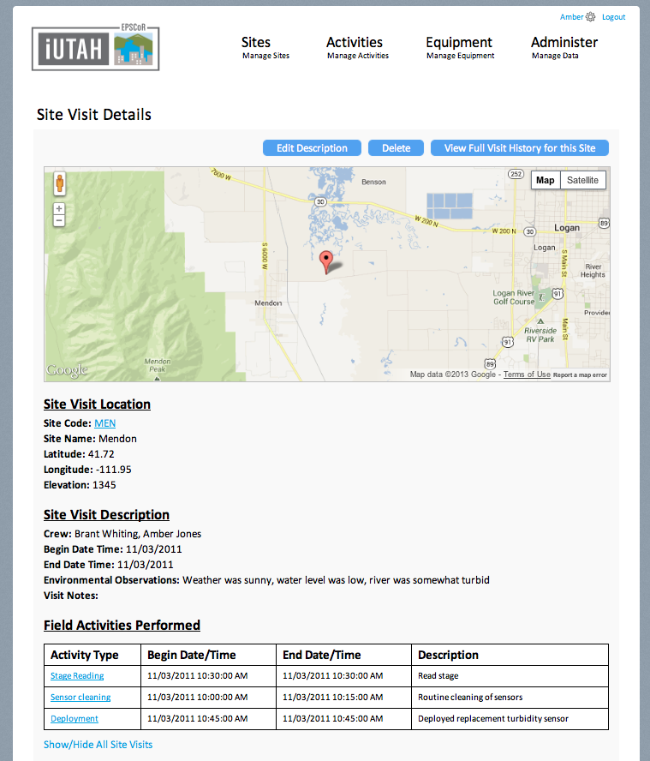
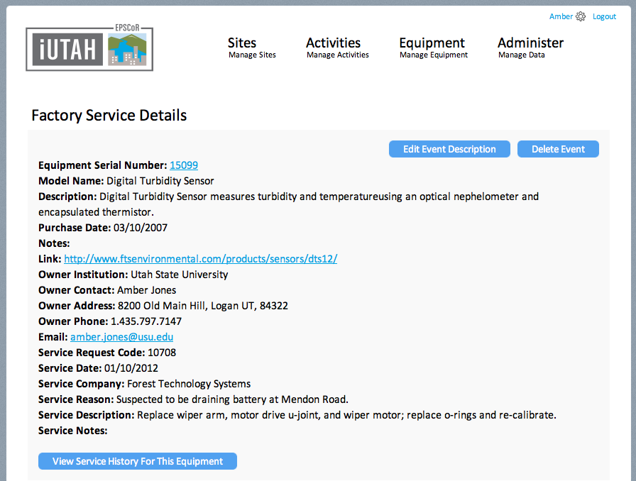
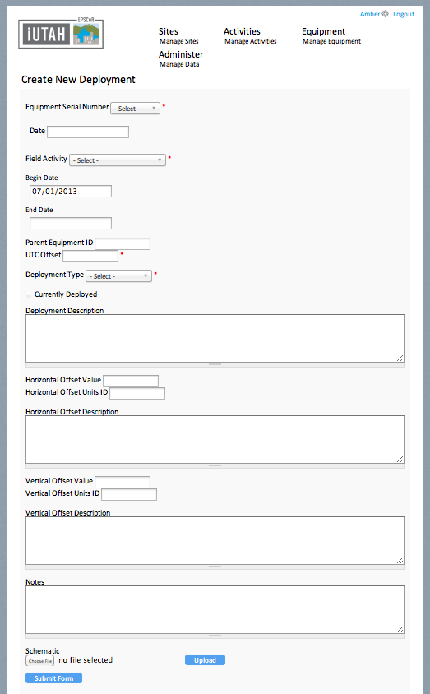
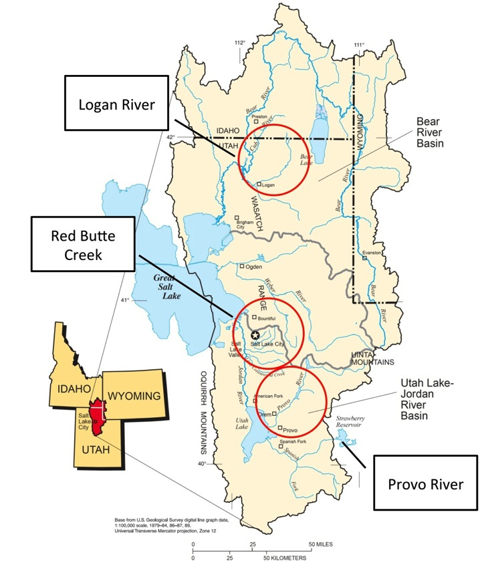
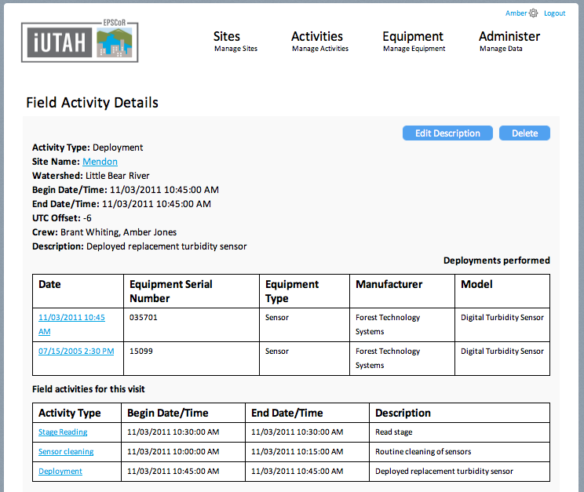
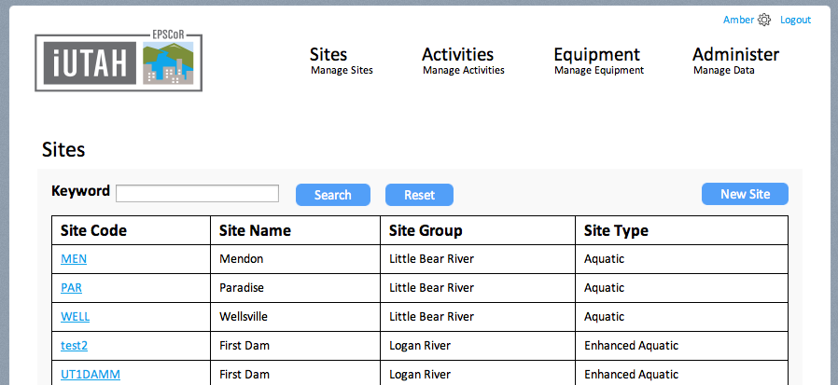
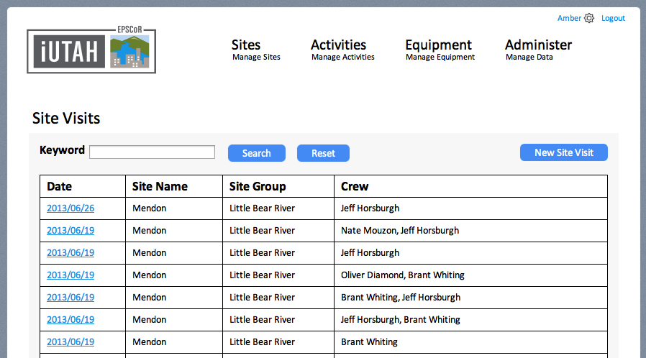
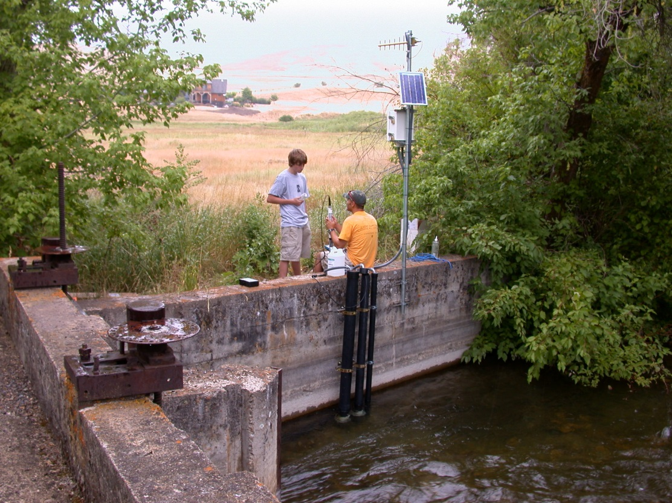
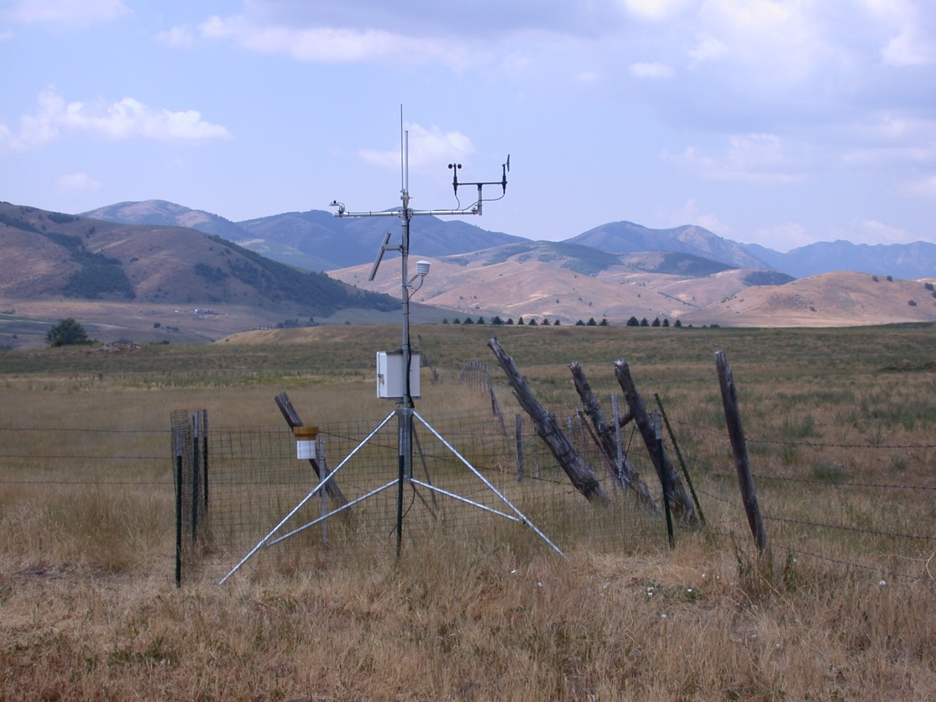
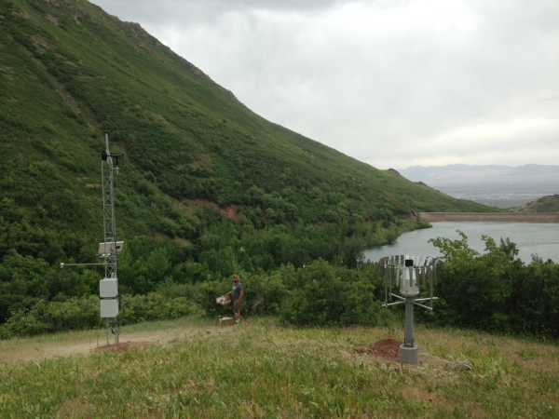
Managing Sensor Infrastructure: A Sensor Extension for ODM2 Amber Spackman Jones, Jeffery S. Horsburgh, Juan Caraballo, Maurier Ramírez Utah Water Research Laboratory, Utah State University
This project is funded by National Science Foundation grants EPS-1208732 and EAR-1224638.
Background: The Observations Data Model (ODM) is a relational data model for storage and management of environmental observations data designed to capture consistent descriptions for unambiguous interpretation among users. ODM 1.1 was intended for publication of point-based hydrologic observations using the Consortium of Universities for the Advancement of Hydrologic Science, Inc. (CUAHSI) Hydrologic Information System (HIS). Because of its focus on data publication, ODM 1.1 does not provide all of the functionality needed to fully describe the data collection and management process for sensor and sample-based observations. We are working to develop a new version of ODM (ODM2) that better supports both management and publication of sensor and sample-based observations.
Motivation: Research sites conducting long term monitoring using in situ sensors need the functionality to track equipment, deployments, calibrations, and other events related to site maintenance and to link this information to the observational data that they are collecting.
What were the field conditions of our discharge measurement?
Which sensors were deployed at this site? Who installed them?
Which standards did we use for that calibration?
When was the last time we cleaned this sonde?
Sensor replaced
New sensor deployed with incorrect programming
Beaver dam blow out – sensor lost
Rain on snow event
Sensor repro-grammed
Biological buildup on sensor
Sensor cleaning
Which soil moisture sensor is buried at 40 cm?
Has this turbidity sensor been serviced at the factory?
Who programmed this datalogger?
Battery replaced
Soil moisture sensors diagnosed as drawing current and replaced
Large storm, sensor clogged with sediment
Sensor replaced
Lightning strike
Sensor failed, sent to factory for service
Sensor calibration
Battery dead
Battery dead
Sensor cleaning
What is this dissolved oxygen sensor’s calibration history?
How long has that battery been deployed?
ODM2 Core: ODM2 consists of a core set of entities common to all types of observational data to describe location, observed variable, and time.
Sensors Extension. The Sensors Extension permits information about individual sensors, deployments, and the associated time series to be recorded and managed.
Table Descriptions
Equipment contains attributes of individual sensors and other pieces of field equipment while EquipmentModels describes attributes of equipment of the same type.
Deployments provides information about the sensor deployment in space and time.
SiteVisits/FieldActivities/Calibrations record activities of field crews and sensor calibrations.
Vendors provides information on equipment manufacturers and suppliers and FactoryServiceEvents records sensor servicing by the manufacturer.
SensorOutputVariables contains information on a specific variable being measured by a sensor. It is linked to the specific deployment through DeploymentMeasuredVariables.
DataloggerProgram tables allow for tracking of programs, files, and each variable recorded in the file.
Controlled Vocabularies are used for types of equipment, deployments, sites, vendors, activities, and calibration standards.
ODM2 Extensions: Additional metadata can be provided via extensions to the core to support particular types of observations.
Extensions Under Development:
Sensors: describe monitoring equipment, deployments, and in situ time series.
Samples: capture sample hierarchy and analytical methods.
Features: detail the physical feature(s) from which an observation is made.
Annotations: provide qualifiers or comments to variables or observations.
Provenance: describe data versioning and processing.
Linkage to ODM2 Core: The connection between the Sensors Extension and the ODM2 Core provides linkages between observations, equipment, and events associated with the observations. The linking tables are Methods, Observations, People, and Sites.
Web Interface: Field technicians and other researchers can use the web interface for the Sensors Extension to add and edit sensors, sites, and field activities such as calibrations and deployments. The interface can be used to address questions such as what sensors are deployed at a site, the deployment history or factory service history of a sensor, and the history of field activities performed at a site.
Implementation: The iUTAH (innovative Urban Transitions and Aridregion Hydro-sustainability) network of aquatic and terrestrial sensors is being used as a test case for the Sensors Extension. The ODM2 Sensors Extension and associated tools will be useful for similar large scale and long term monitoring networks. See http://data.iutahepscor.org.
OPEN SOURCE CODE REPOSITORY:
The web application for the Sensors Extension is available in GitHUB https://github.com/UCHIC/ODM2Sensor
Any opinions, findings, and conclusions or recommendations expressed in this material are those of the author(s) and do not necessarily reflect the views of the National Science Foundation.
Contact Information
Amber Spackman Jones, (435)797-7147, amber.jones@usu.edu
Jeffery S. Horsburgh, (435)797-2946, jeff.horsburgh@usu.edu
Juan Caraballo, (435)797-0045, juan.caraballo17@gmail.com
Maurier Ramírez, (435)797-0045, mauriel.ramirez@gmail.com

